Slide 1

INTRODUCTION TO WAGGGS CONSULTATION ON SCIENCE, TECHNOLOGY, ENGINEERING AND MATHEMATICS (STEM) 2022

Slide 2
Session content
Overview of WAGGGS STEM Consultation 2022
Navigating the resource on Campfire
Steps to conduct the STEM Consultation with Girls and Young Women
Online feedback form
Teaser activities
How can we support you
How will we use the data
Save the Date – 2 global virtual events on STEM
Q&A

Slide 3
WAGGGS Consultation on STEM 2022
Member Organisation STEM Survey
  13 May to 18 July 2022 (now closed)
  One official response per Member Organisation/Component Association
  To understand what Member Organisations and Component Associations are interested in and need from a STEM offering from WAGGGS
STEM Consultation with Girls and Young Women
  1 June to 11 September 2022 (still waiting your participation!)
  Open to all Girl Guide/Girl Scout units (ages 10-30 but can be younger or older depending on interest and capacity)
  To understand the interest and needs of girls and young women/youths in a STEM offer from WAGGGS.

Slide 4
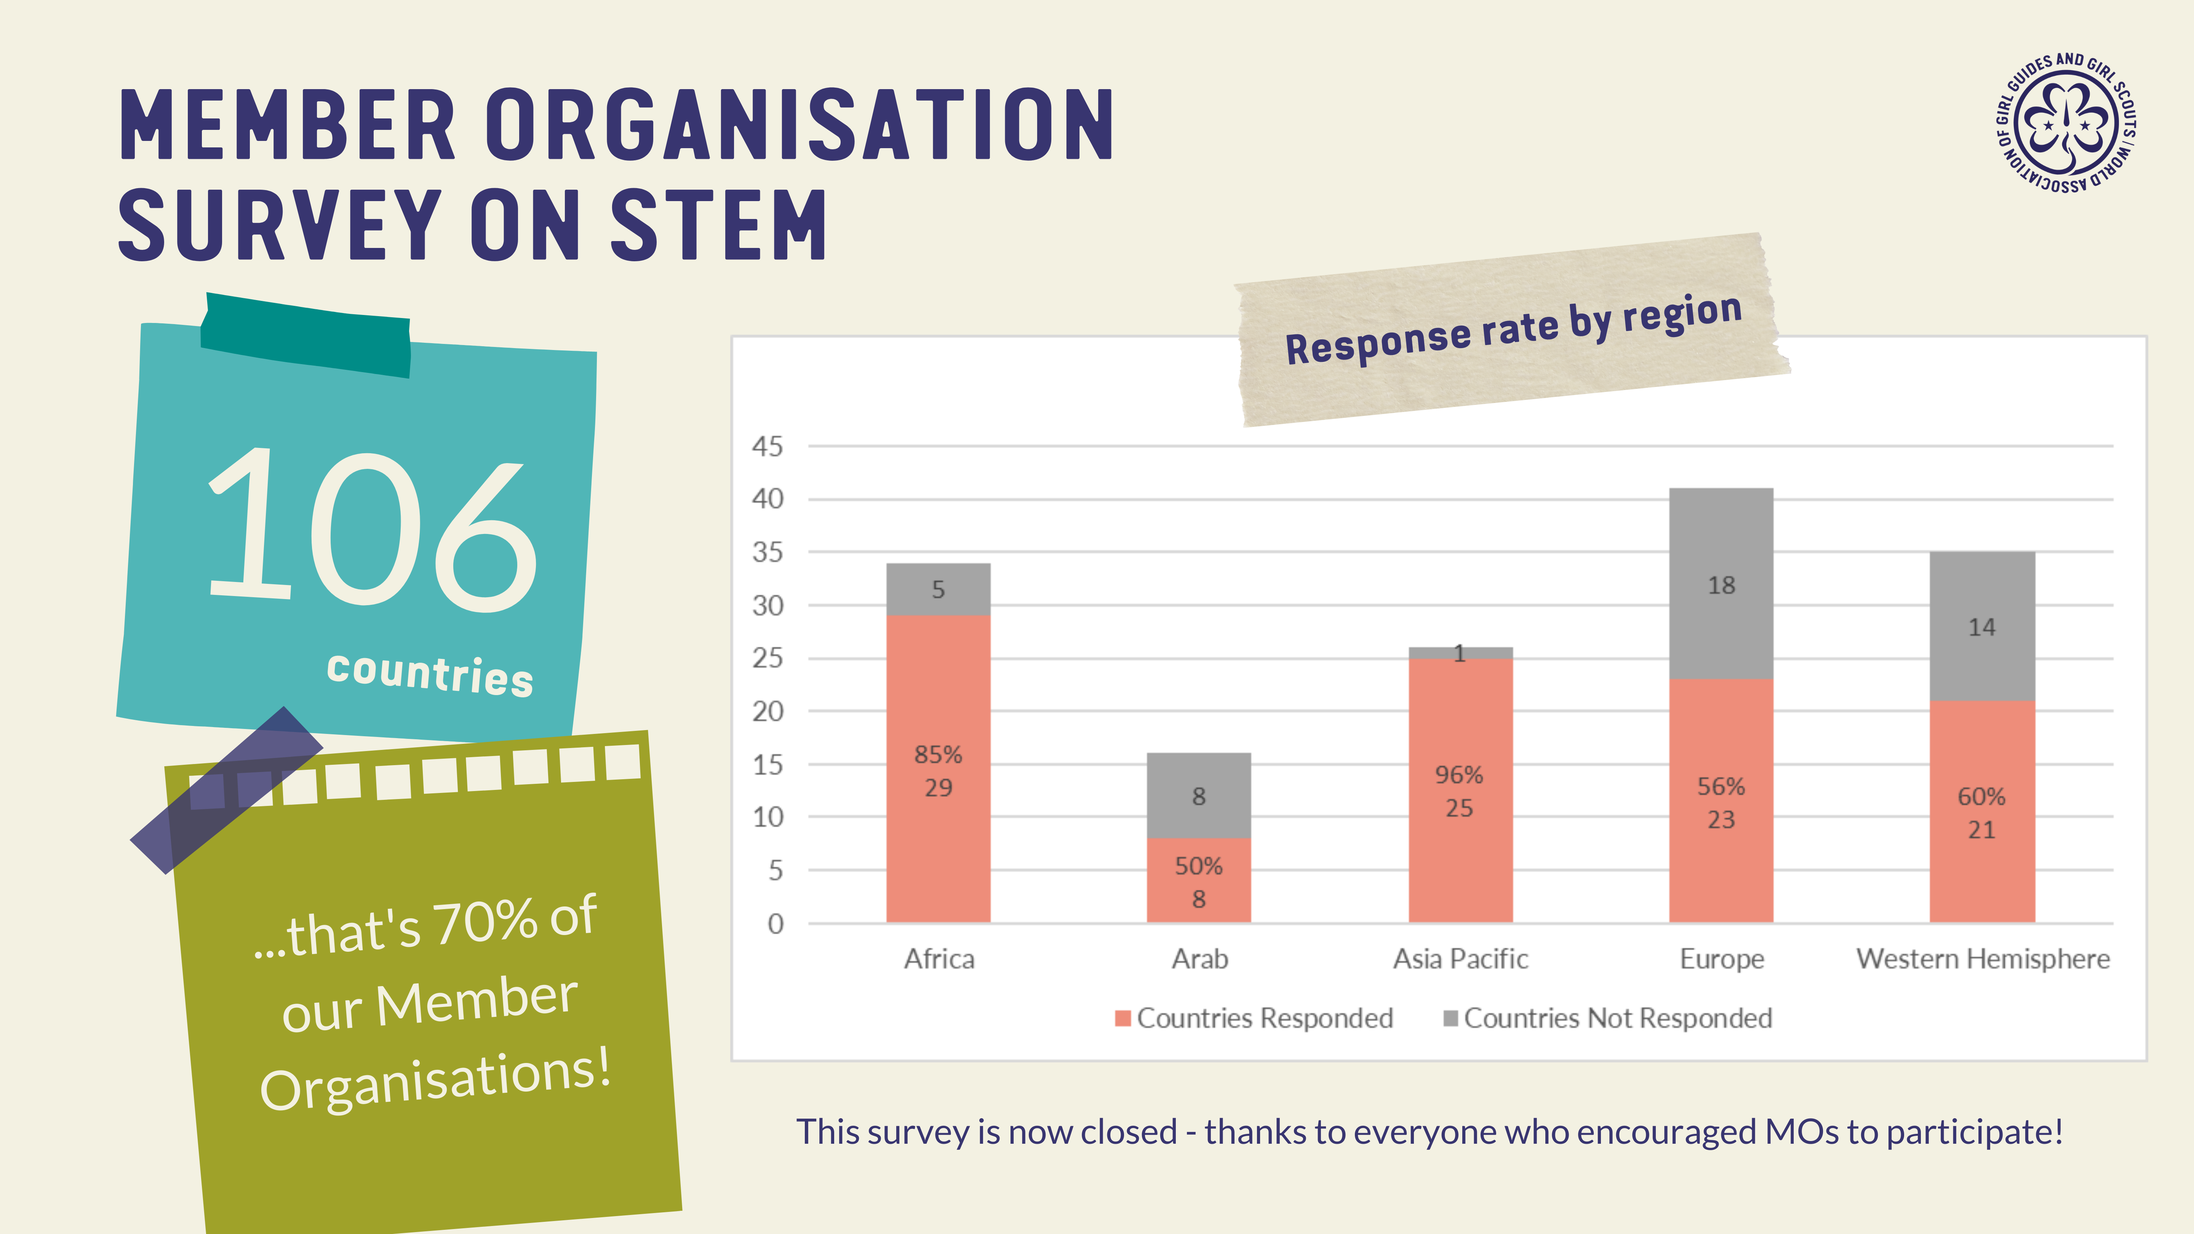

Slide 5


Slide 6
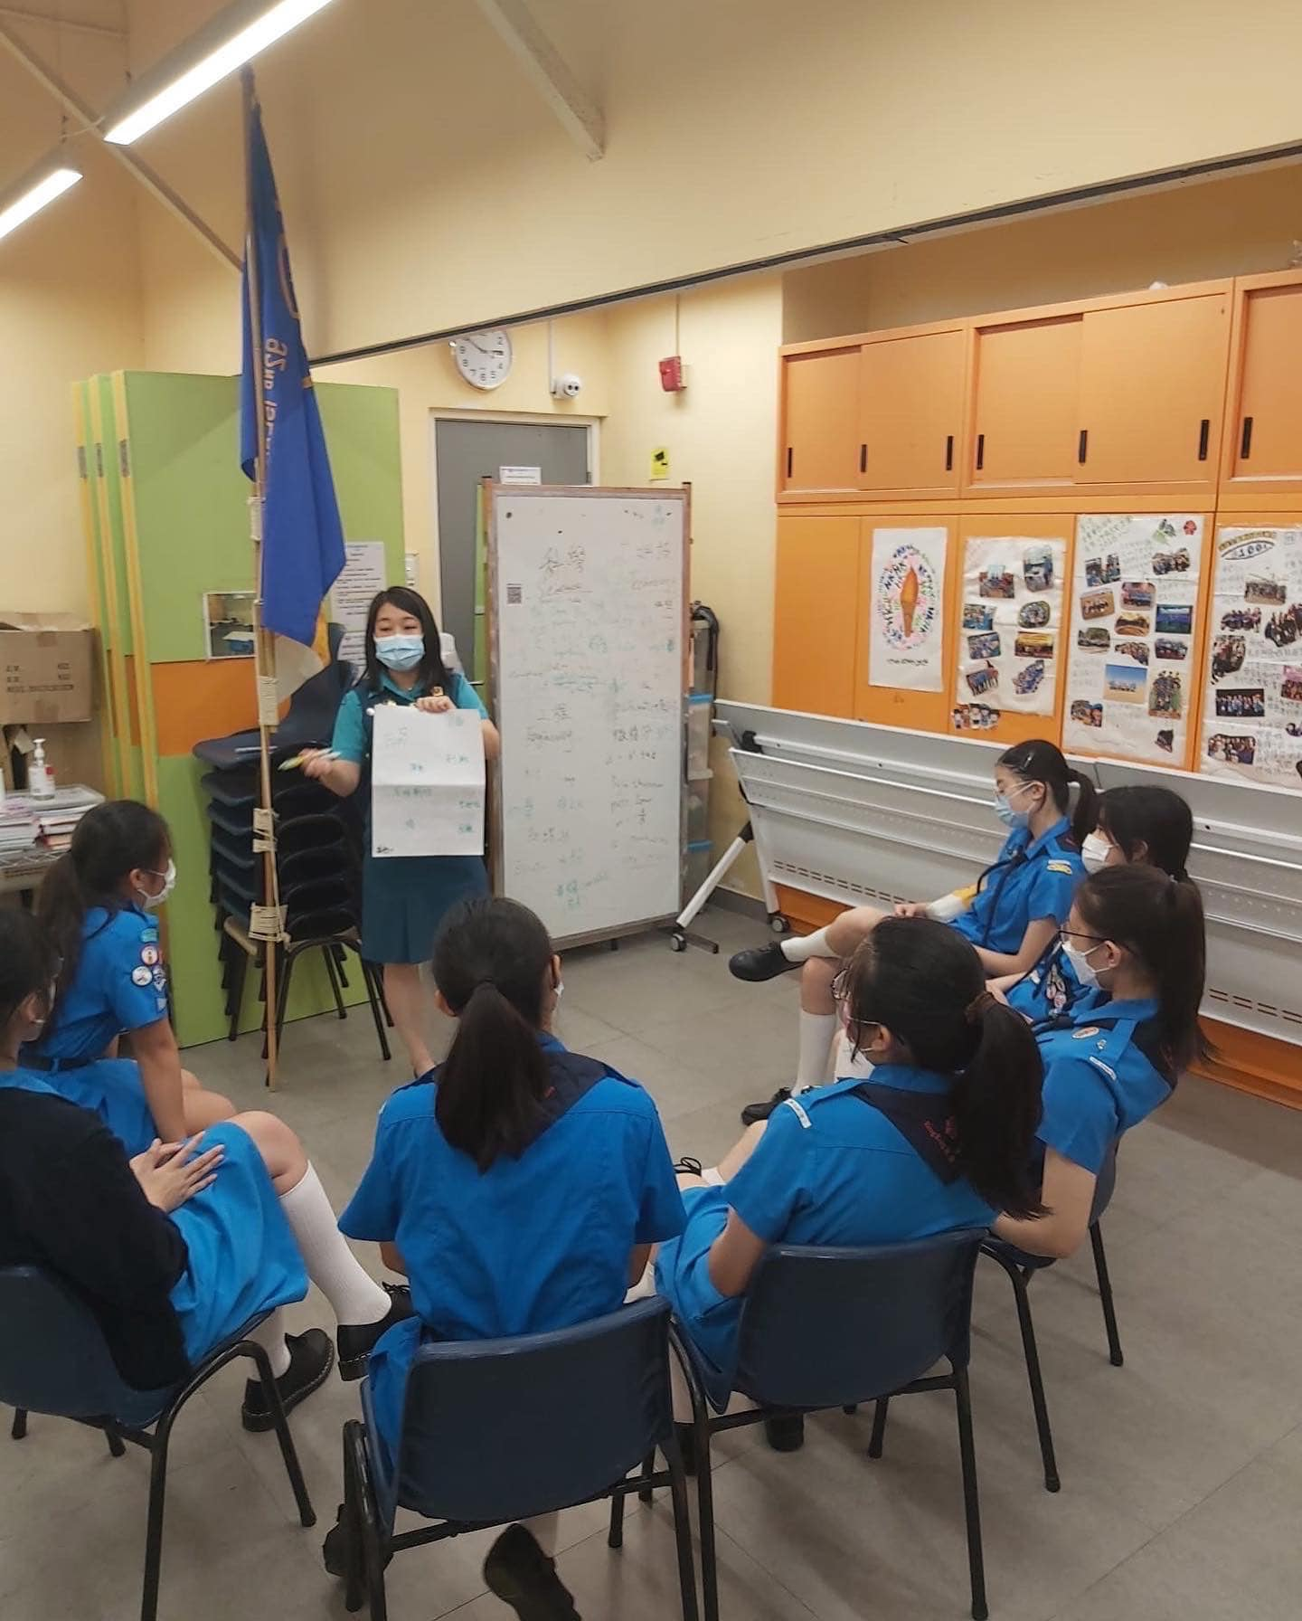
How can Girl Guide/Girl Scout units/troops participate?
Visit https://bit.ly/WAGGGSSTEM
Select your preferred language to view the resource in the website (104 languages available) OR download the PDF version of the consultation pack from the same page
Follow instructions for each of the 7 activities and complete all activities with your Girl Guide/Girl Scout unit/troop
Take photos or videos during the activities to share with us
Girl Guide/Girl Scout leader to complete the online feedback form with the responses collected during the activities
WAGGGS will email the respondents to the online feedback form Certificate of Appreciation for the Girl Guide/Girl Scout leader and Certificate of Participation for the participants

Slide 7
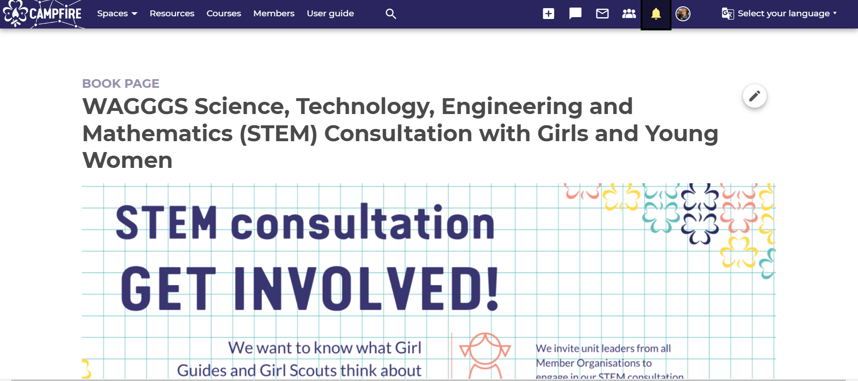

Slide 8
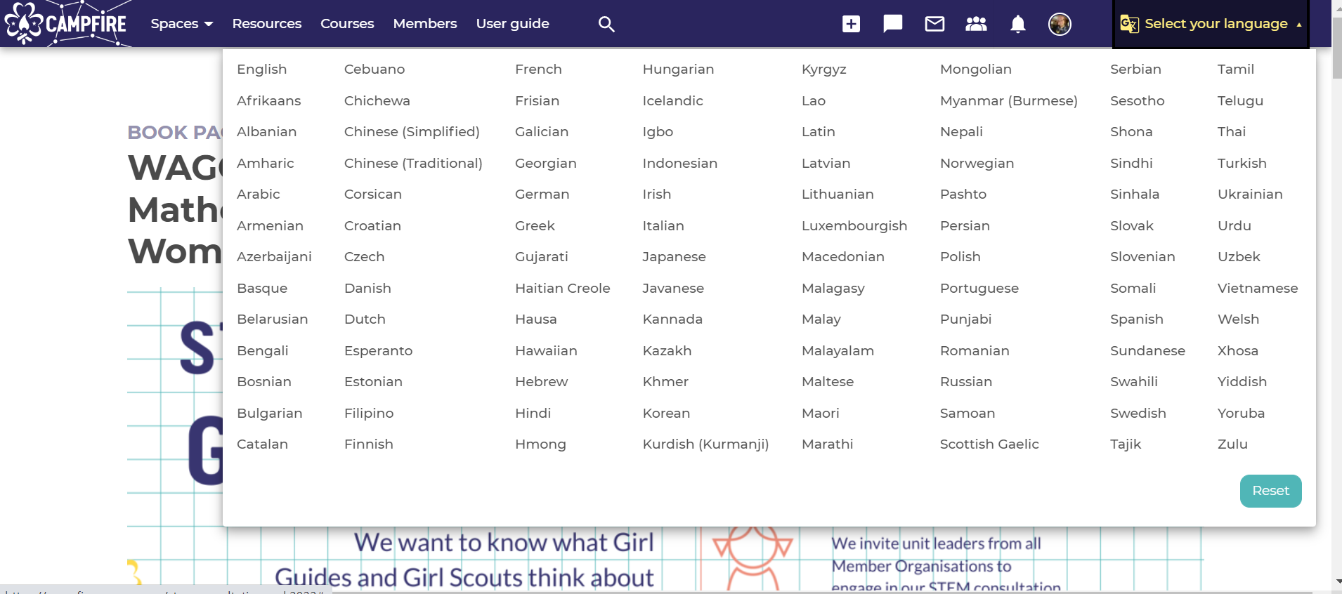

Slide 9
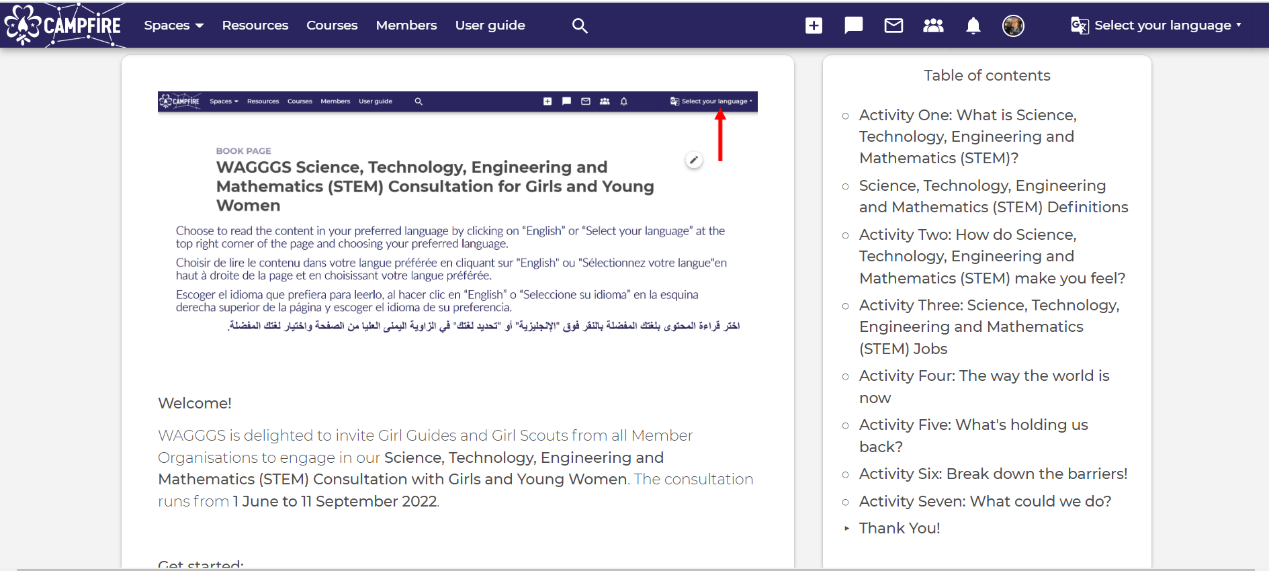

Slide 10
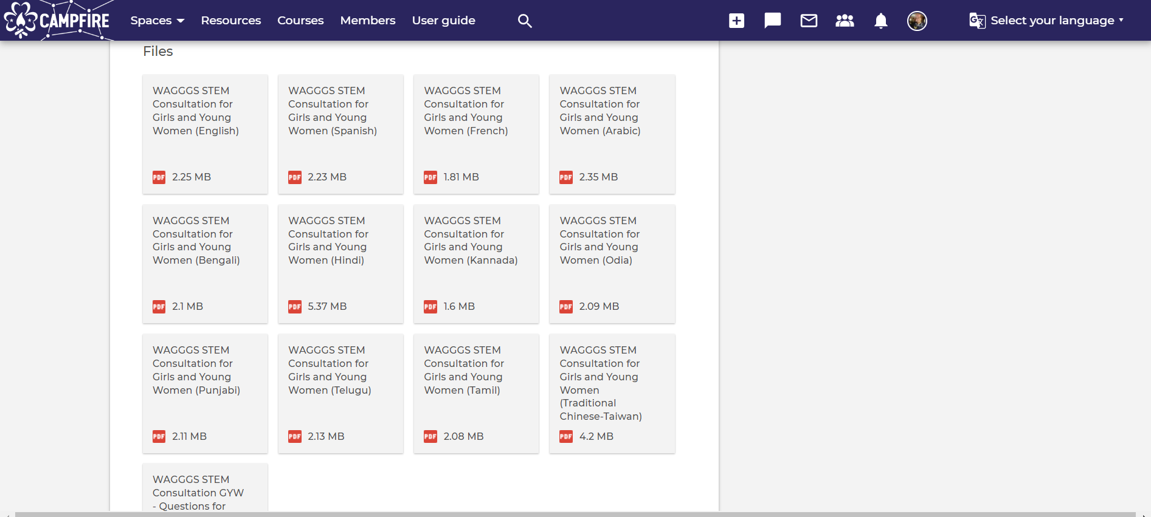
DOWNLOAD
RESOURCES

Slide 11
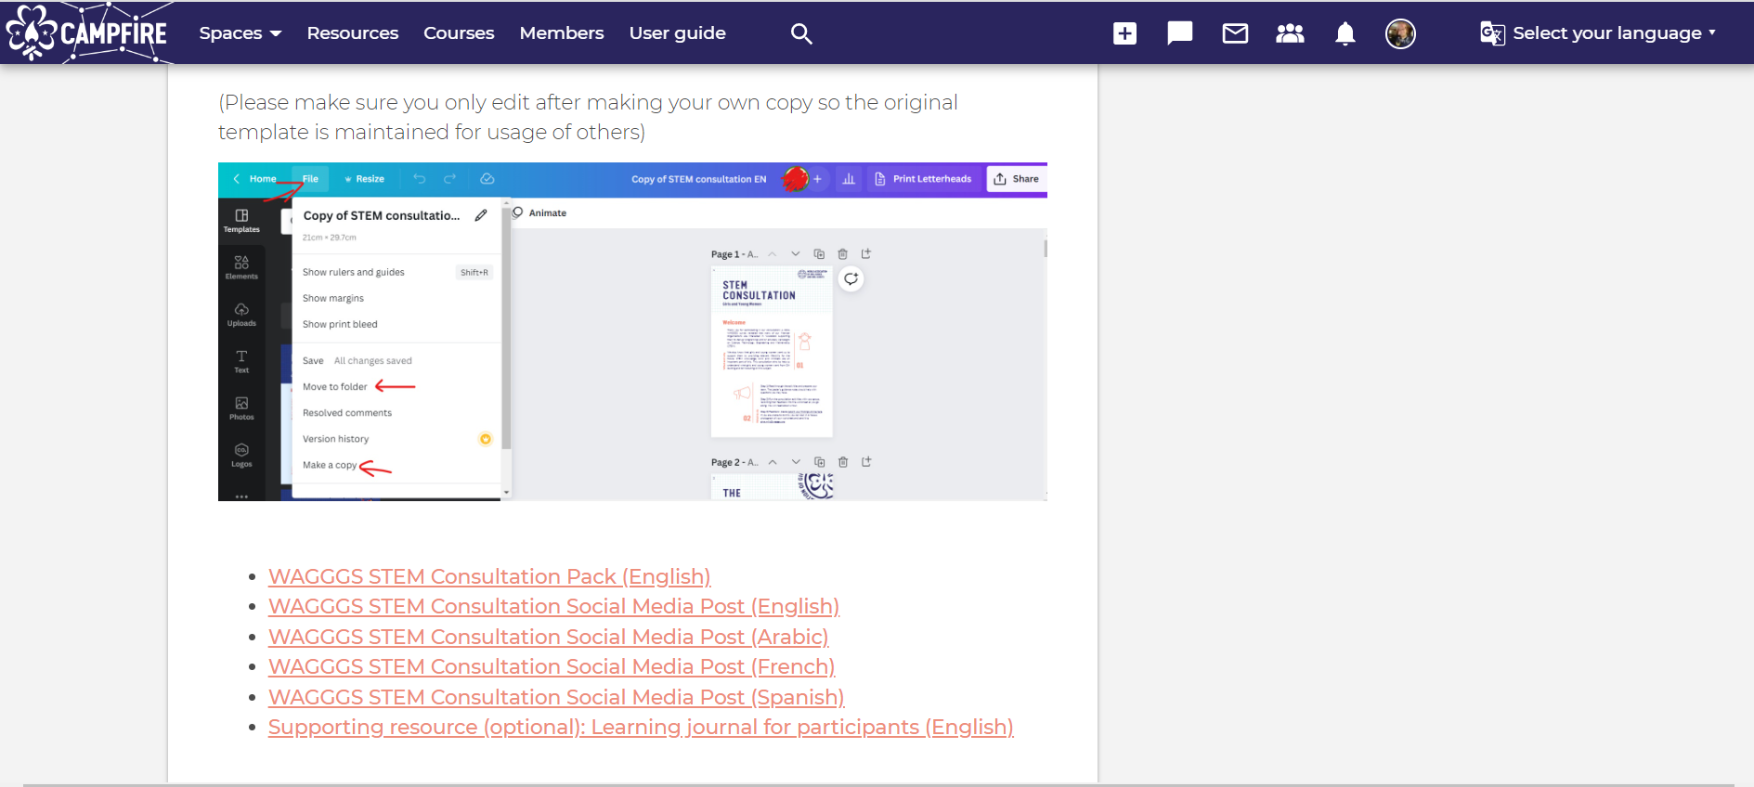
MAKE COPY OF DESIGN FILE FOR YOUR OWN LANGUAGE
DOWNLOAD
RESOURCES

Slide 12
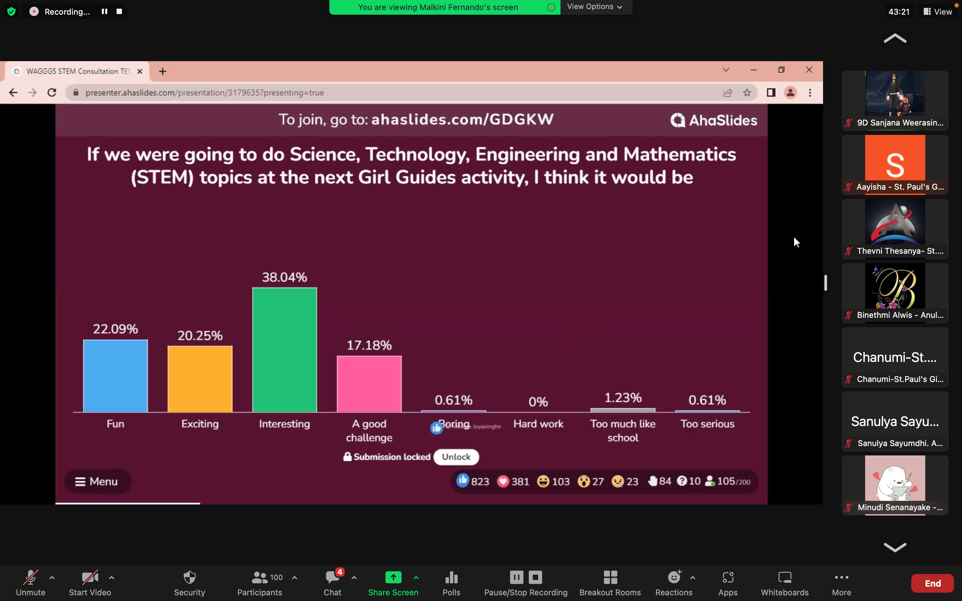
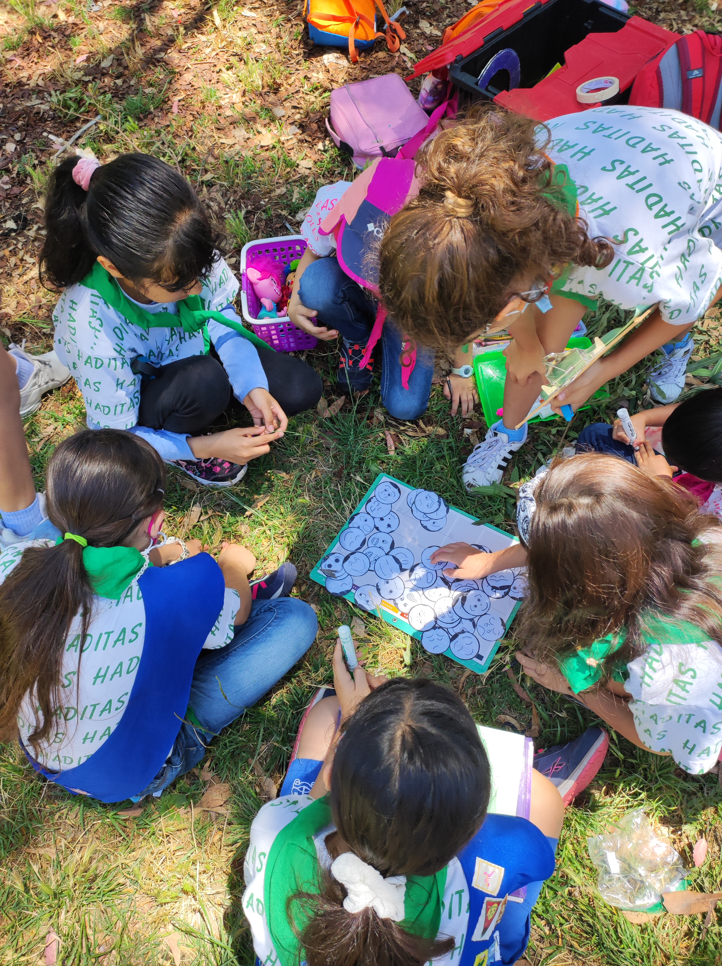
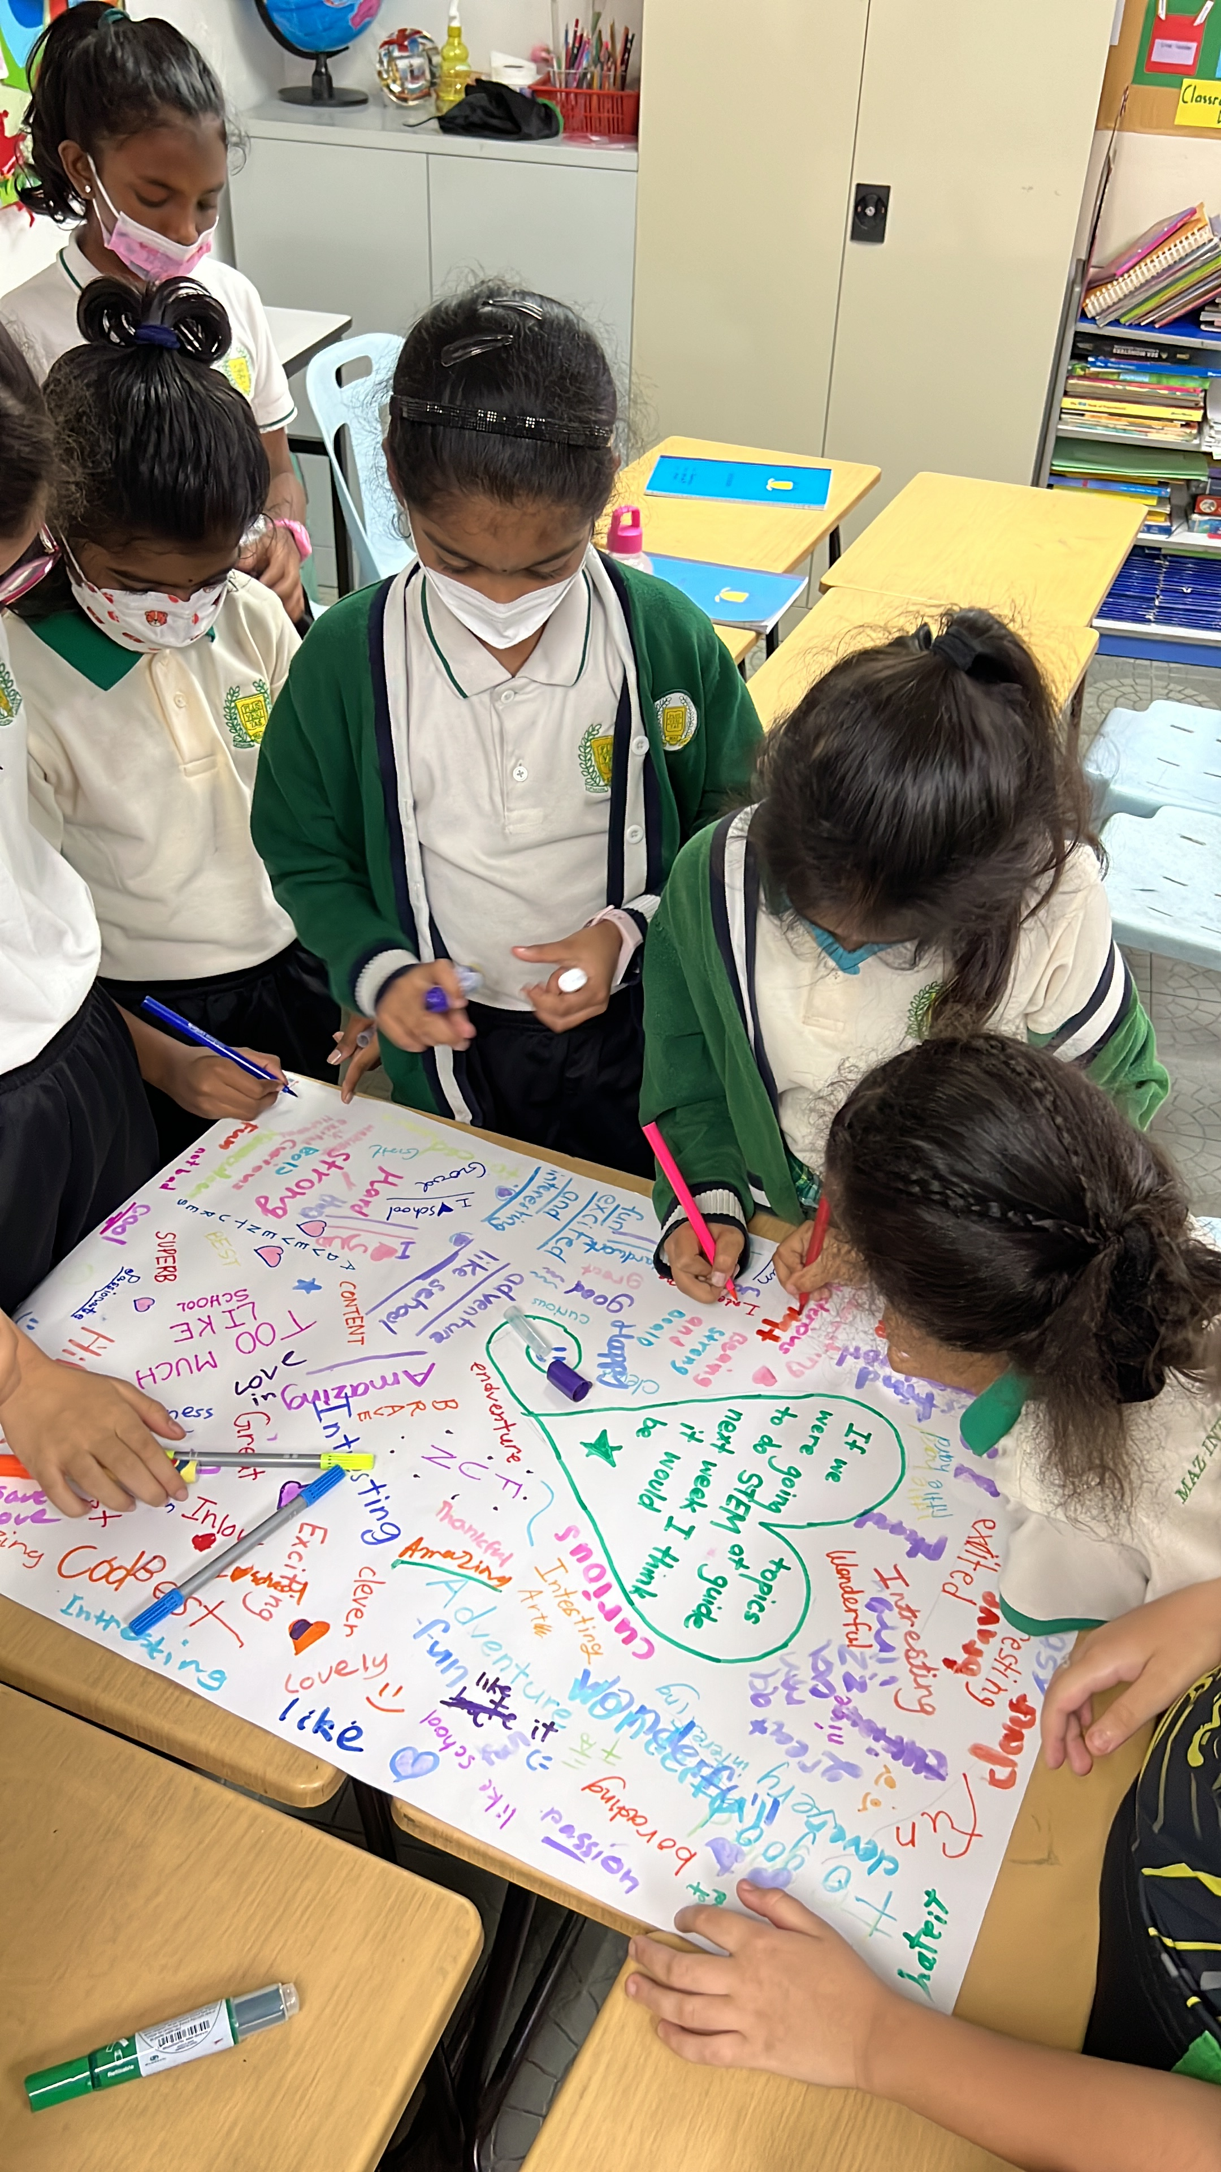
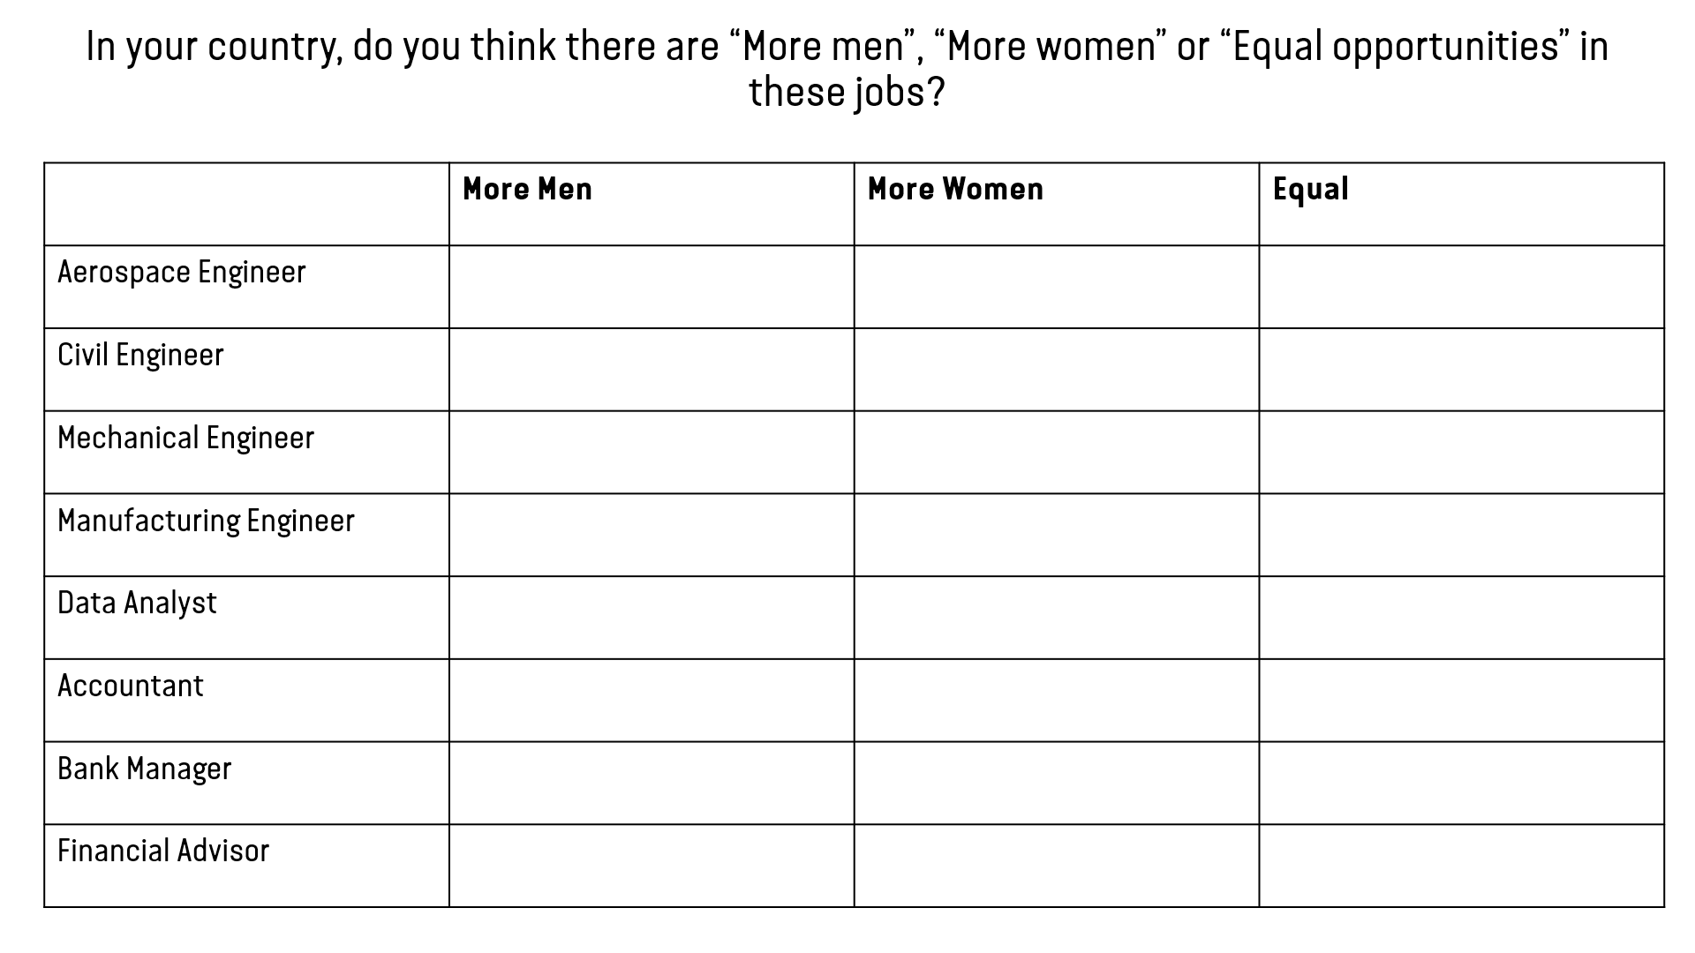
How can the activities be delivered?
Face to face activity/event
Virtual
As static display at existing event/camp if no time can be allocated to do the activities one by one

Slide 13
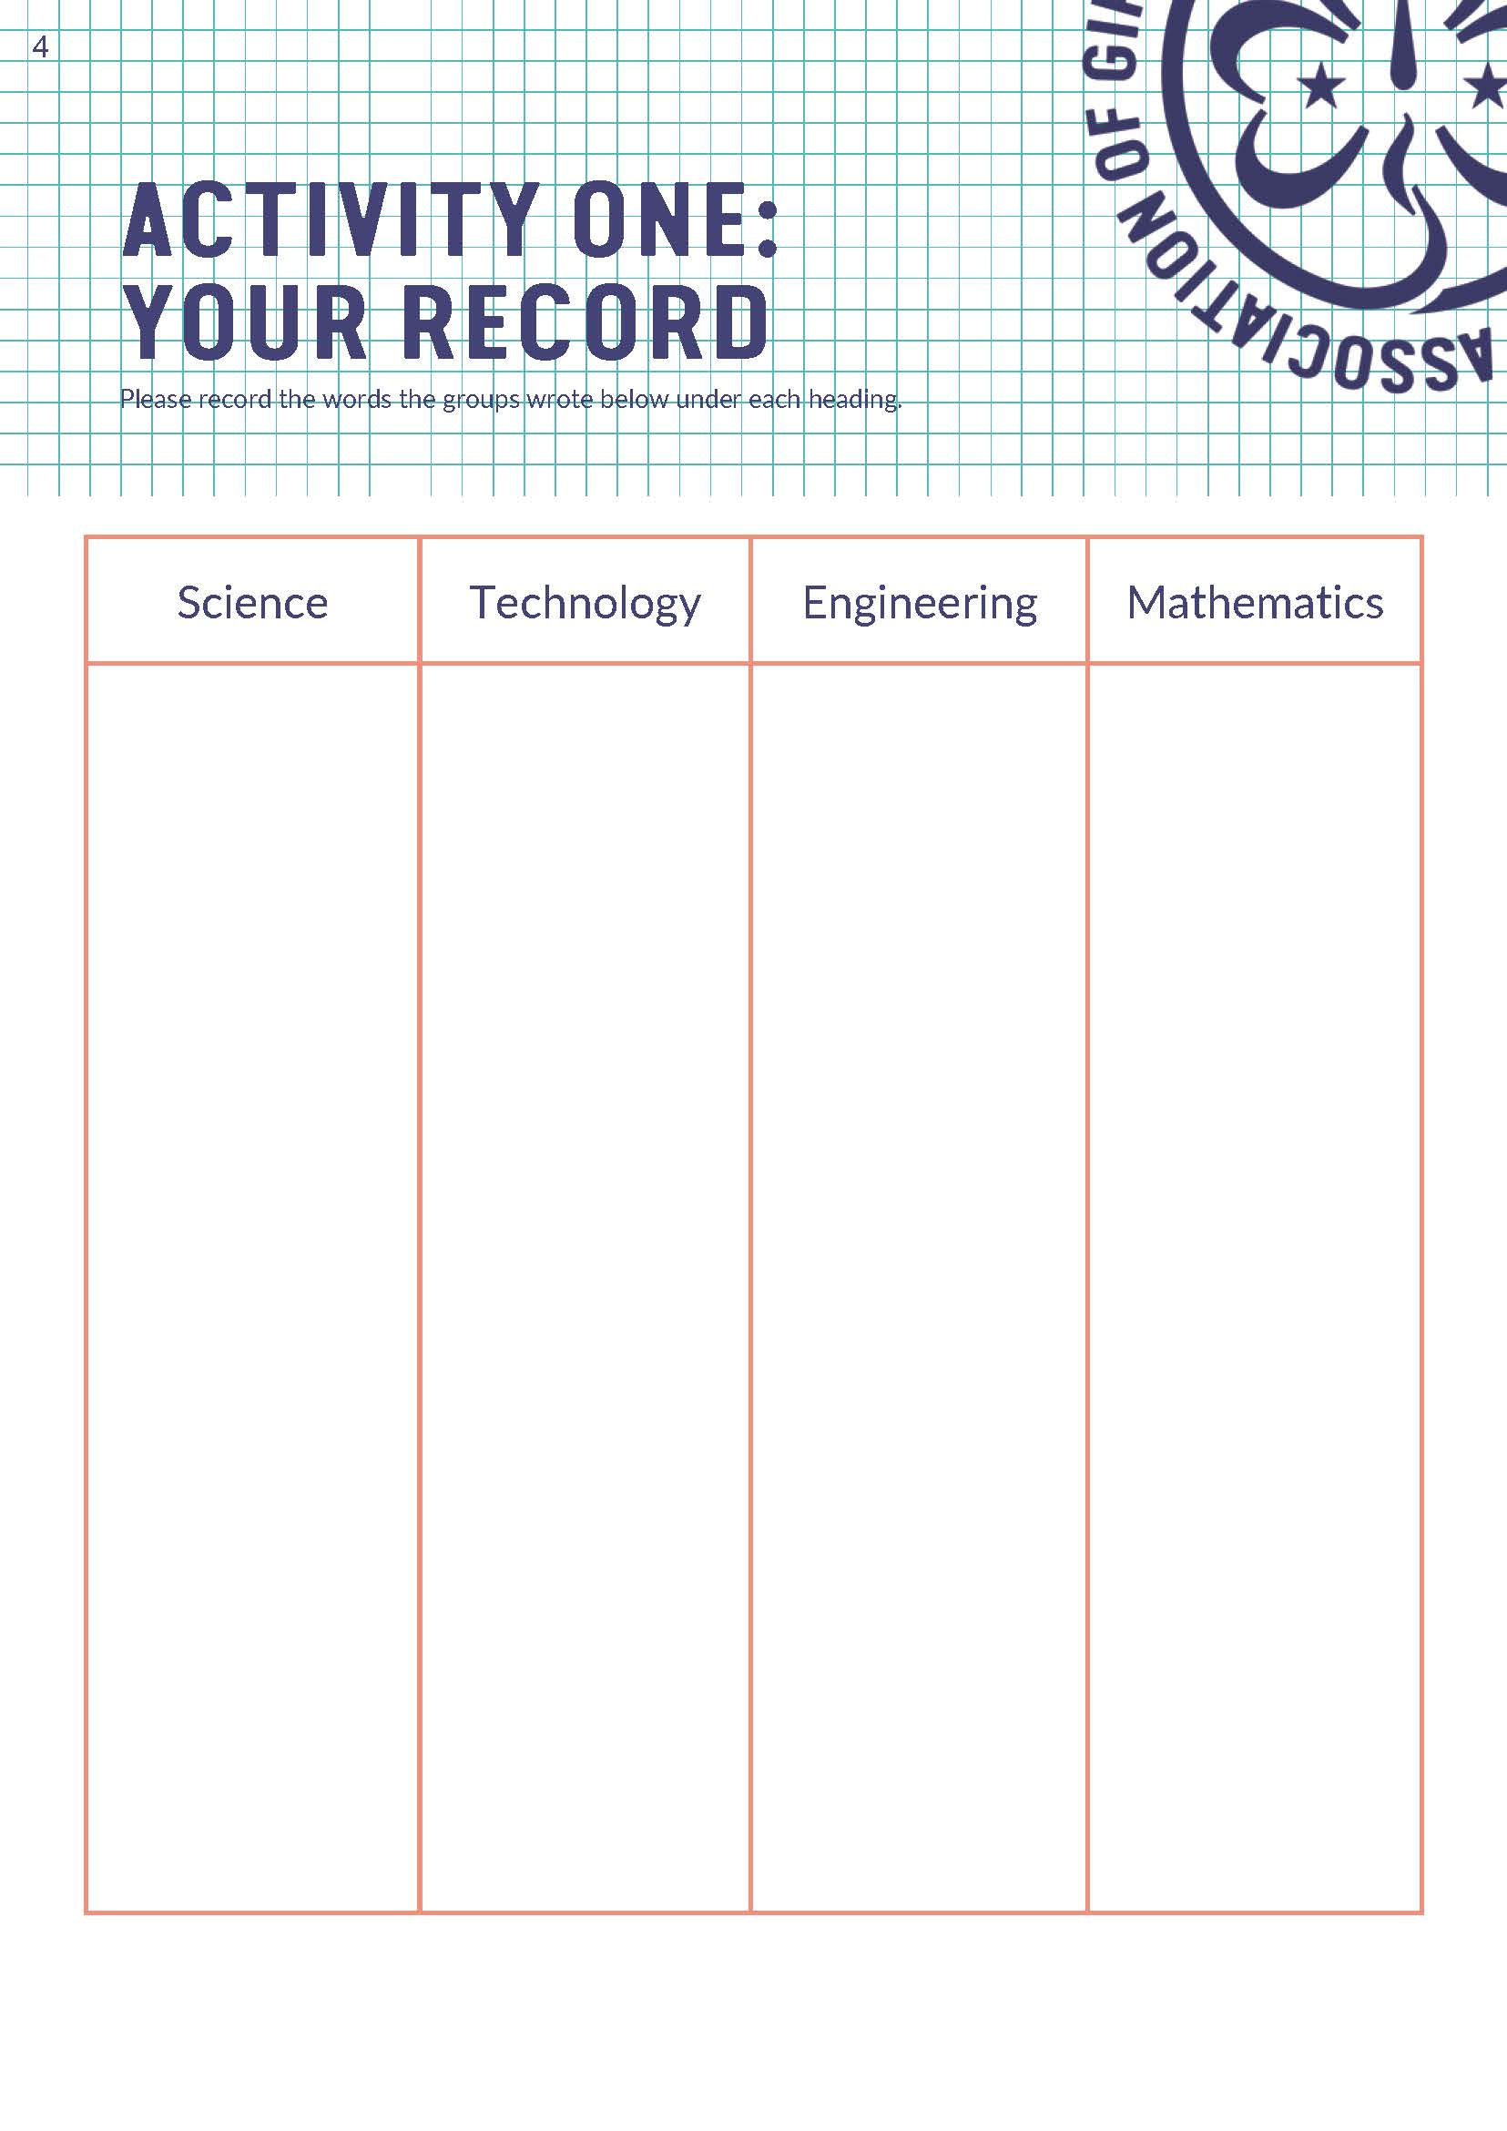
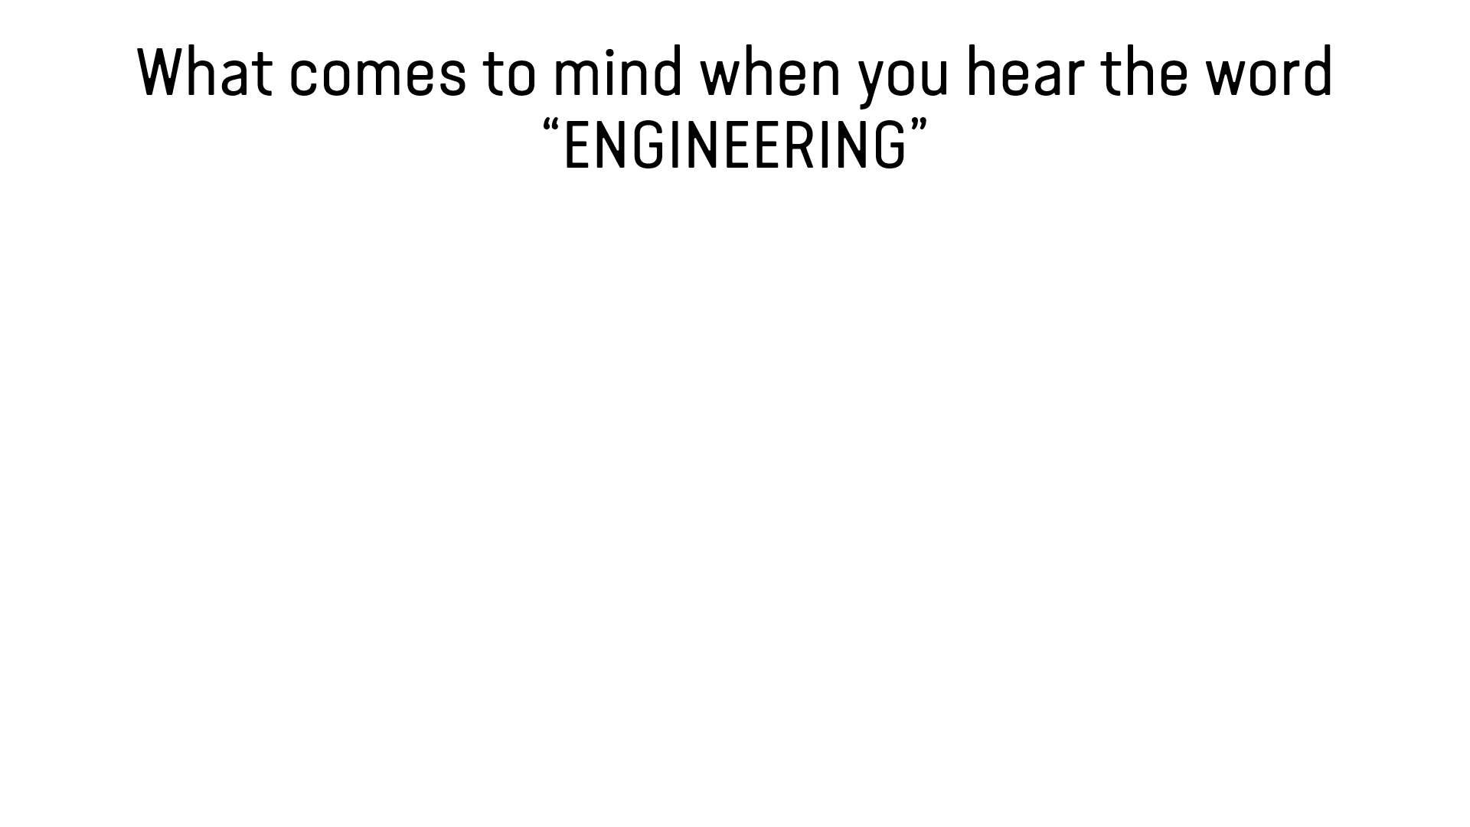
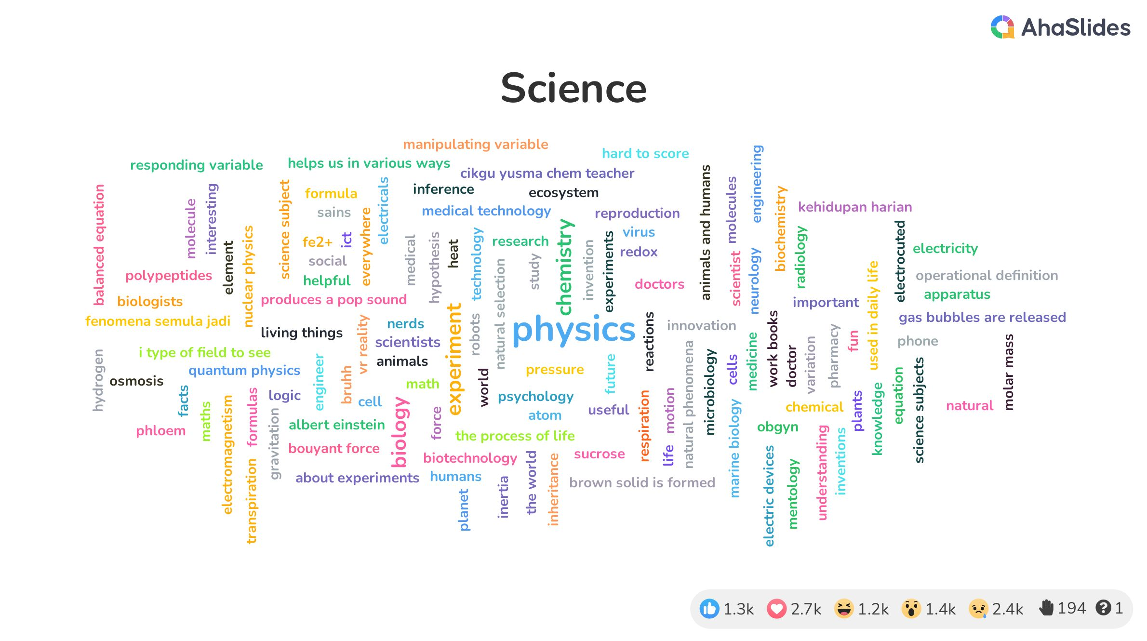
ACTIVITY 1: WHAT IS STEM?
Let girls discuss or state what comes to mind when they hear the words (These can be actions, activities, items, materials, people and places but not feelings)
  Science
  Technology
  Engineering
  Mathematics

Slide 14
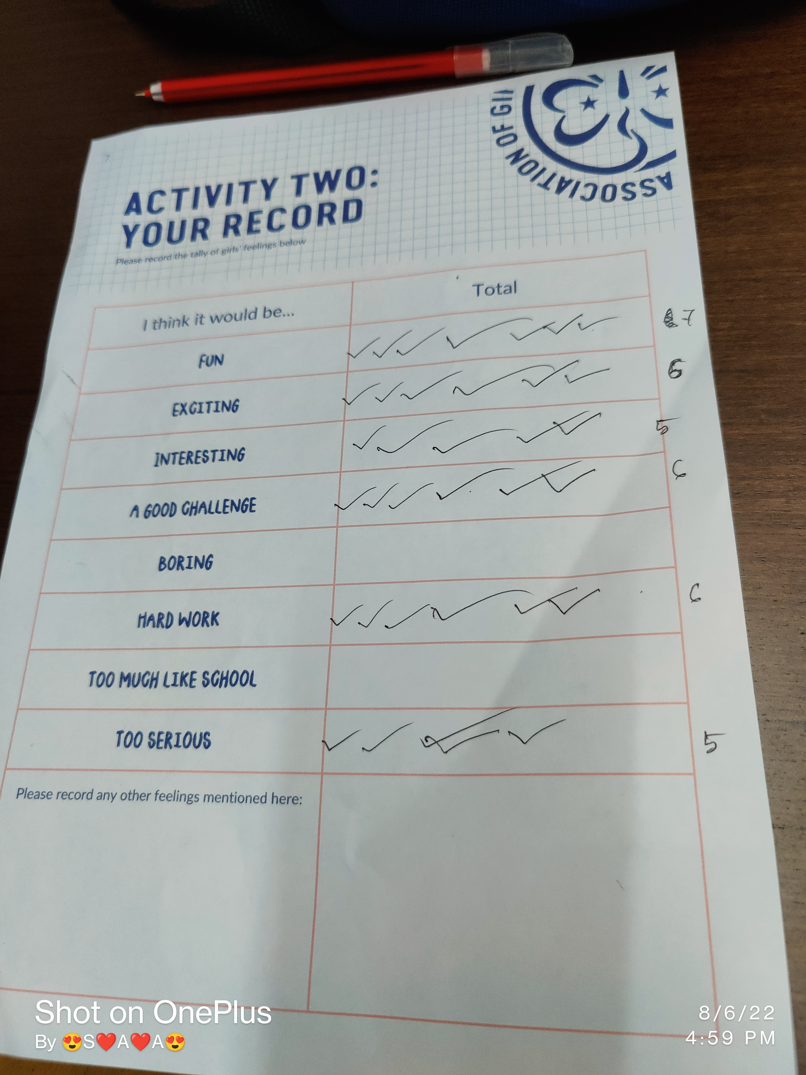
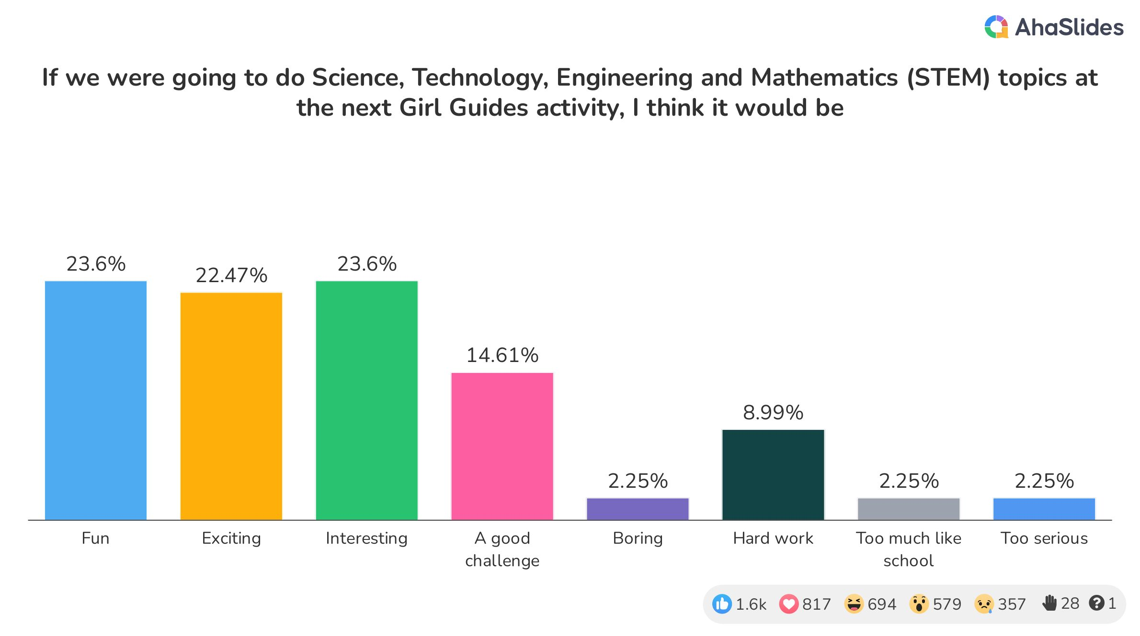
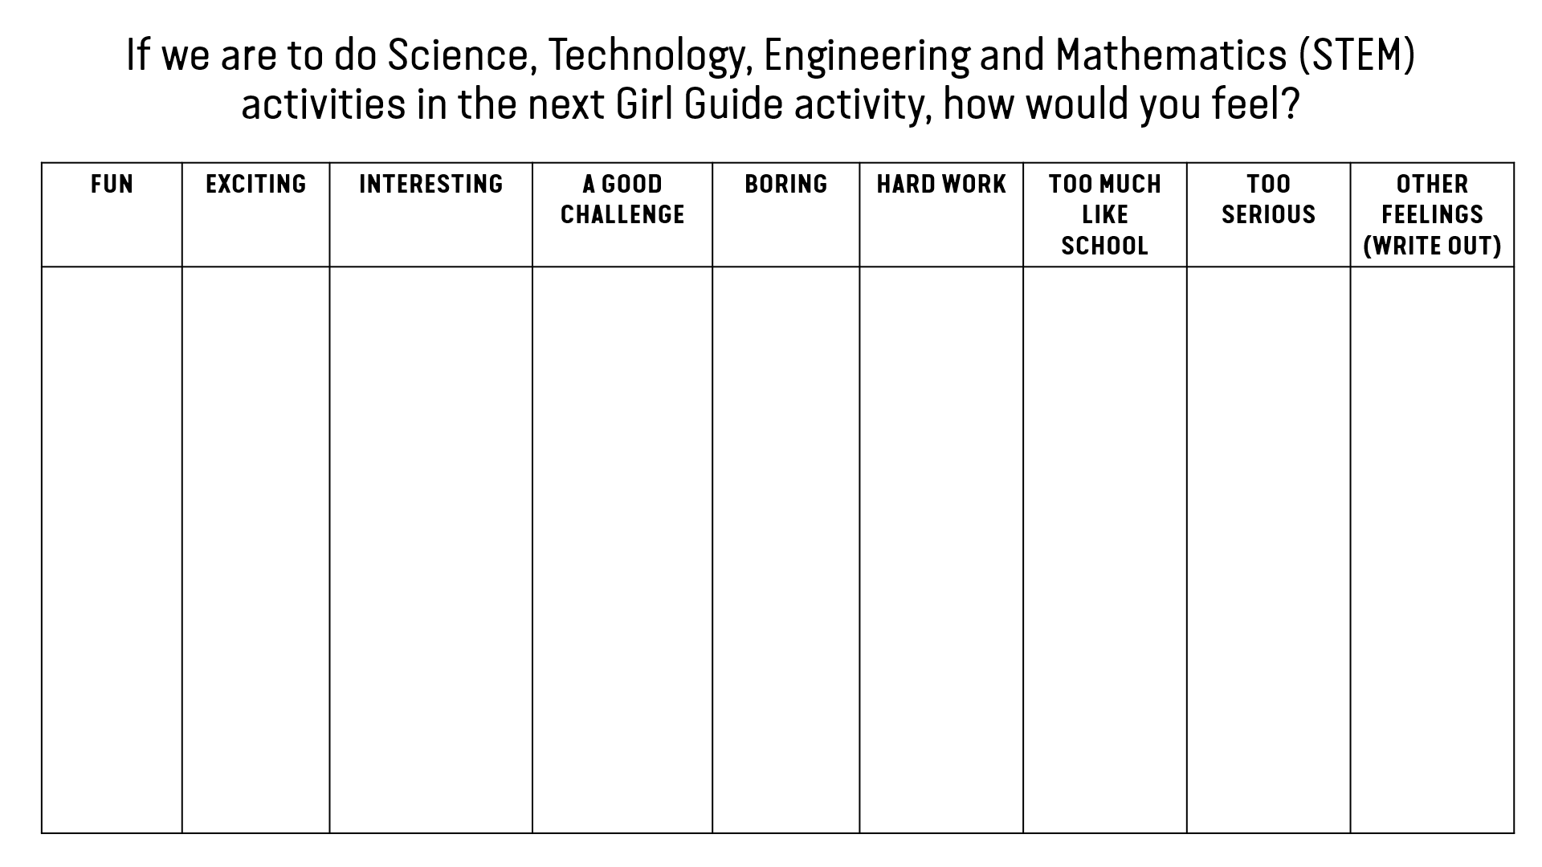
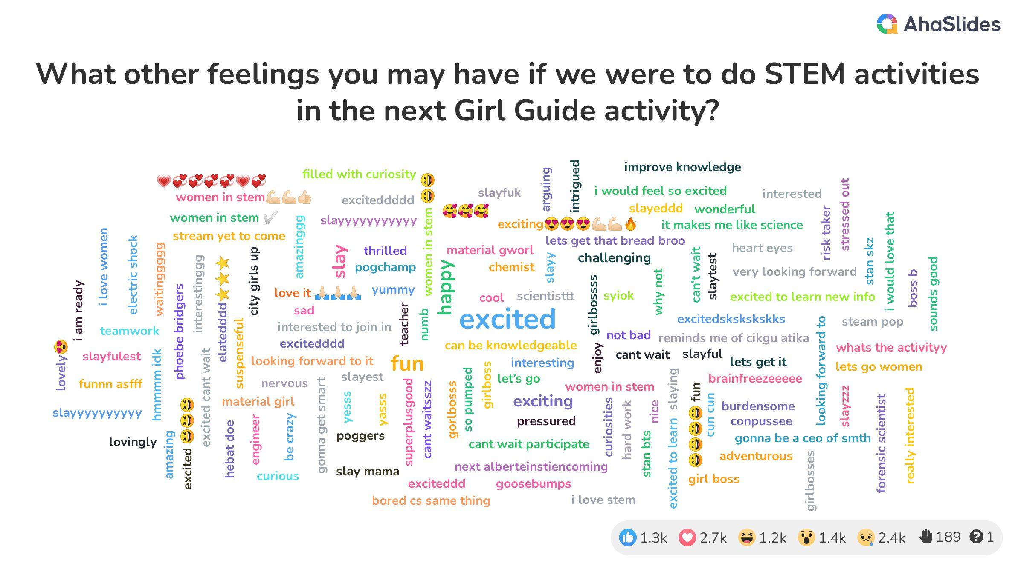
ACTIVITY 2: HOW DO STEM MAKE YOU FEEL?
Ask girls to indicate how would they feel if we are to do STEM activities in the next Girl Guide/Girl Scout activity
Prepare list of feelings for them to vote and a blank section for any other feelings

Slide 15
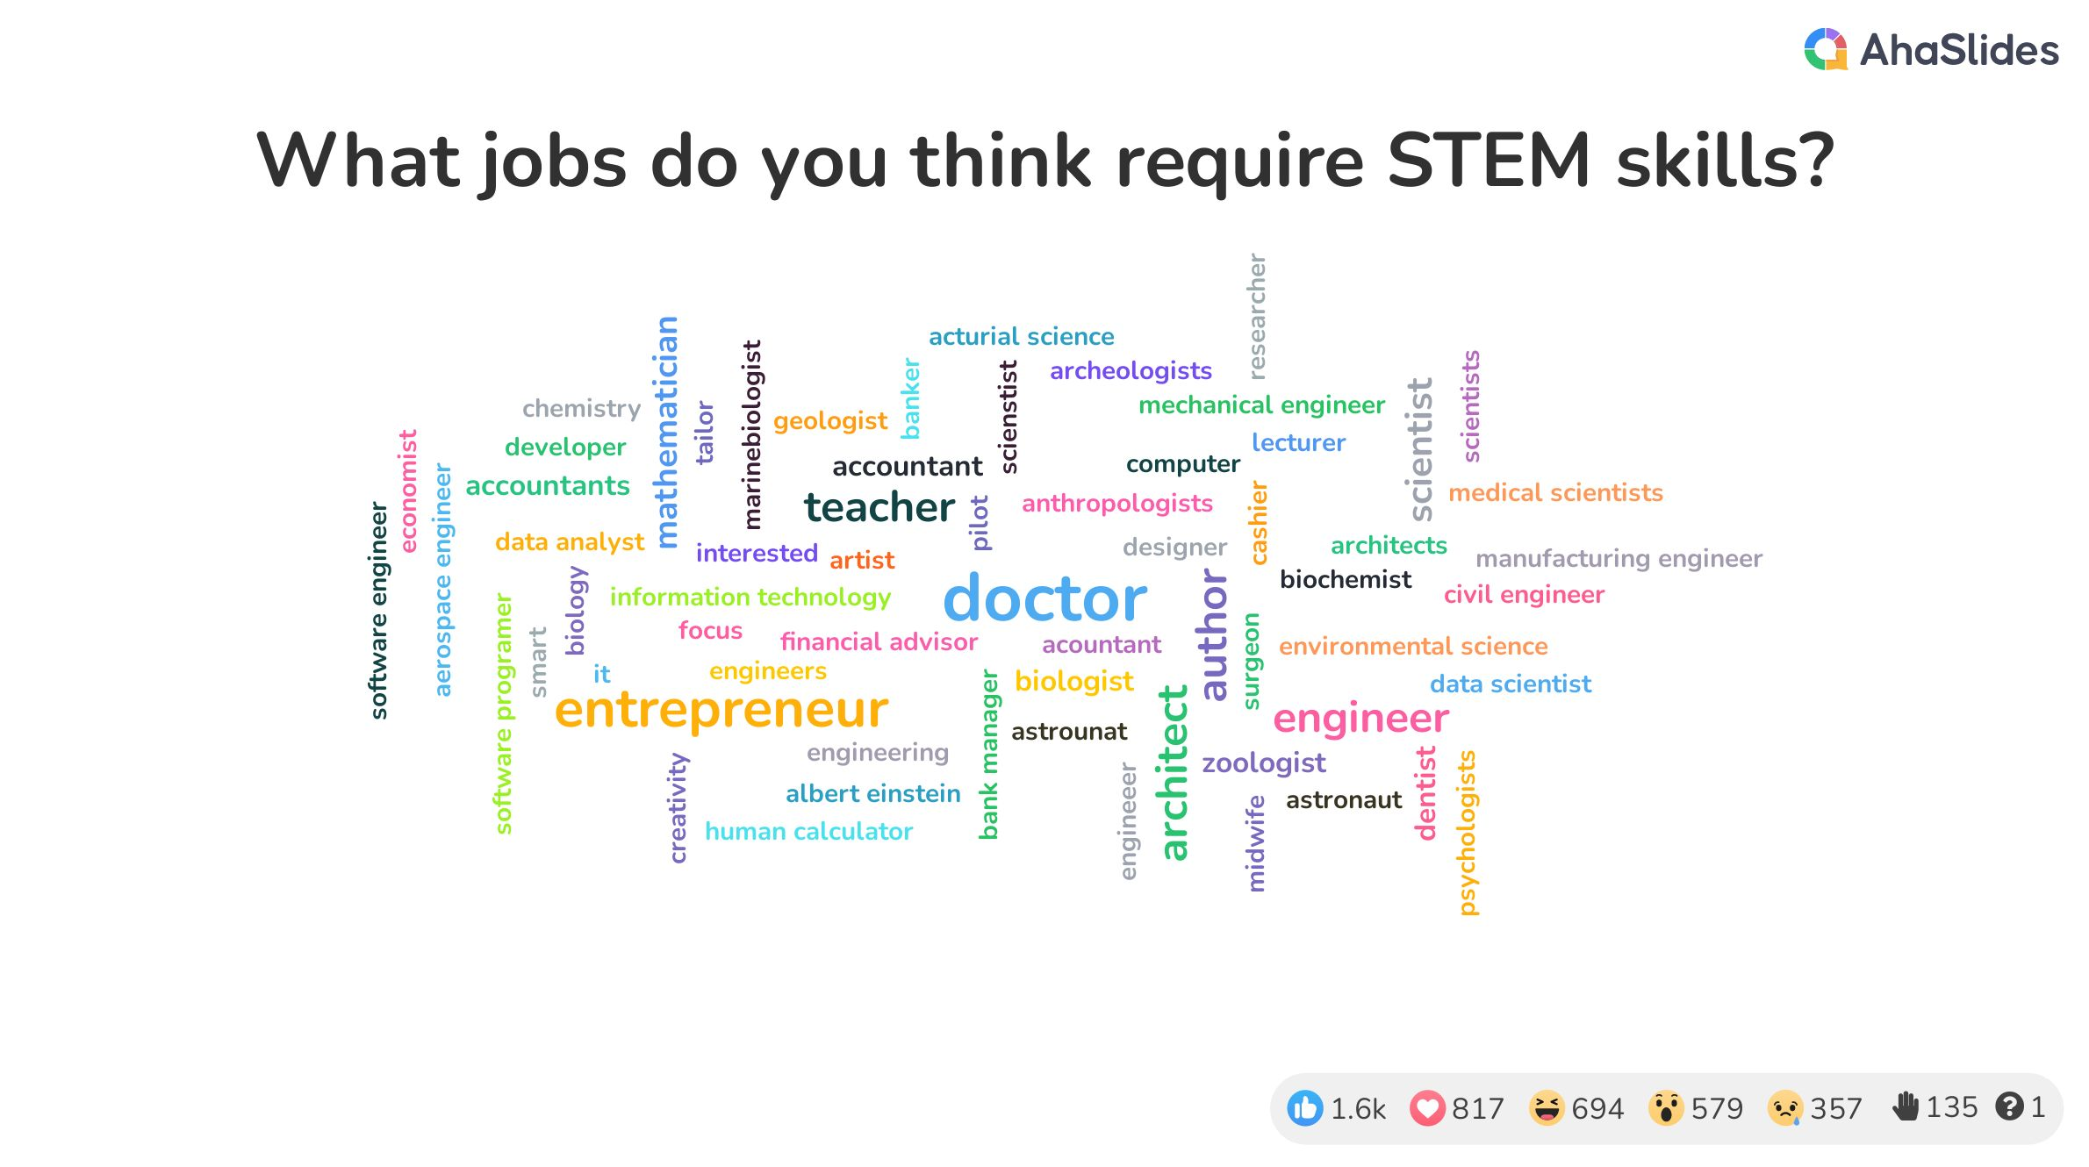

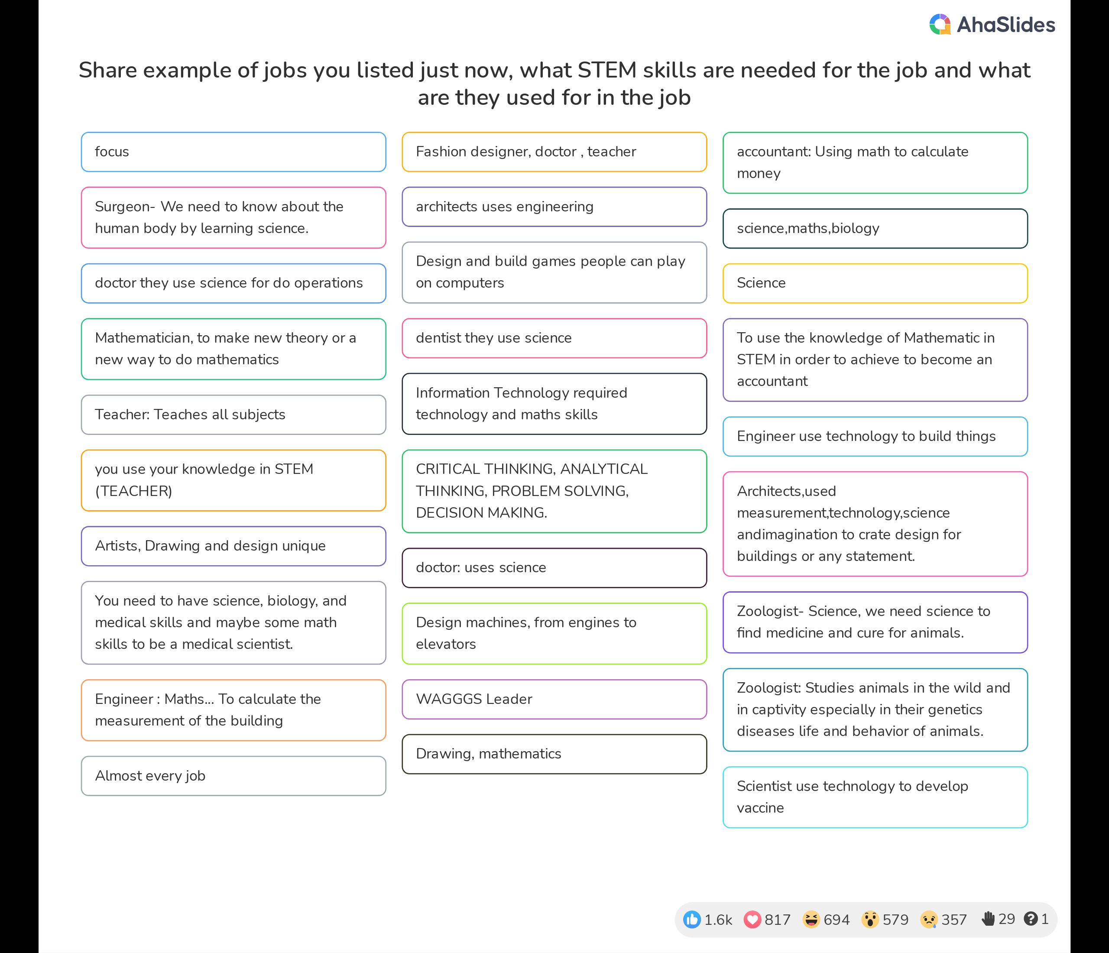

ACTIVITY 3: STEM JOBS
Ask girls to discuss and list jobs/careers that may require sills in STEM
You may also ask them to discuss why they think the jobs require STEM skills

Slide 16
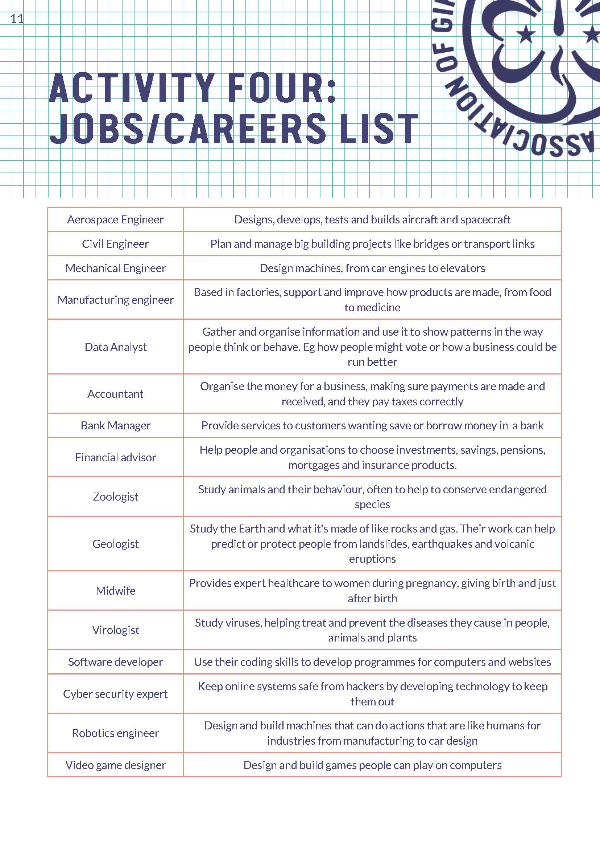
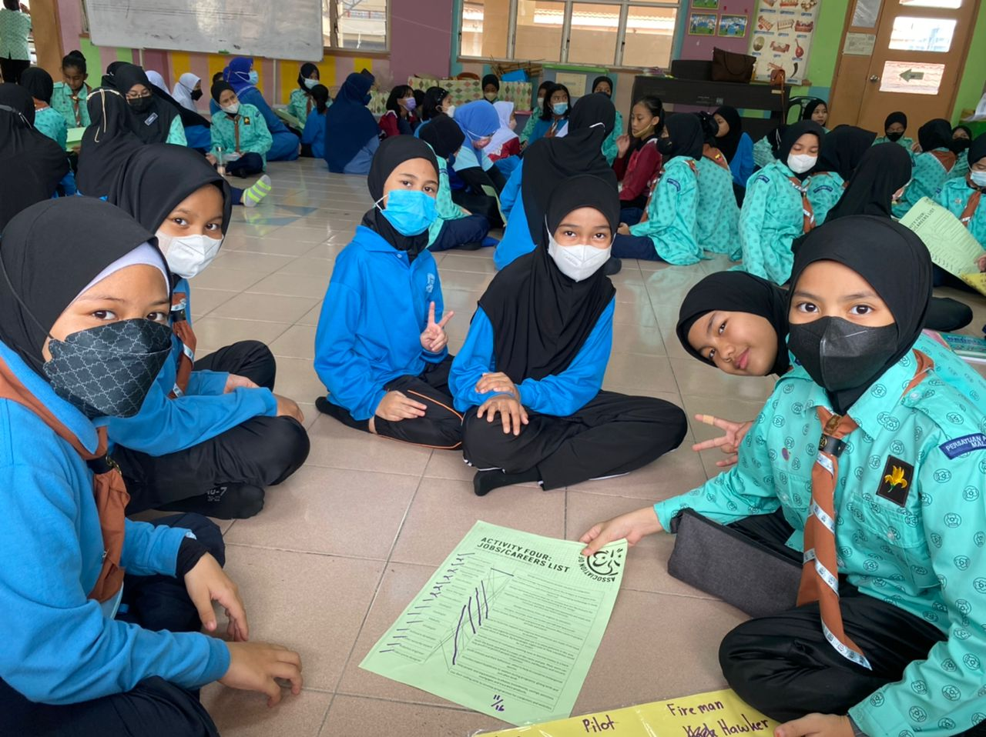
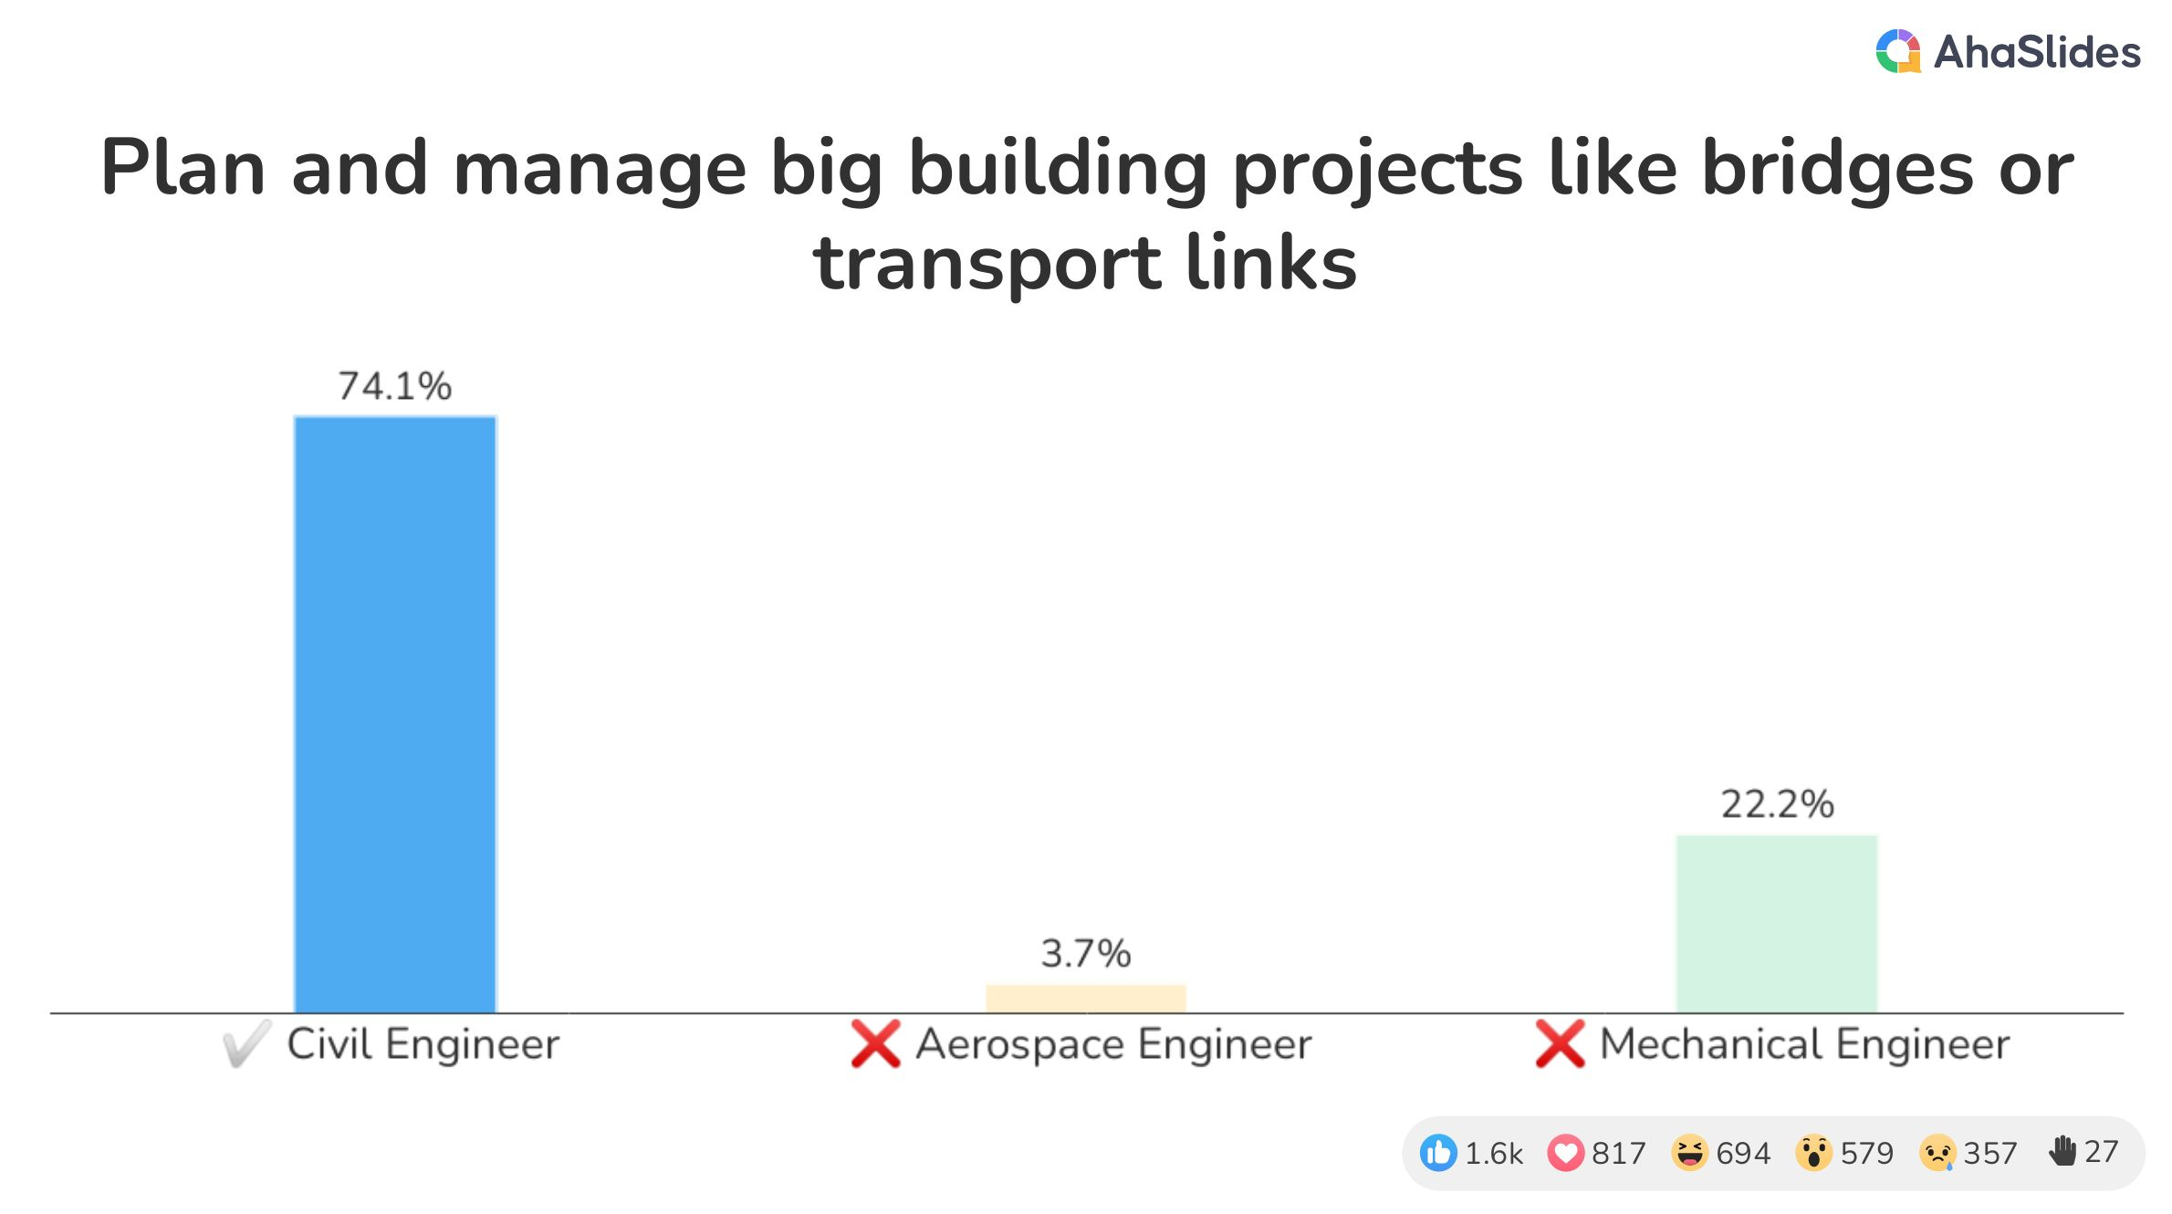
ACTIVITY 4: THE WAY THE WORLD IS NOW
Step 1: Warm up by sharing a list of jobs and their descriptions. Ask them to match the descriptions to the jobs

Slide 17
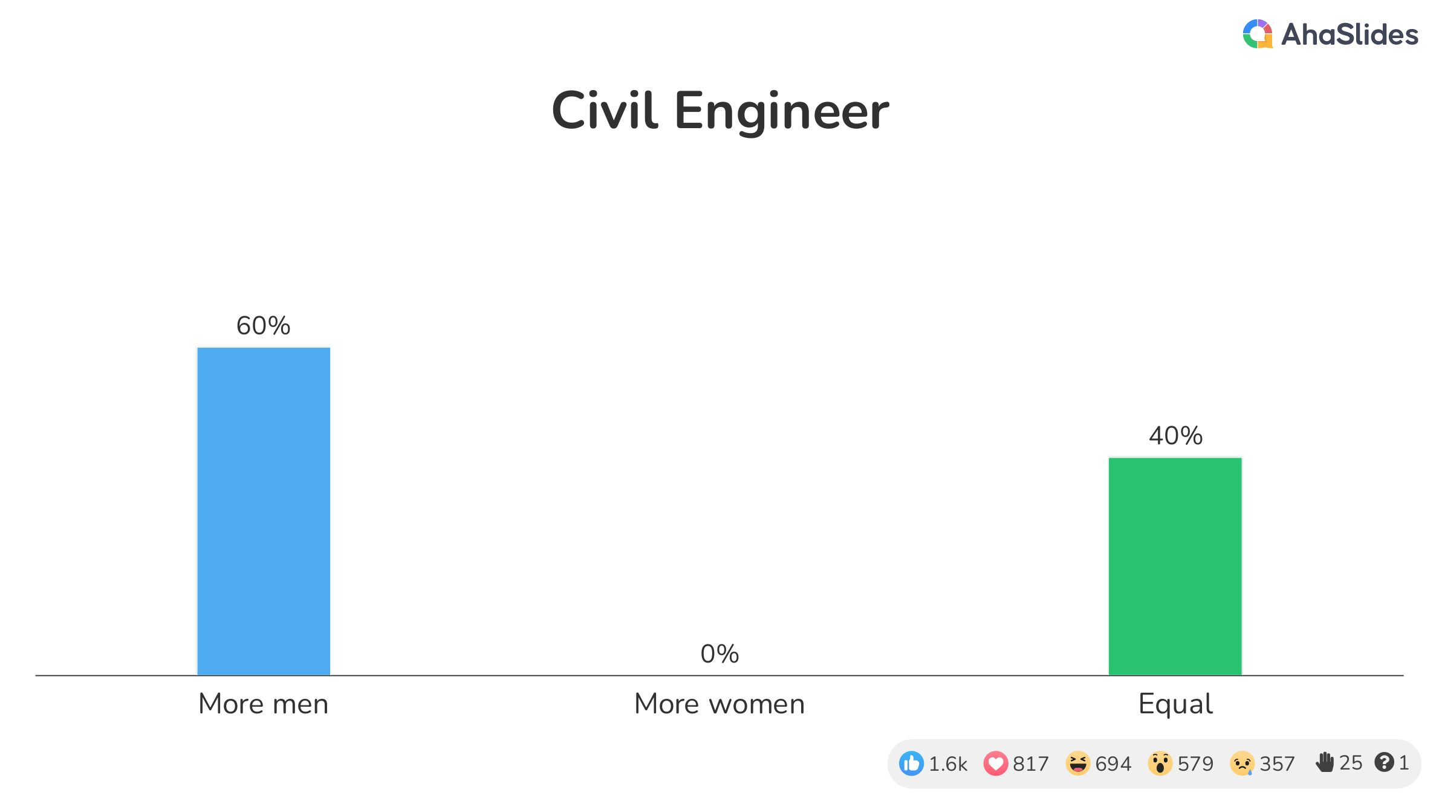
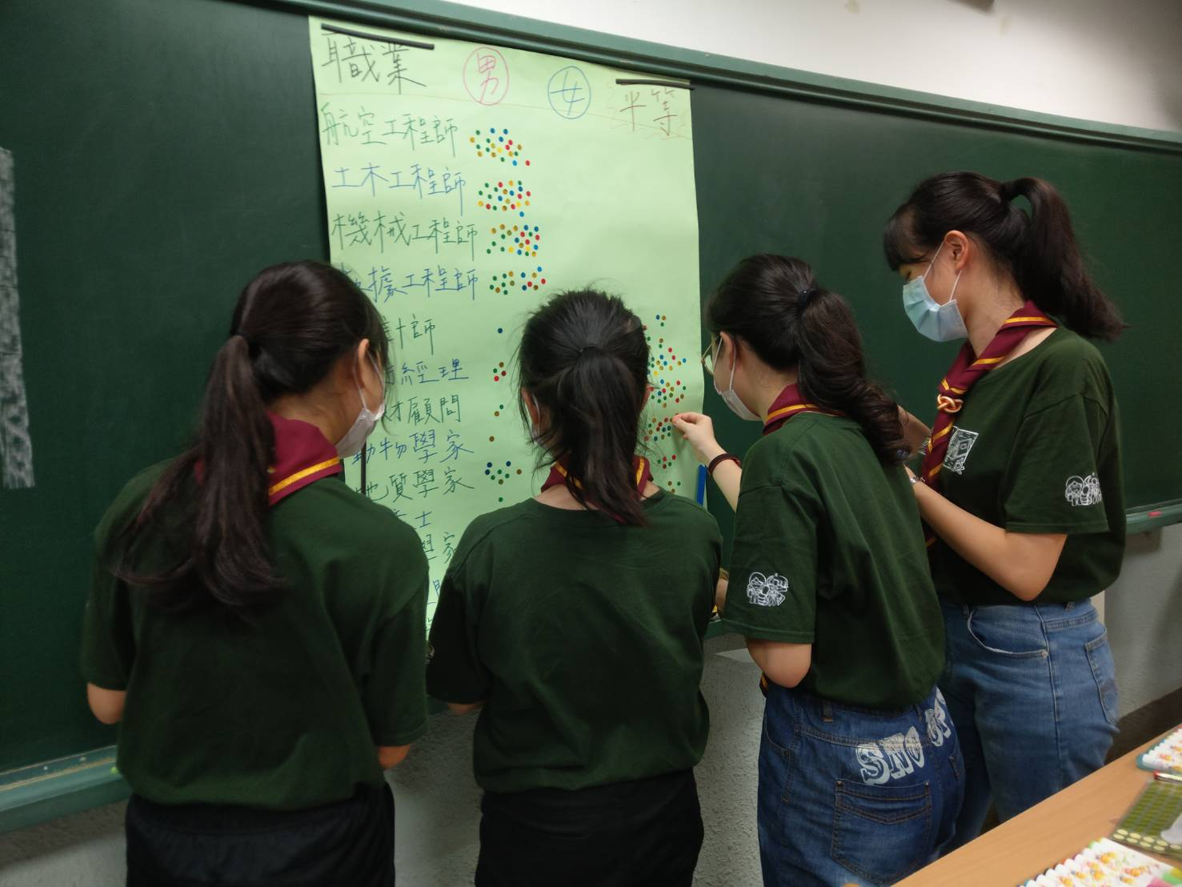
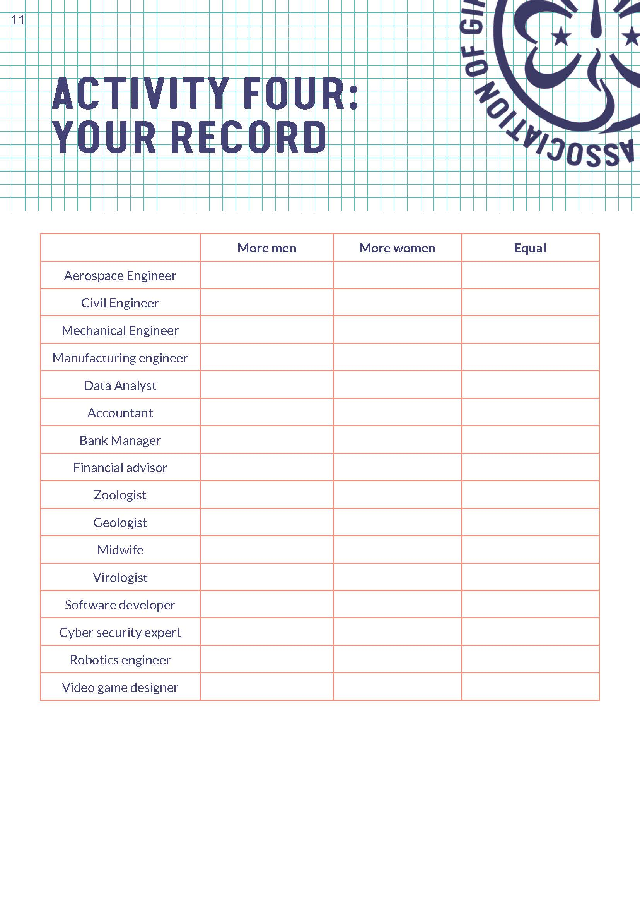
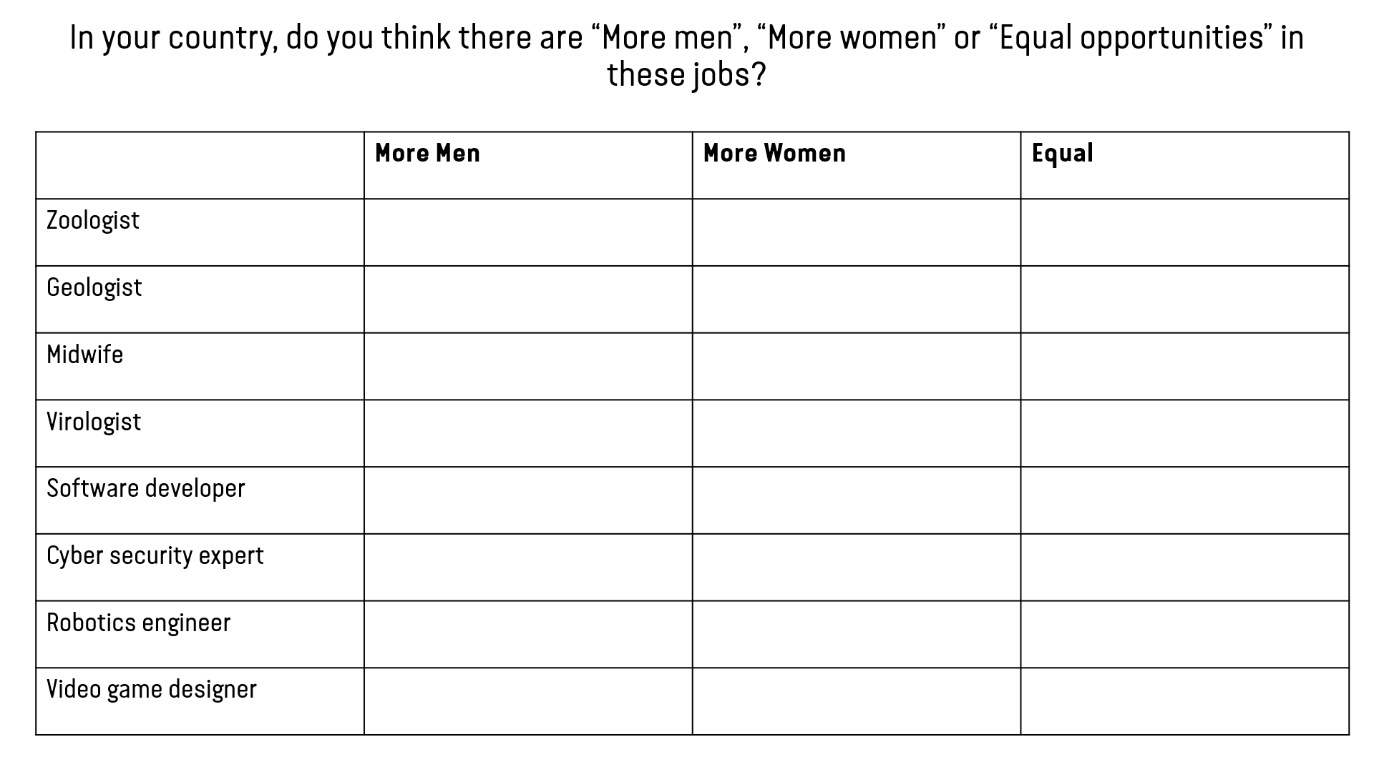
ACTIVITY 4: THE WAY THE WORLD IS NOW
Step 2: Ask them whether these jobs have “More Men”, “More Women” or “Equal representation” in their country

Slide 18
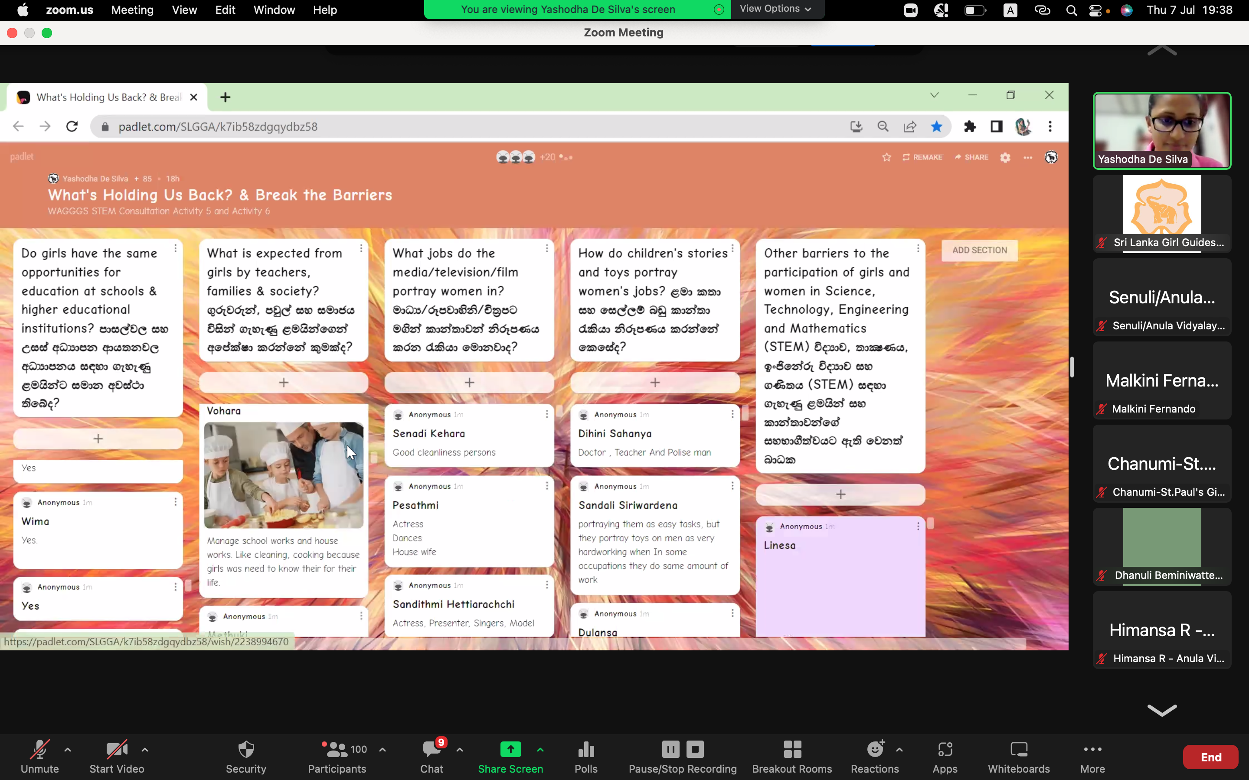
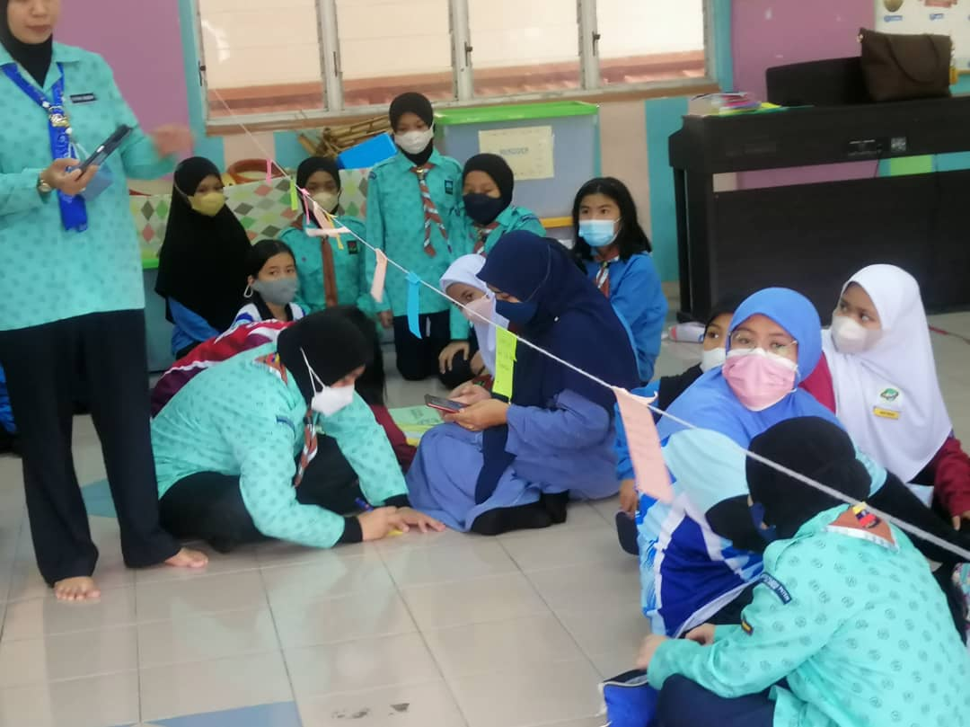

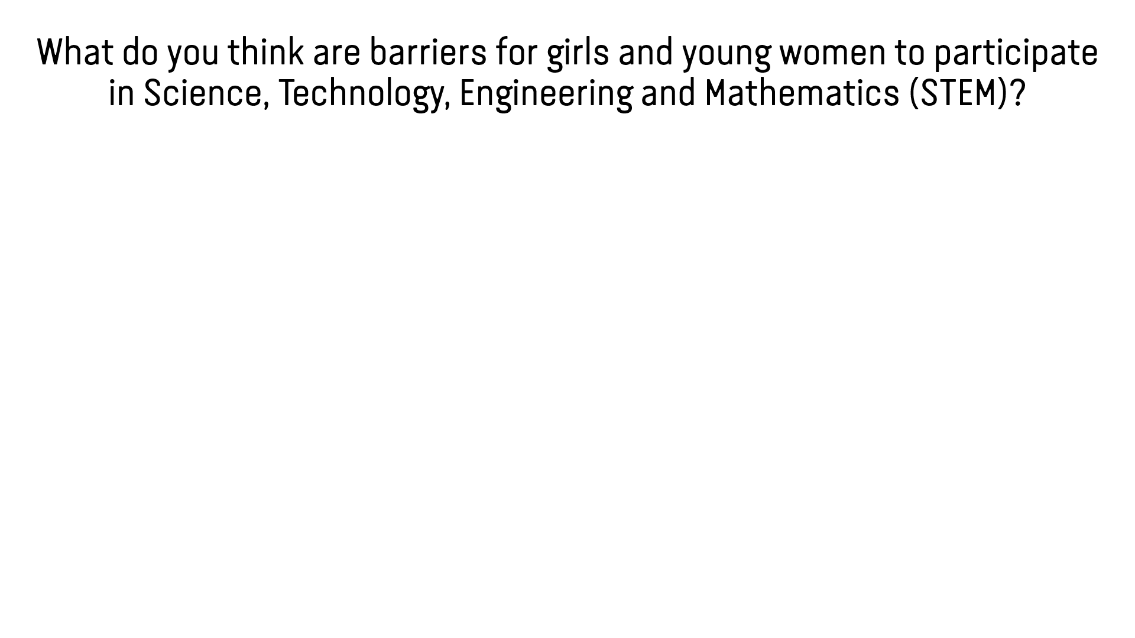
ACTIVITY 5: WHAT’S HOLDING US BACK?
Discuss and list barriers that prevent girls and women from participating in STEM

Slide 19
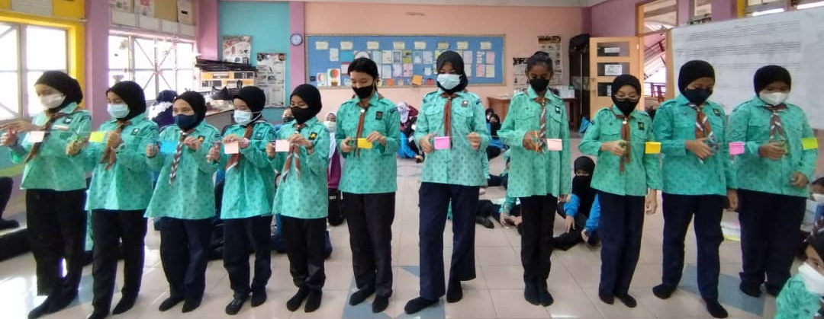
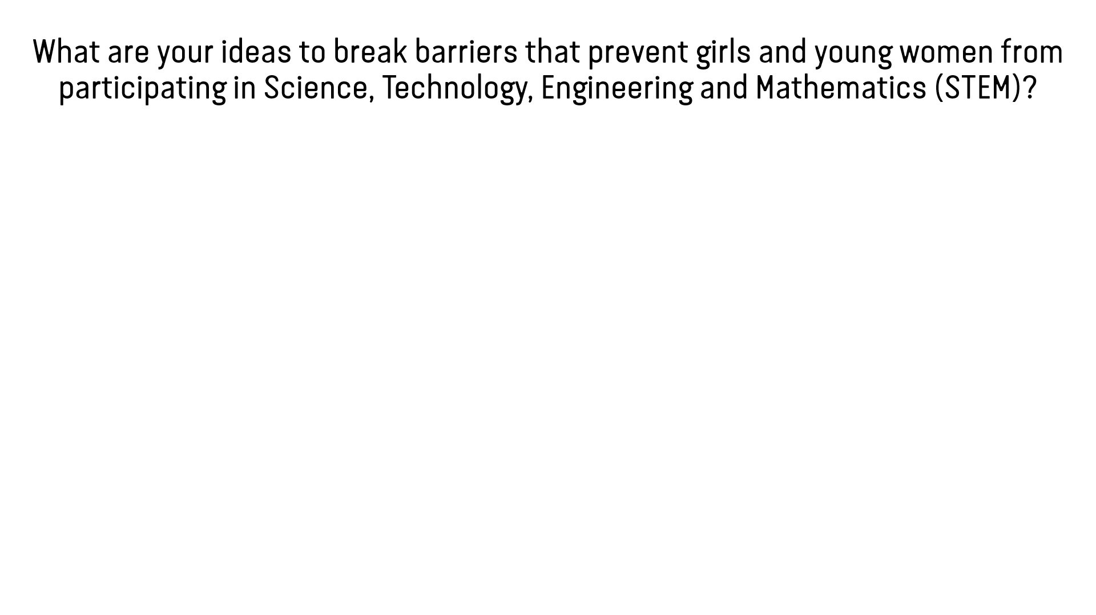
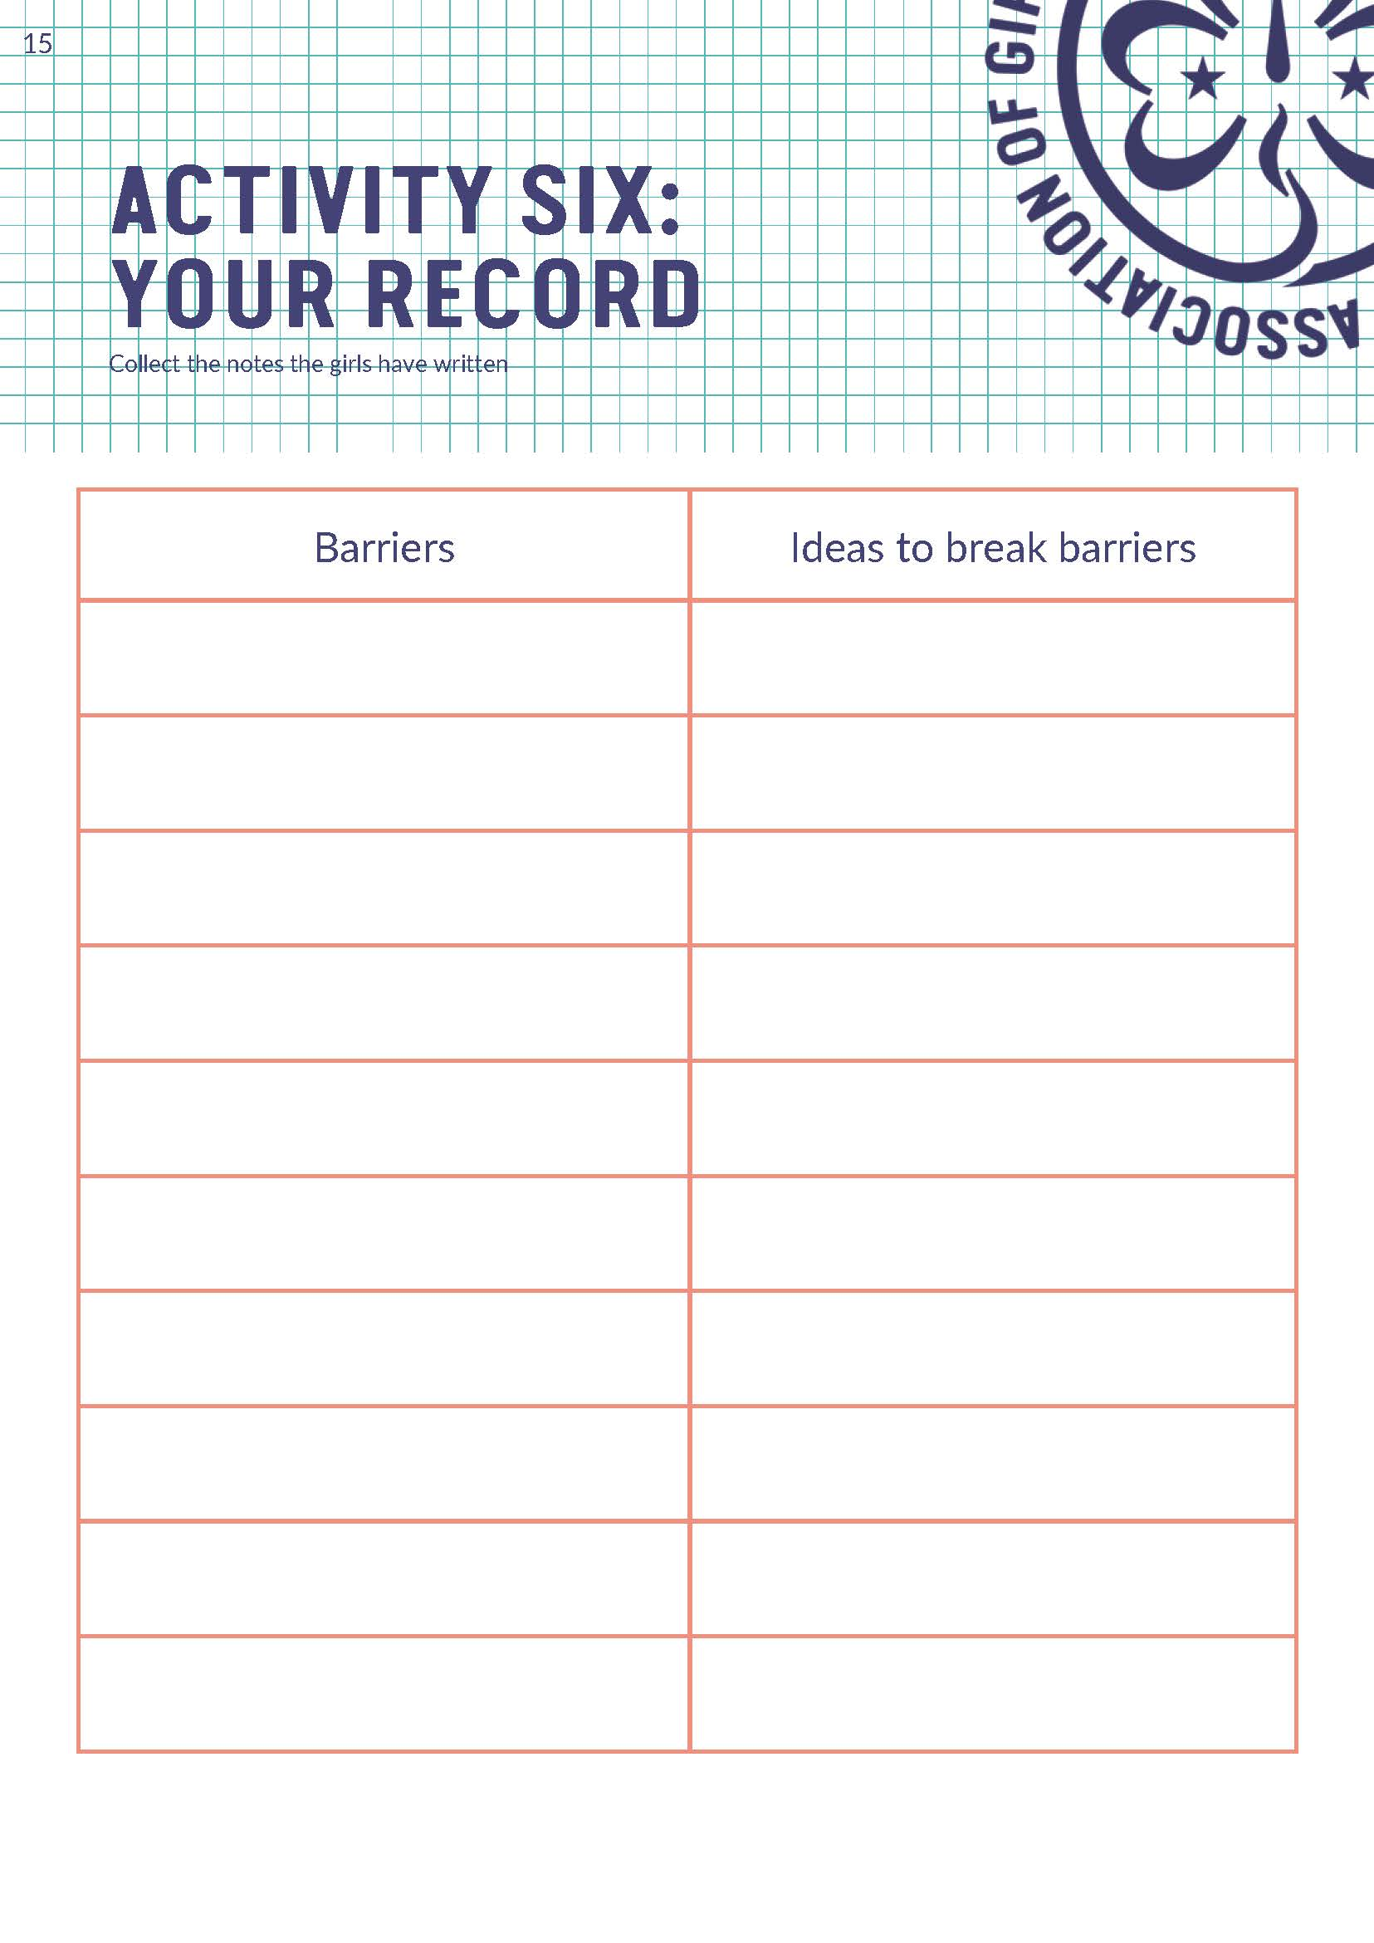
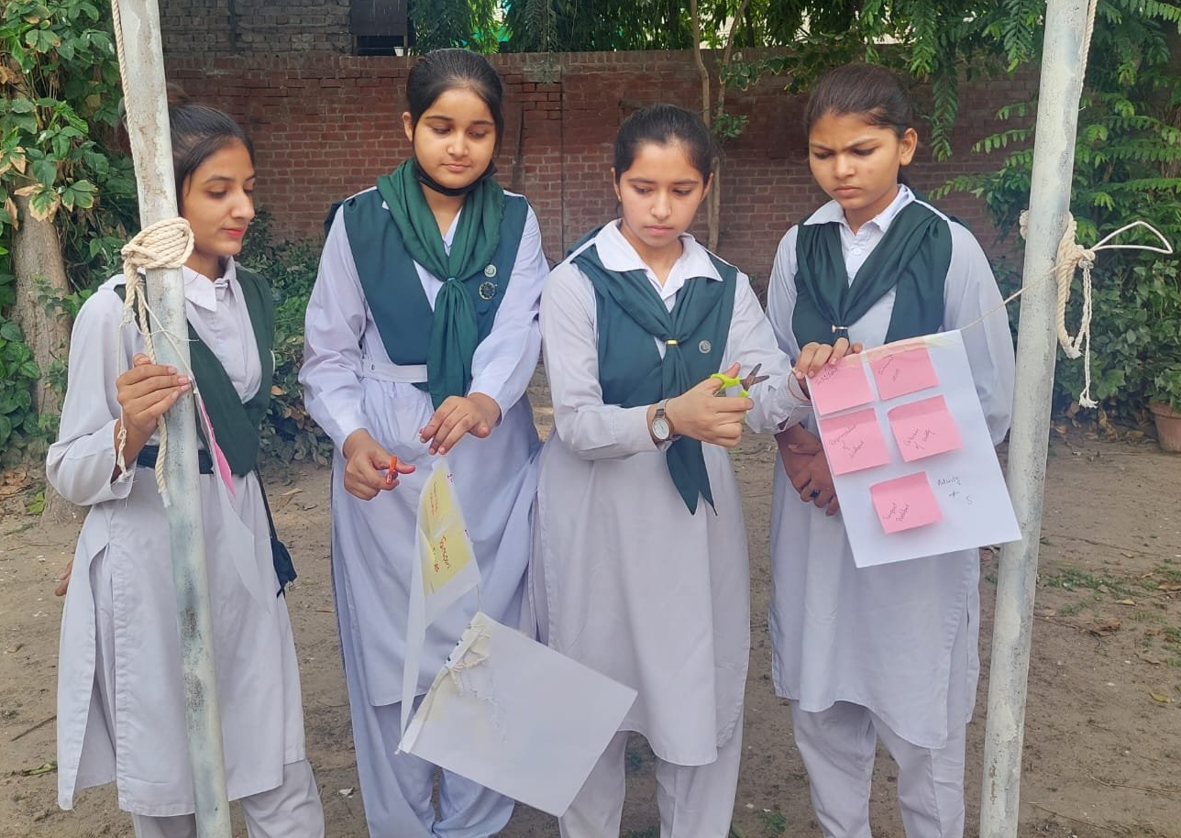
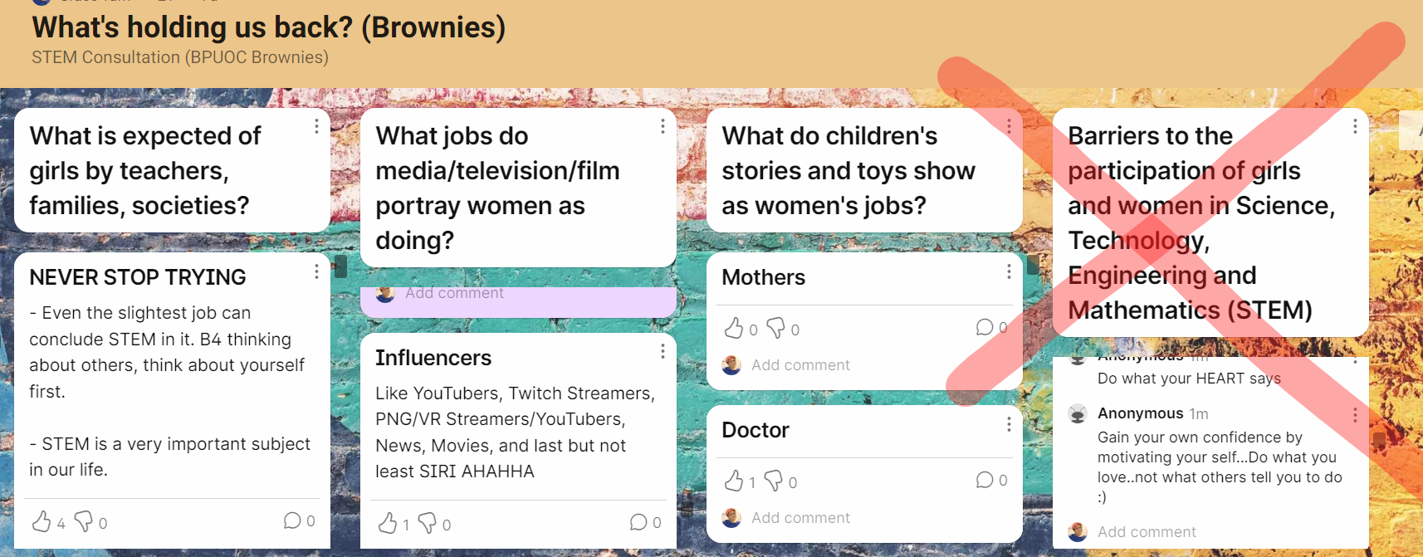
ACTIVITY 6: BREAK DOWN THE BARRIERS
Continue using the method from Activity 5
Add on ideas on breaking the barriers to each of the barriers listed

Slide 20
ACTIVITY 6: BREAK DOWN THE BARRIERS
CUT THE STRING!
Additional step if resources permit – BREAKING THE BARRIERS
Place the list of jobs from activity 3 or 4 at one side of the venue
Girls stand here after putting all the ideas to the barriers on the string. Ask them to run to the list of jobs after the cut the string (barriers) with scissors.
String with barriers and ideas to break the barriers

Slide 21
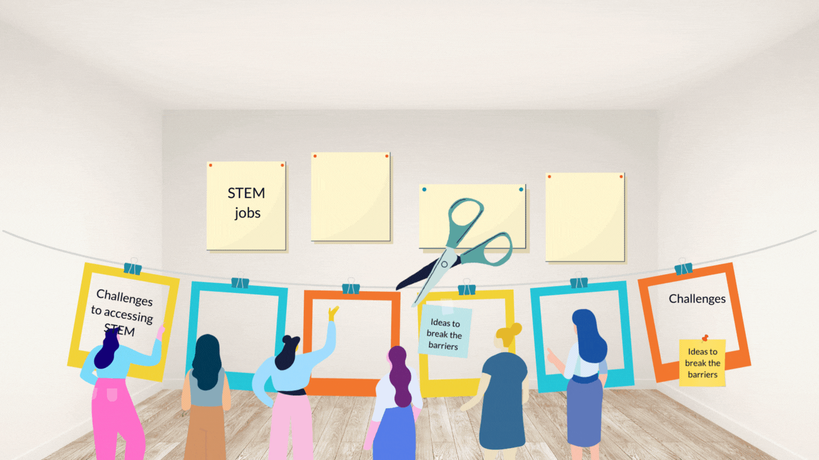
ACTIVITY 6: BREAK DOWN THE BARRIERS
ACTIVITY 6: BREAK DOWN THE BARRIERS
Additional step if resources permit – BREAKING THE BARRIERS
Additional step if resources permit – BREAKING THE BARRIERS

Slide 22
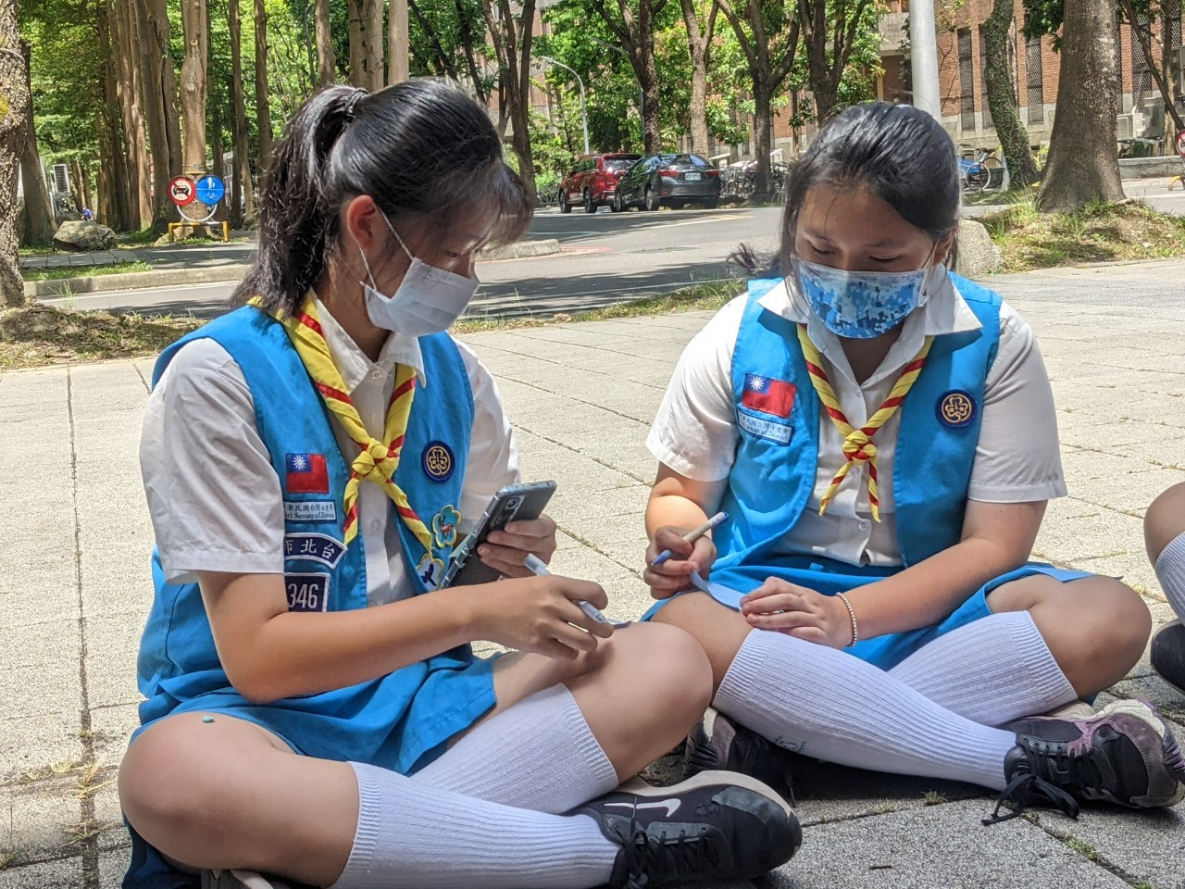
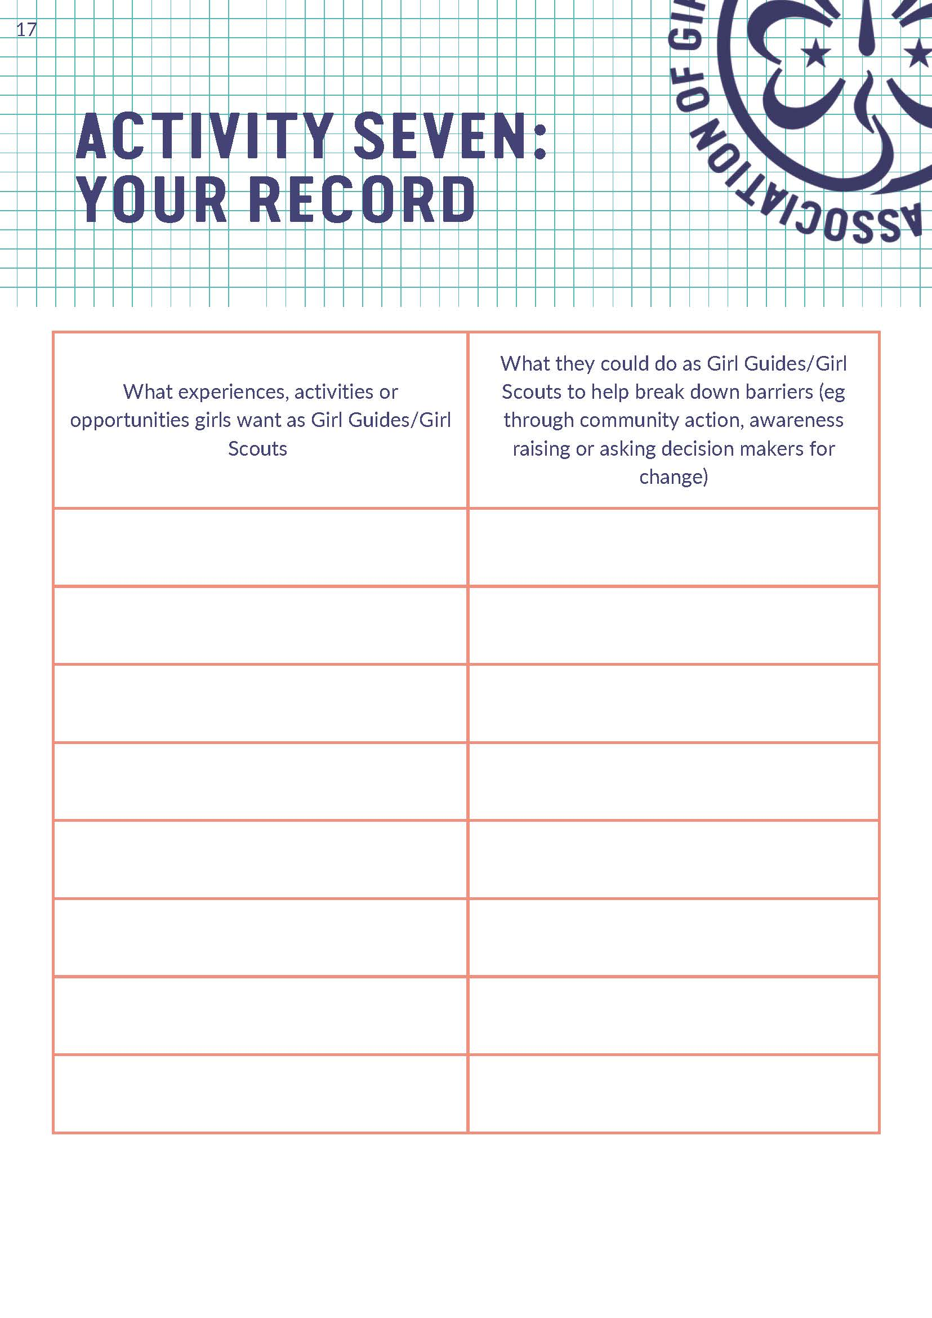
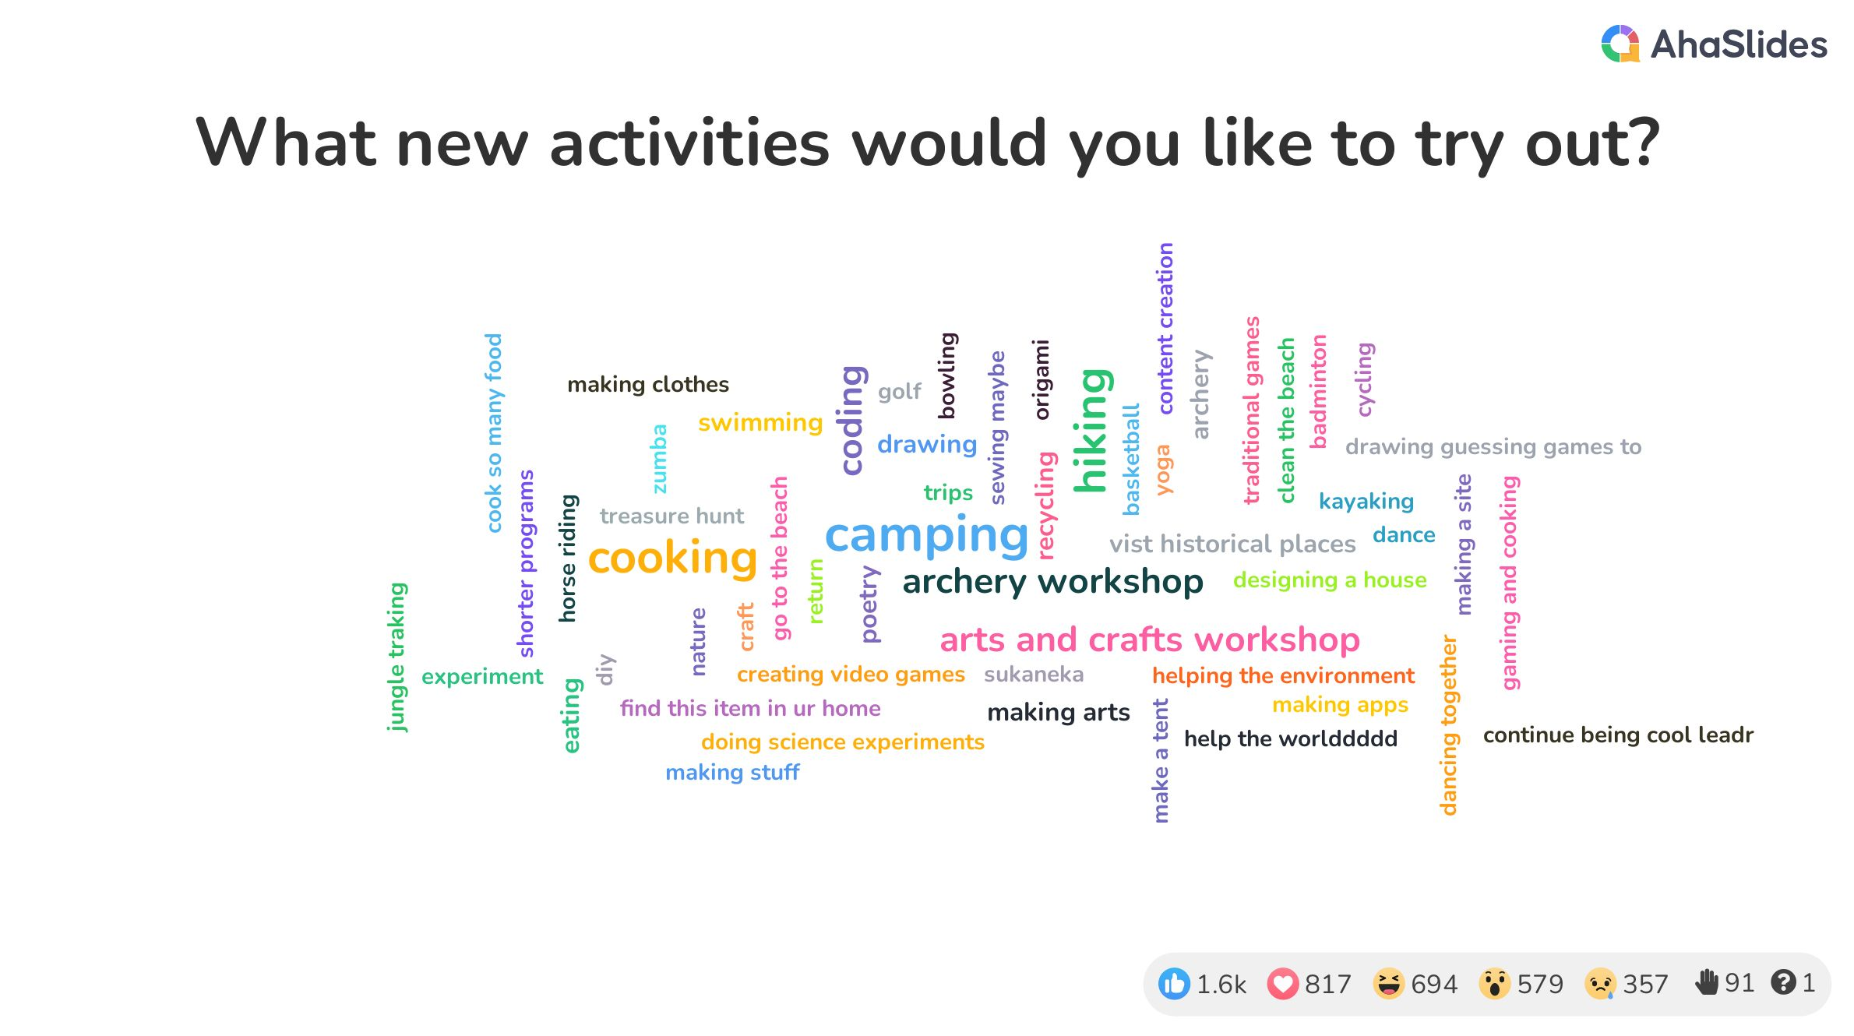
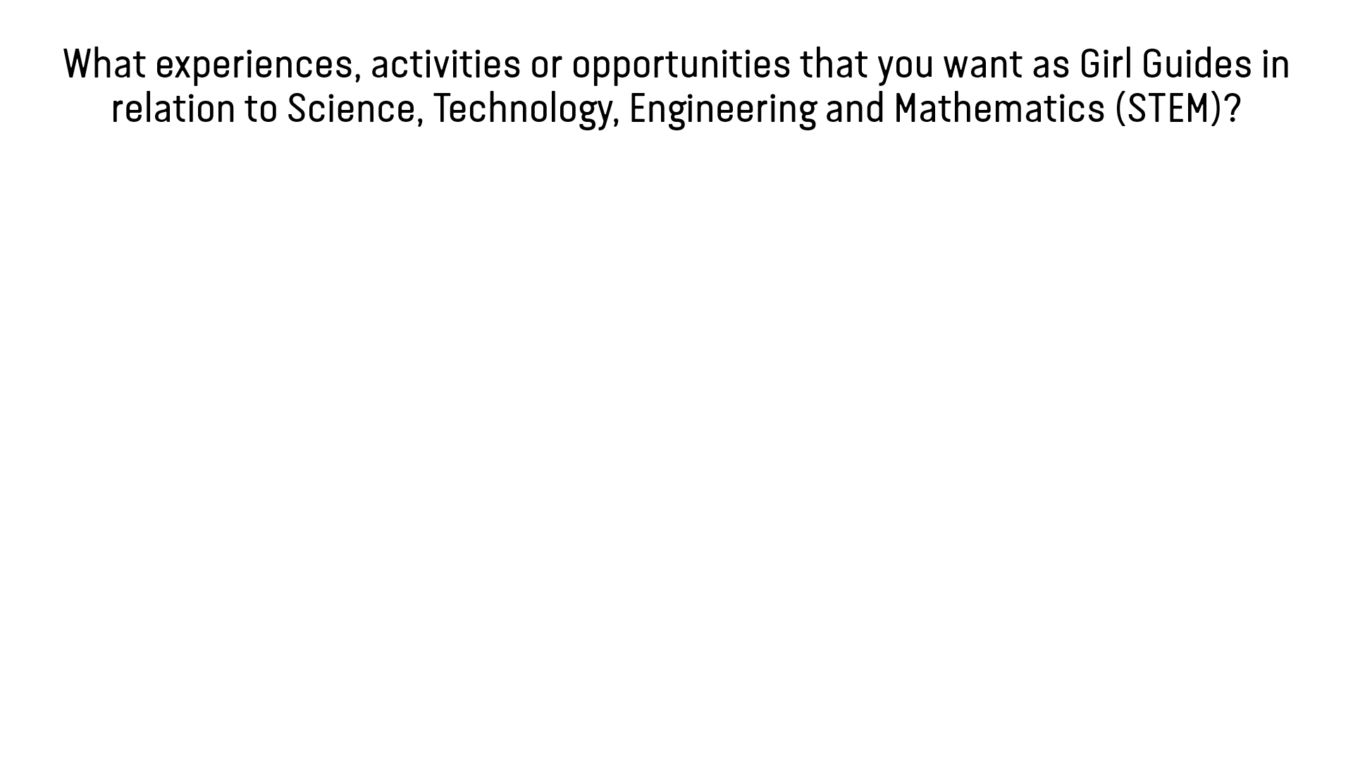
ACTIVITY 7: WHAT COULD WE DO?
Step1: Discuss what they already experienced in Girl Guiding/Girl Scouting that can help develop STEM interests and skills, what would they like to keep doing, what new activities they would like to try out

Slide 23
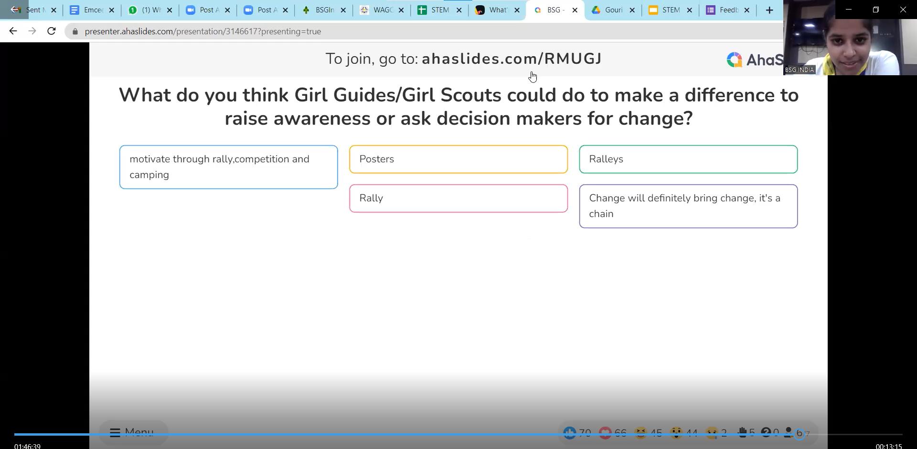
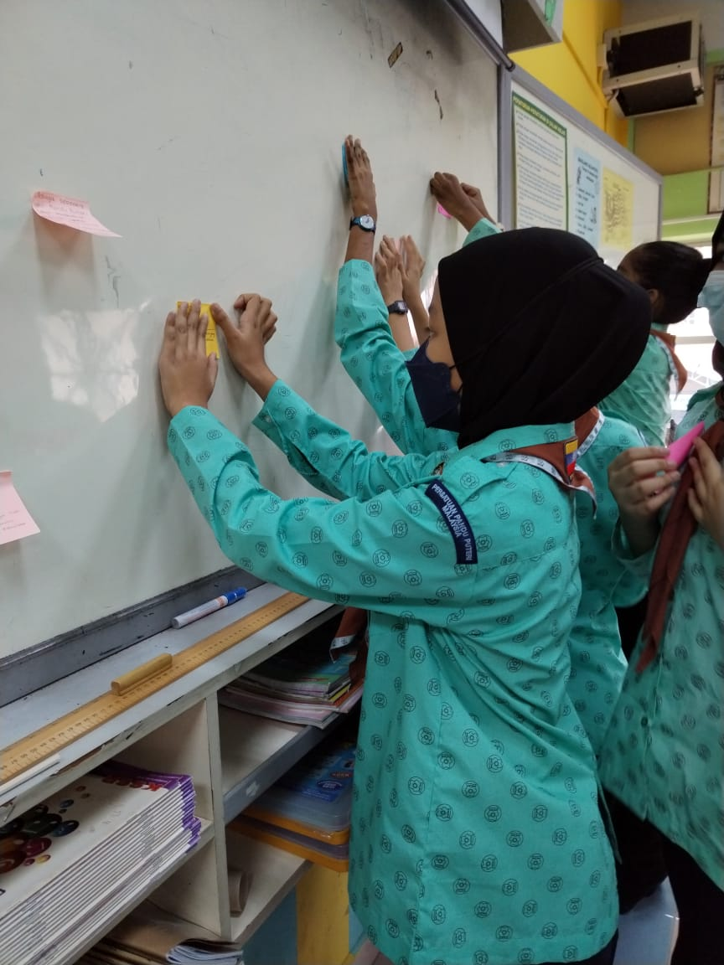
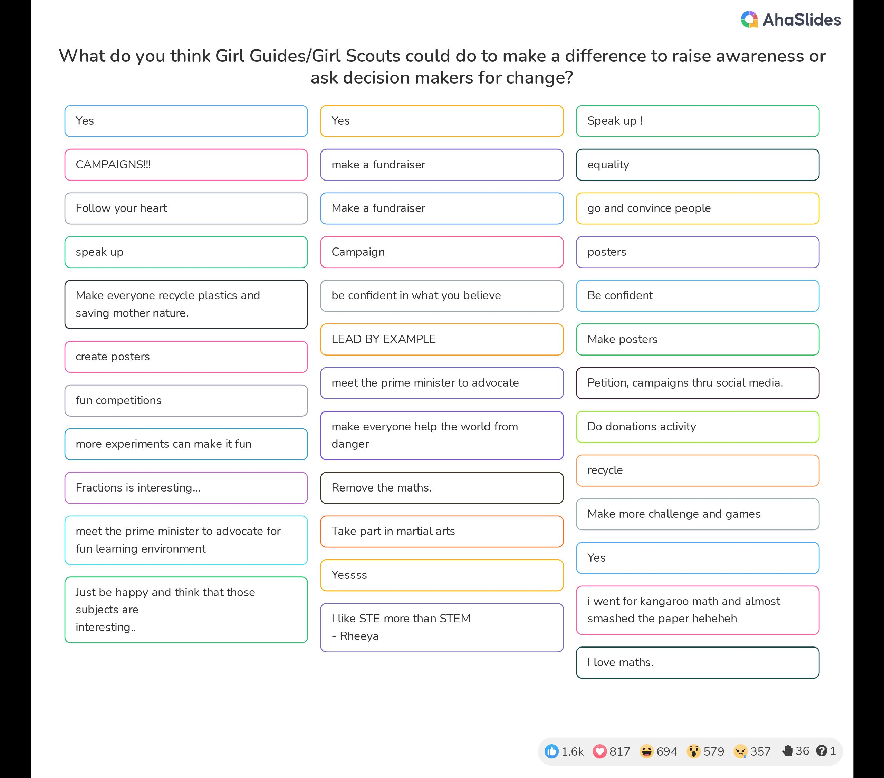

ACTIVITY 7: WHAT COULD WE DO?
Step2: Discuss what they think Girl Guides/Girl Scouts can do to help break the barriers that prevent girls and young women from participating in STEM in their country/community

Slide 24
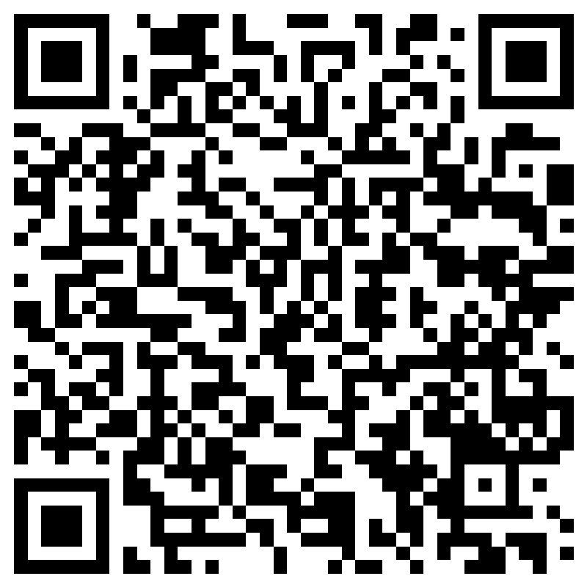
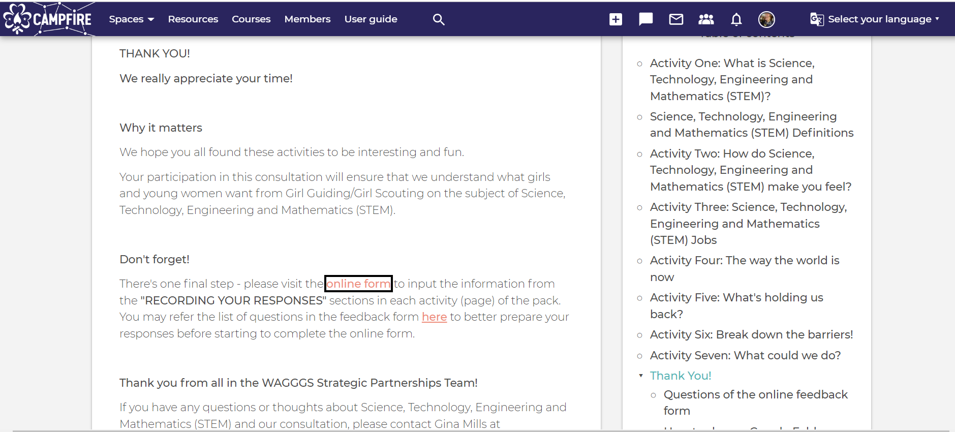
After activities – ONLINE FEEDBACK FORM
https://forms.office.com/r/6MhMBXF3qT

Slide 25
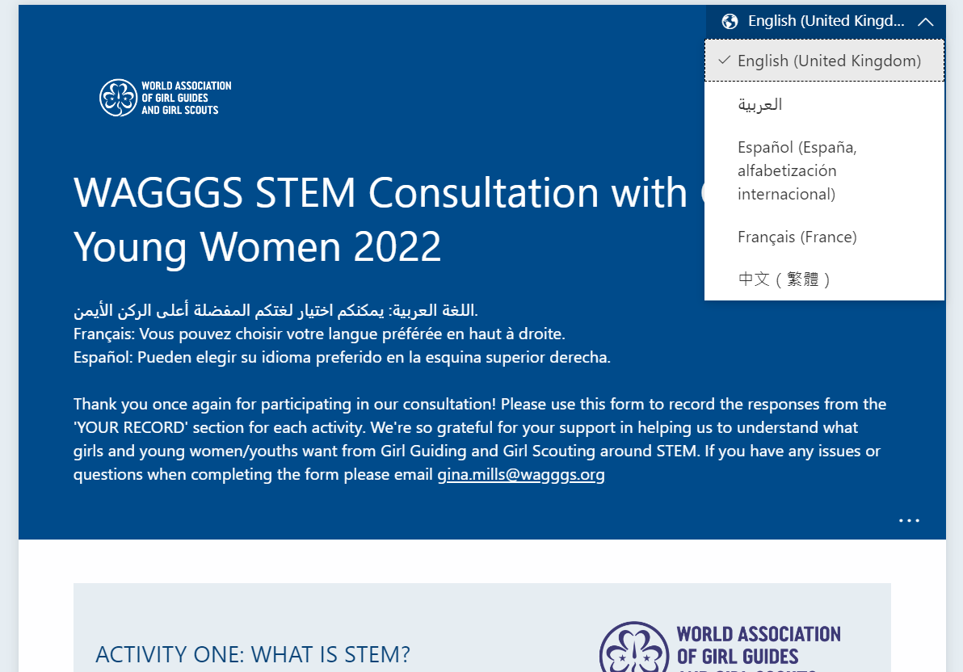
After activities – ONLINE FEEDBACK FORM
https://forms.office.com/r/6MhMBXF3qT
Copy of questions available as reference before you start filling up online
Select preferred language to input your responses (WAGGGS official languages)
If your Member Organisation thinks it will be more helpful for your leaders to read the form in your local language, please discuss with Grace. You will need to provide the translations for the feedback form for us to key in the questions to the form in your language
We can accept responses in languages that can be translated by Google/online

Slide 26
Tips
Use common sense and decide the best way to get responses from your group
You don’t have to follow the activity steps 100%. It is OK as long as you are able to get responses to each of the questions
Remember to record these too:
  number of participants (girls and/or boys)
  lowest age in the group
  highest age in the group
  where your audience comes from (city/rural/both)
Photo/video sharing – please upload to a cloud server (Google Drive, OneDrive, Dropbox, iCloud, WeTransfer etc) and paste the link in the online feedback form. Make sure it is set to “anyone can view or edit” to enable WAGGGS to access. (Please obtain photo/video permission from the parents of participants under 18 years old as you will be signing the consent to WAGGGS on behalf of them)

Slide 27


CERTIFICATES
SAMPLE!

Slide 28
How can we support you?
Provide design copies of the materials and social media graphics if you wish to use in your own language
Enable option of your local language in the online feedback form for leaders (Provided the language option is available in Microsoft Forms. You will need to provide the translation for us to input)
We can accept responses in languages that can be translated by Google/online
Provide this presentation for you to use with your leaders
Train your leaders to conduct the consultation activities (if necessary)
TELL US WHAT ELSE YOU NEED TO RUN THIS CONSULTATION LOCALLY - HELP US TO HELP YOU!

Slide 29

How will we use the data
Global report
Reference for developing global programming on STEM
Funding proposals
Position statements
Advocacy campaigns
Member Organisations can also use the data you collected locally through the consultation with girls and young women!

Slide 30
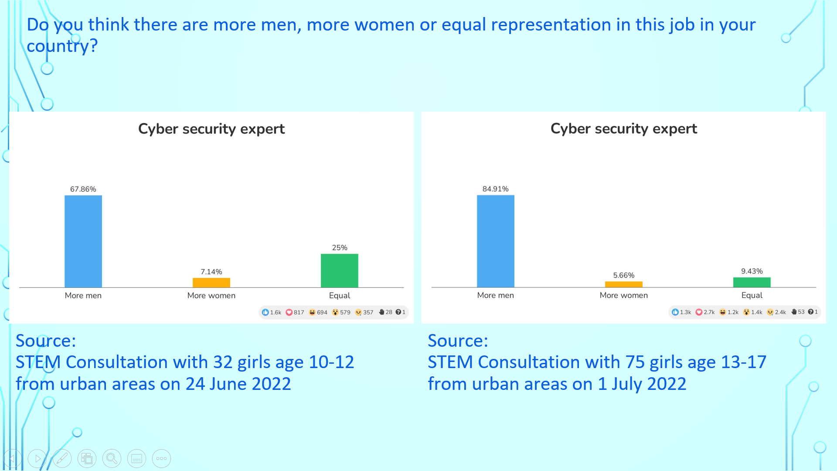
Example from Girl Guides Association Malaysia in a presentation to donor – make your case stronger!

Slide 31


Slide 32

SAVE THE DATE – EVERYONE’S INVITED!
Session 1
Date: 22 October 2022 (Saturday)
Time: 13:00-15:00 UTC
Session 2
Date: 6 November 2022 (Sunday)
Time: 08:00-10:00 UTC
Zoom Webinar and live streaming to YouTube – certificates available for all (with submission of online feedback form)
Support us to reach out and engage more
How can we have a large audience from your MO?
Do you have any speakers to recommend – Girl Guide/Girl Scout or alumni in STEM and/or youth/girl speakers

Slide 33

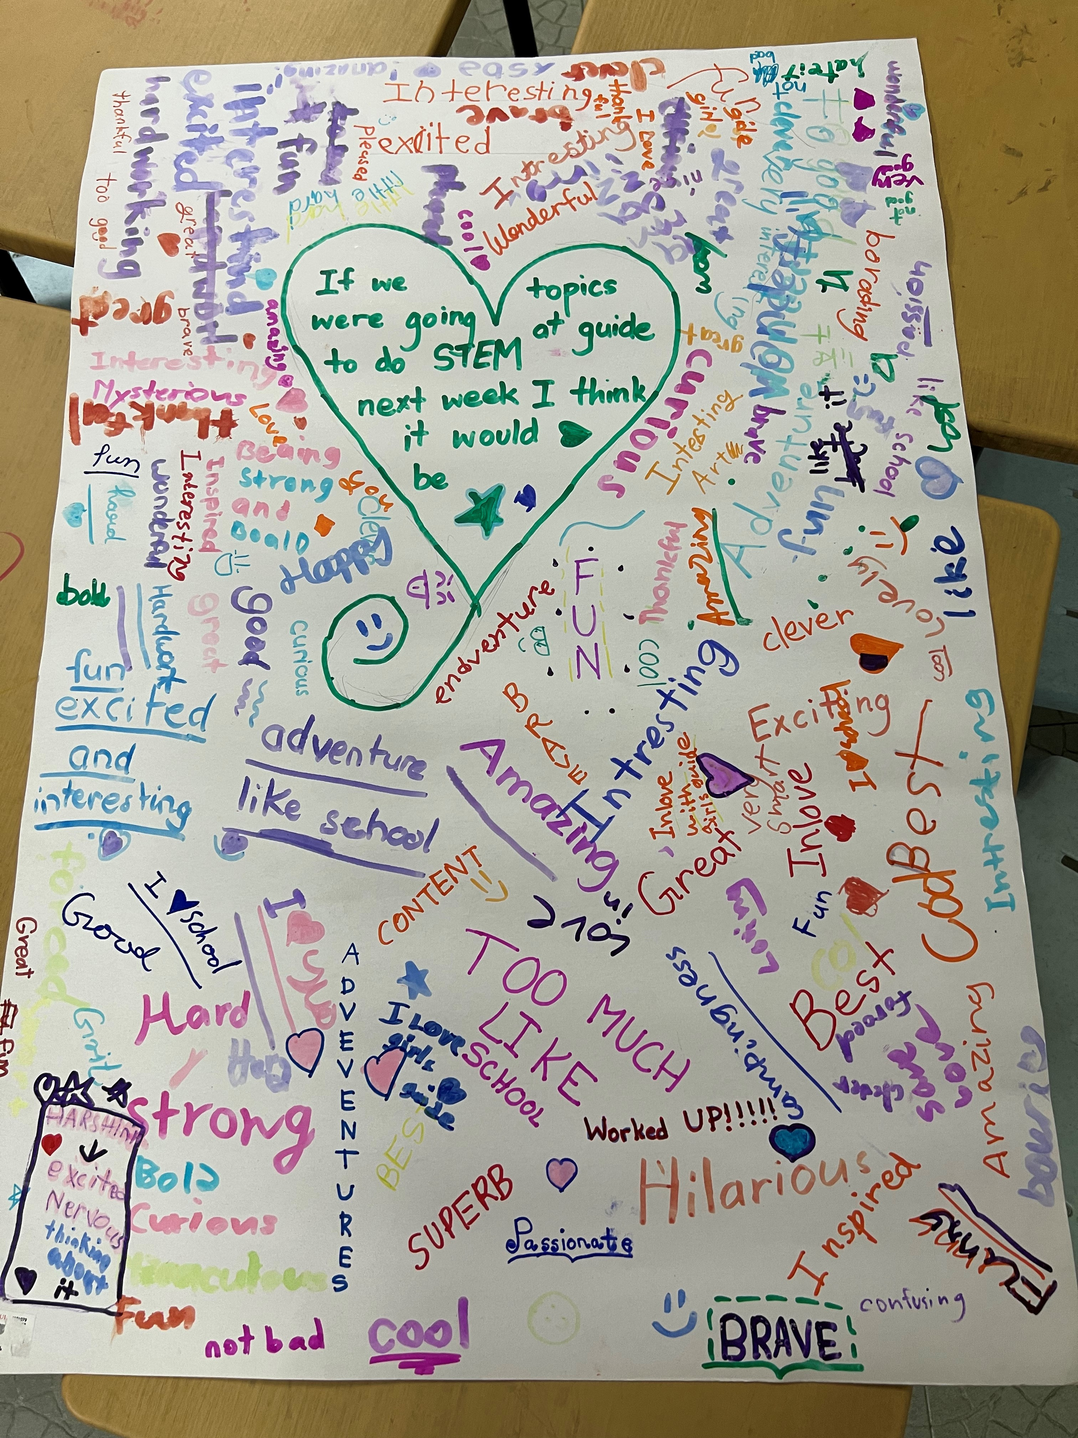

Slide 34
Questions?

Slide 35
© 2020 - WAGGGS
Notes:
Download presentation and toolkit https://bit.ly/3hGrre8

