Slide 1


Slide 2

Woo-hoo! You did it! 🎉🥳💥

Slide 3

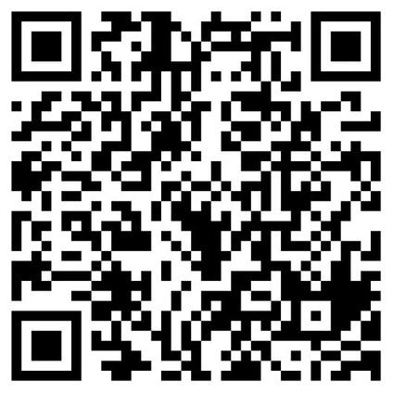
Let's be friends!
https://ahaslides.com/NPMJJ

Slide 4
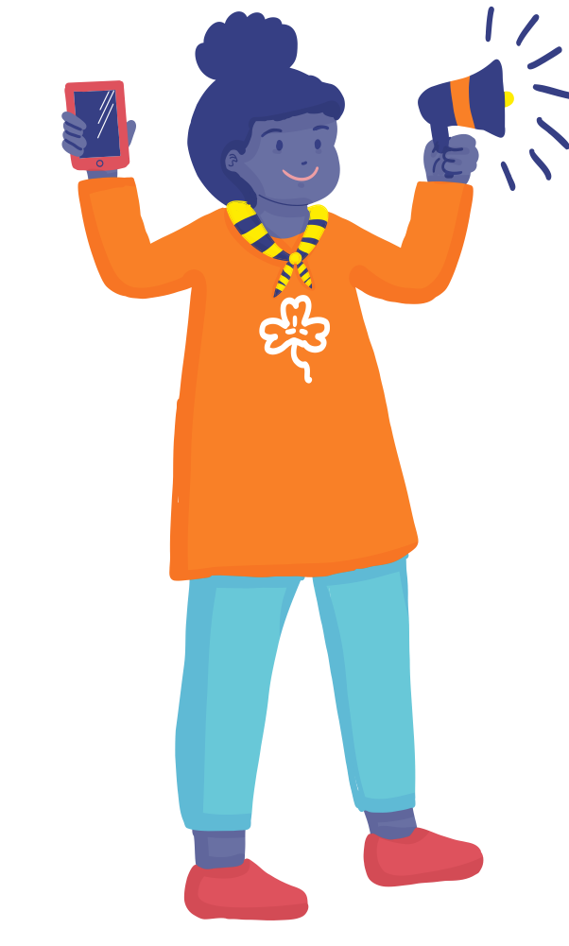
Why am I here?: My responsibilities
  Act as Advocacy Champions/Smart Surfers
  Connect and build relationships with decision-makers with decision-makers
  Represent your MO and speak at national, regional, and global events
  Regularly report the success of the campaign with the MO and WAGGGS.
  Write blogs/make video documentaries
  Act as an “Advocacy Mentor”

Slide 5
Get ready to create a space that's bold and free - a Brave Space!

Slide 6
Be Punctual
Mute your Microphone
Use Video Wisely
Respect Others
Raise Your Hand
Chat Etiquette
Privacy and Security
Do not share meeting links or passwords publicly

Slide 7
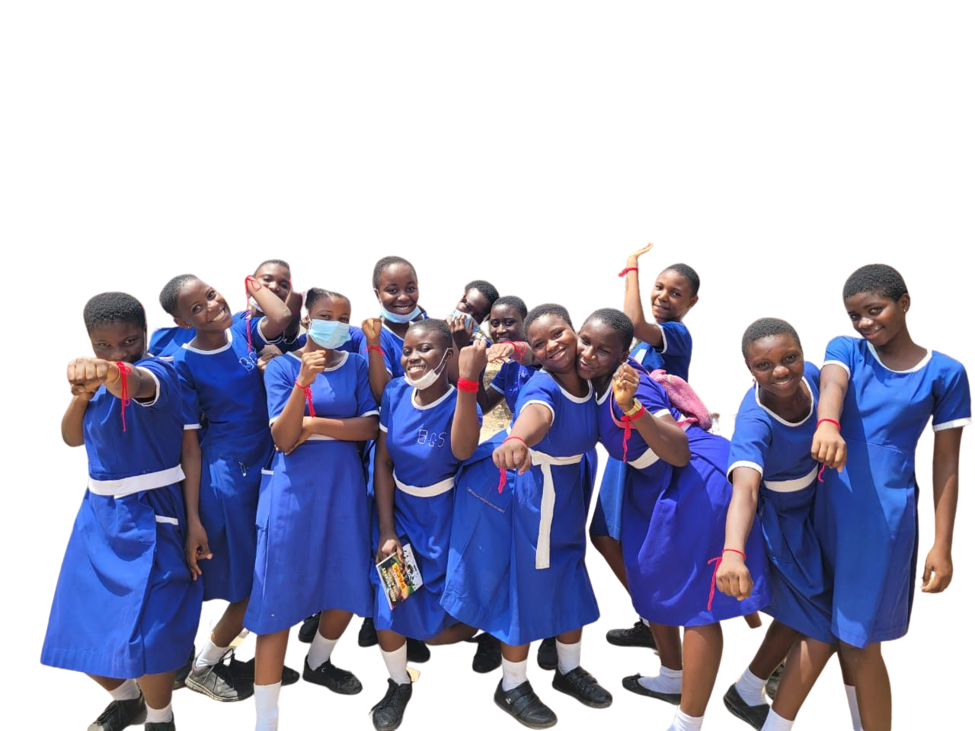
QNA’s Surf Smart Programme
When did the Surf Smart Programme begin?

Slide 8
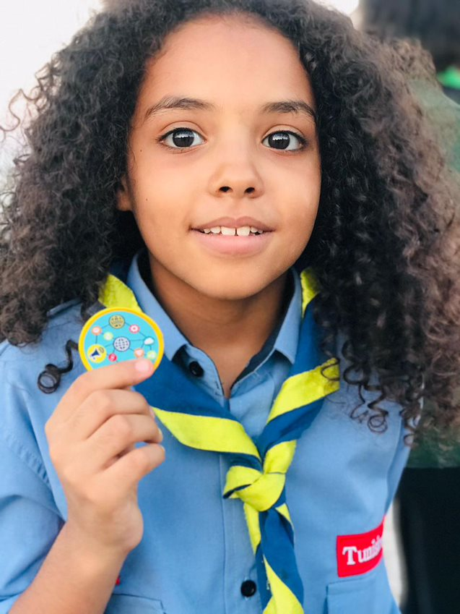



WAGGGS and Norton
Our Partnership
surf
smart
2.0
GENERATION
DIGITAL
We have been working together since 2011
Our shared vision:
To inform young people about how to connect positively online, protect themselves from online threats and respect their rights and reputation on the internet.

Slide 9
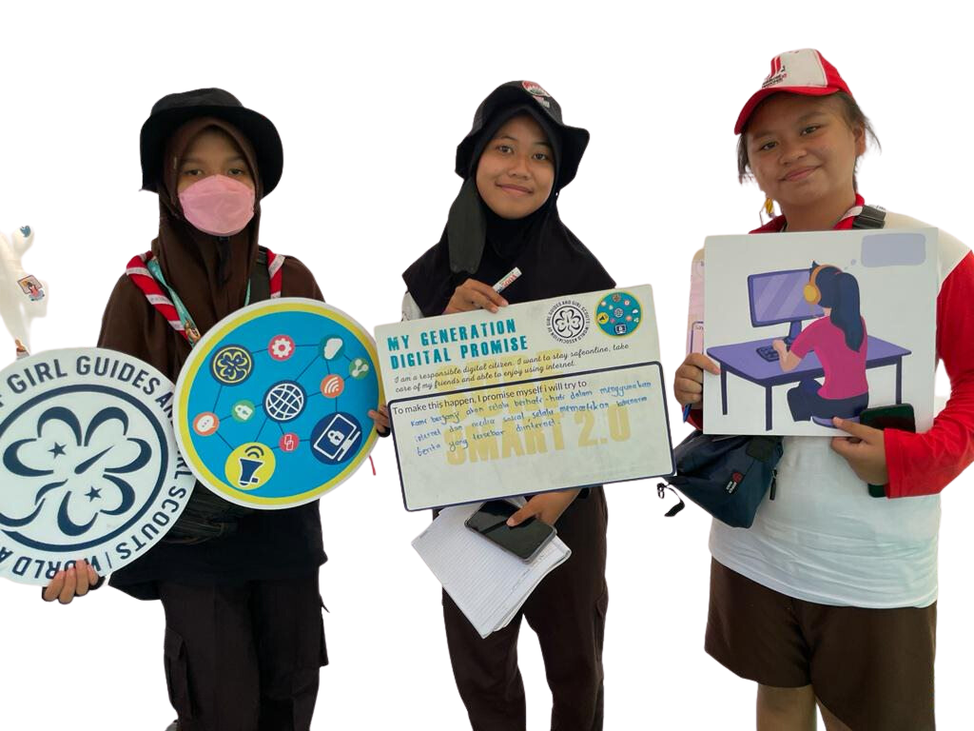
Guess How Many?
How many lives has Surf Smart Programme Reached?
How many countries are involved in Surf Smart Programme?
How many languages is Surf Smart Programme available?

Slide 10

More than 600,000 reached across
5 continents
SURF SMART JOURNEY
More than 44 countries globally are involved in the program
Surf Smart Curriculum is available in all 4 WAGGGS languages
Notes:
9

Slide 11





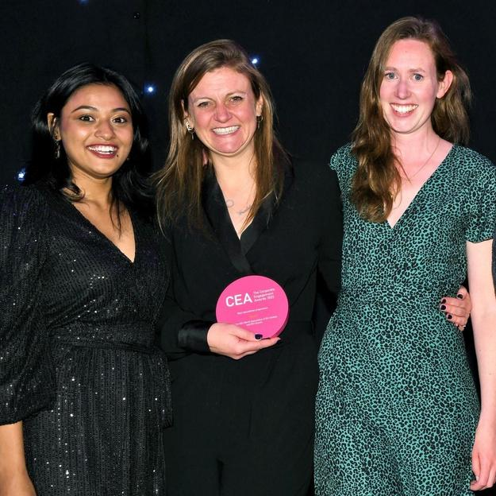
Best Educational Programme Award

Slide 12

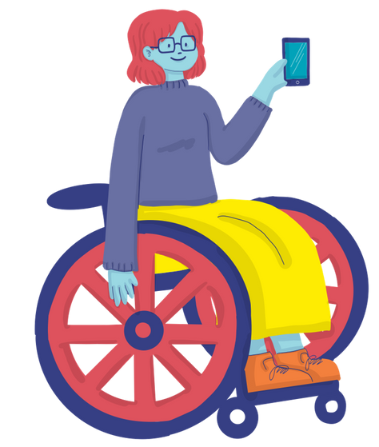
Guess How many?
How many girls and young women will be engaged in SS Advocacy Fund?

Slide 13
Over 200 girls and young women in 12 countries as “Smart Surfers” until 2024.

Slide 14
How many projects per country/member organizations (MO) will be funded by WAGGGS?

Slide 15
Number of projects: 2 advocacy projects per member organizations

Slide 16
What are the kinds of projects will get funded?

Slide 17
Surf Smart Advocacy Fund
  Project with SMART advocacy objectives
  Help make the internet a better place in any area of girls' and young women’s interest.
  This includes but is not limited to safety, inclusivity, accessibility, affordability, and overall positivity on the internet.

Slide 18

Key information
Size of fund available: £400-600 per project
Time frame: The first round of project began in June 2023 onwards and must be completed by March 2024

Slide 19
Why should we care about the internet?

Slide 20

Did you know?
60% of the global population have access to the internet
More than 175,000 children go online for the first time every day
People spend two and a half hours each day online

Slide 21
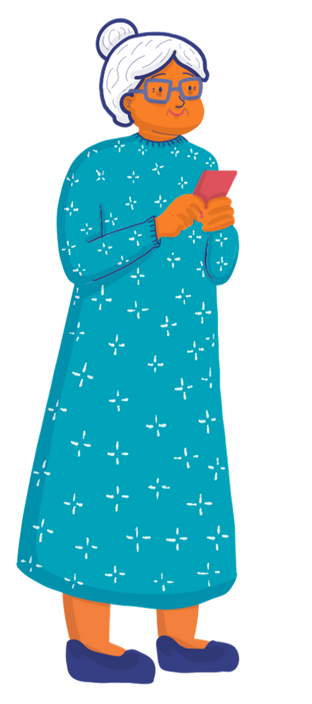
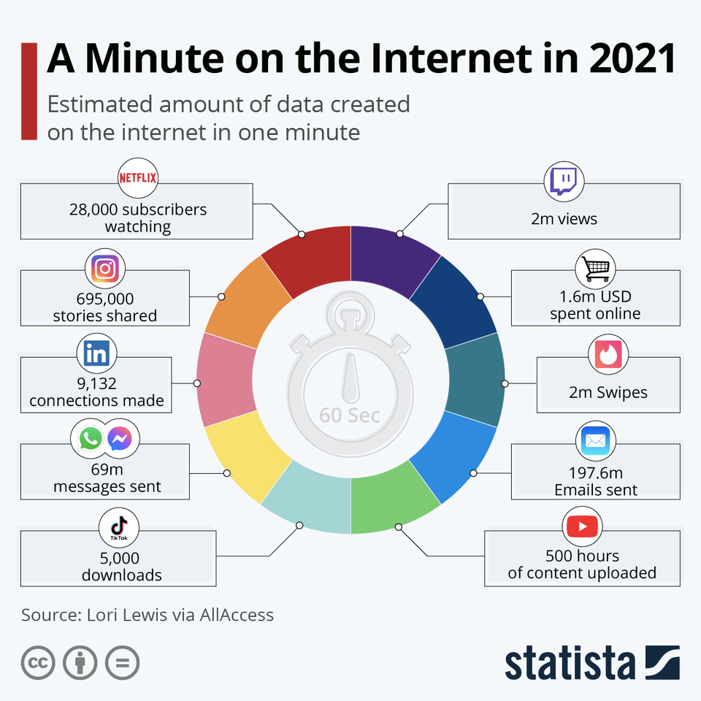
https://www.statista.com/chart/25443/estimated-amount-of-data-created-on-the-internet-in-one-minute/

Slide 22
Pros and Benefits
The gaps and challenges have increased especially after COVID-19
Technology is Good News
There are Risks, Challenges and Gaps

Slide 23
Challenges and Gaps
Fake News and Conspiracy Theories
Expensive, Inaccessible, Unequal, biased and not inclusive
Online abuse and violence

Slide 24
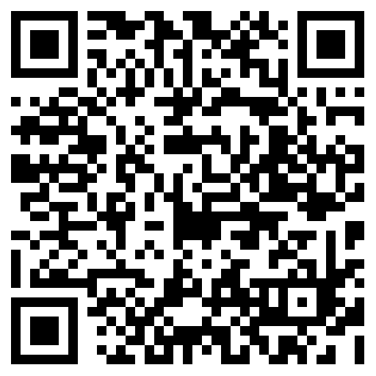
What is Advocacy?
https://ahaslides.com/3QXUF

Slide 25




Important point
“For WAGGGS, Advocacy means”
Influence
people
To
take actions
That will improve our lives and the lives of the others

Slide 26

Why should GG&GS Speak out?
  WAGGGS was born through Advocacy.
  To achieve WAGGGS’s mission.
  Powerful medium to achieve necessary changes.
  If not us, who else?

Slide 27
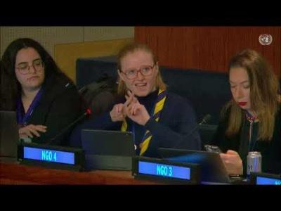
How does WAGGGS do Advocacy?
Globally:- Influence Laws/Policy

Slide 28
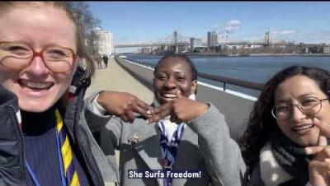
How does WAGGGS do Advocacy?
  High level speaking engagements
  Face to face with your leaders
  Addressing more than 500 decision makers in the room

Slide 29
Advocacy: National Level
  Organize advocacy projects/campaigns
  Lobby to the national policy makers for changes you want in policies and practices.

Slide 30
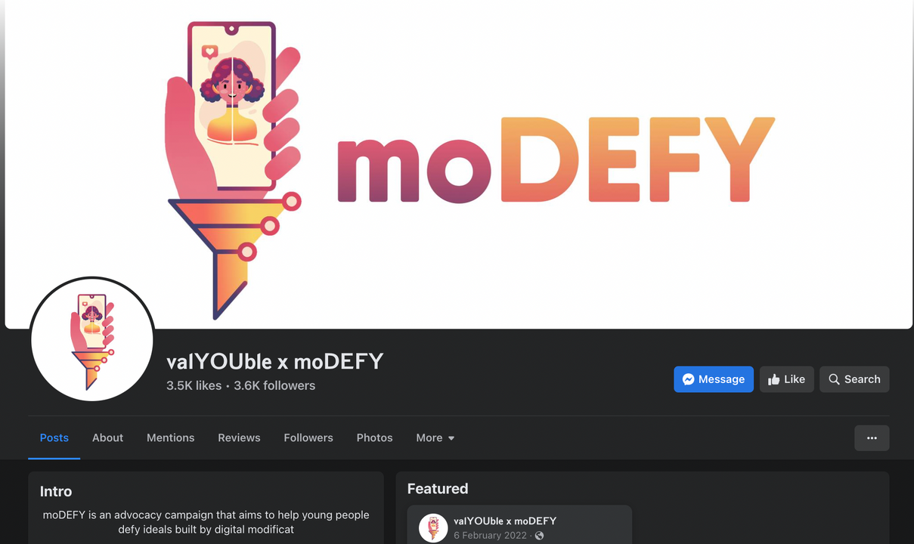
National Advocacy Example
Leader from Philippines led a digital campaign against body mortification.

Slide 31
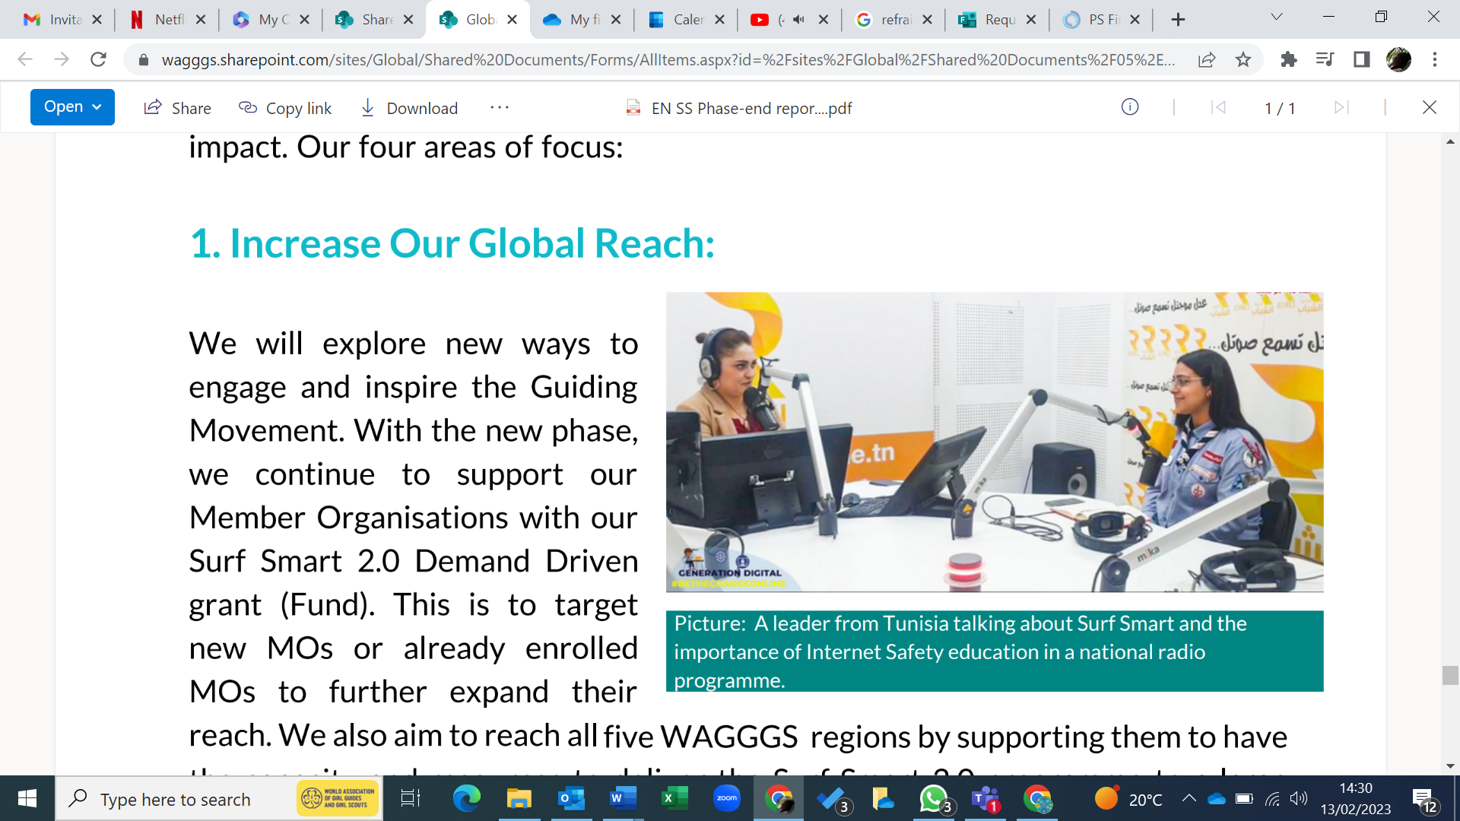
Advocacy for the policies to address cyberbullying and making the internet a safe space, especially for girls

Slide 32
Advocacy: Individual Level
There is a ripple effect:- Global, National, individual.

Slide 33
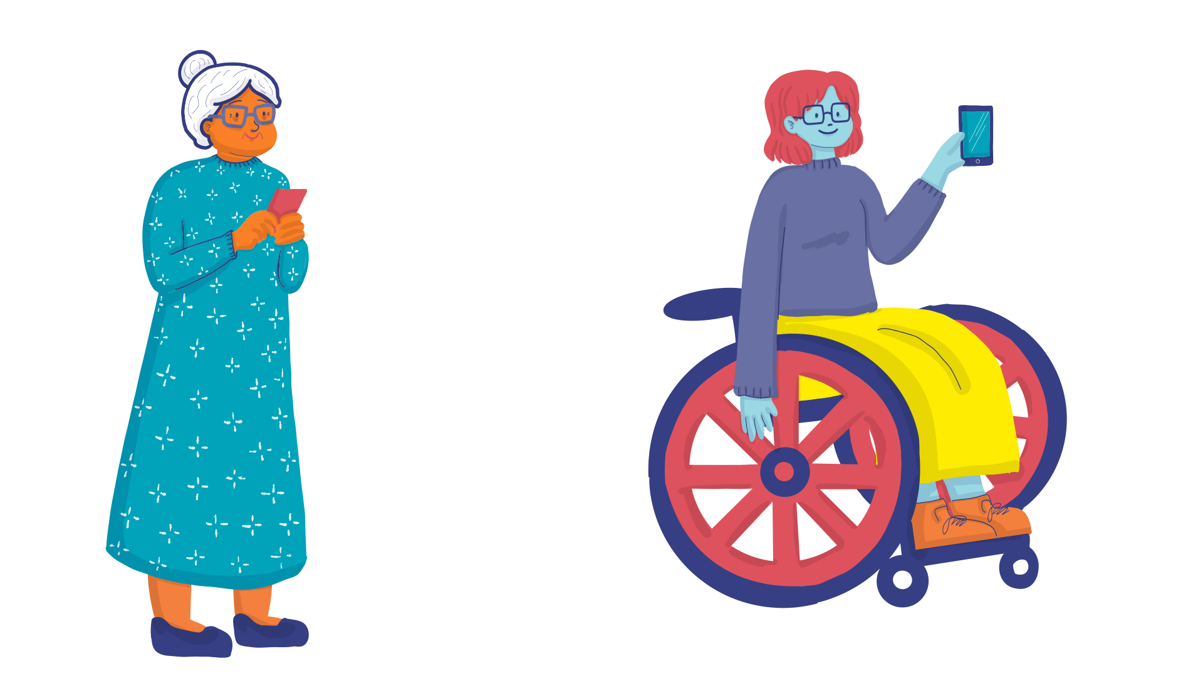
Can I really be an Advocate? : Myth Busting
Advocacy is NOT necessarily politically affiliated.
Advocacy is NOT only for professional lobbyist.
Advocacy is NOT about big and global projects.
Surf Smart Programme

Slide 34
Girl-Led Advocacy at WAGGGS
"Girl-led advocacy happens when girls are the ones choosing the issues they want to advocate on, defining the change they want to see and how to get there.”
Surf Smart Programme

Slide 35
Girls and young women like you take the reins of change in their own hands. Here's how:
✨ Create Your Own Advocacy Projects.
🌐 Choose Internet Issues That Matter to You.
📝 Craft Advocacy Action Plans and Budgets
💡Request Advocacy Funding: Reach out to your Member Organizations (MOs) and WAGGGS to secure the necessary funding for your projects.
🌍 Execute Advocacy Projects: Put your plans into action
Girl-led Advocacy at WAGGGS
Surf Smart Programme

Slide 36
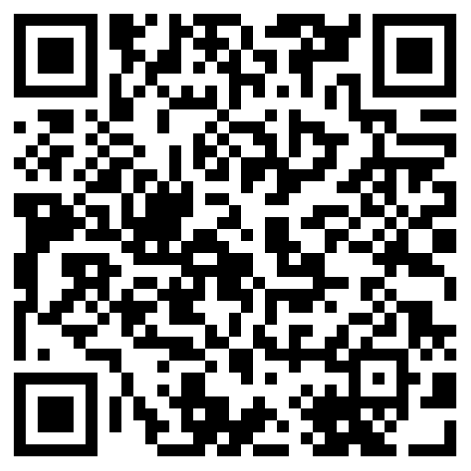
Advocacy,
Awareness raising, and Take action: Unlock the difference
https://ahaslides.com/D9UTY

Slide 37
COFFEE BREAK

Slide 38
Some Facts & Findings
  #SheSurfsFreedom
  CSW67: Innovation, Technology & Digital Education for gender equality: Expert Group Meeting Findings
  Safer Internet Day: February 2024

Slide 39
#SheSurfsFreedom
  WAGGGS’s theme of 16 days of activism against GBV of the year 2023
  WAGGGS’s #shesurfsfreedom survey report
  1000 G&YW from 70 countries participated in the survey
  The survey asked them about their experiences online and recommendations for freedom and equality in online spaces.

Slide 40
Facts from the Survey
  Two-thirds (66%) of the girls and women surveyed have seen and received sexual or violent content that made them feel uncomfortable.
  42% of girls have since changed their behavior online due to this.
  Over 30% have felt negative about themselves due to other people’s comments on their own or other people’s content.

Slide 41
Call to Action
  “We call on governments to create a clear legal framework to address online violence against women and girls. Specifically, adopt a comprehensive definition of technology-facilitated violence against women and girls.”

Slide 42
CSW67
  Priority Theme: Innovation and technological change, and education in the digital age for achieving gender equality and the empowerment of all women and girls

Slide 43
CSW67: Expert Group Meeting
  In 2022, it is estimated that 63% of women across the globe were using the Internet, compared to 69% of men.
  While this rate decreases to 30% in many developing countries and closer to 20% in Least Developed Countries (LDCs).
  Over 40% of countries studied had no meaningful policies or programs to expand women’s access to the Internet.
- Alliance for Affordable Internet (A4AI)’s Affordability Report.

Slide 44
Online gender-based violence (OGBV)
  OGBV can be understood as “any act of gender-based violence against women that is committed, assisted or aggravated in part or fully by the use of ICT, such as mobile phones, the Internet, social media platforms or email, against a woman because she is a woman, or which affects women disproportionately.”
  Source:- A/HRC/38/47, para 23

Slide 45

Break-out Room Question:
  What kinds of issues have you faced or seen in the digital world? If so, can you share your experiences?

Slide 46

Unlocked Global Opportunities for Smart Surfers

Slide 47
Safer Internet Day
  Celebrated on the 7th of February each year.
  Worldwide annual campaign promoting a safe digital environment for children and young people.
  Next year marks the 20th anniversary of Safer Internet Day.
  Connect via Website, Facebook

Slide 48

My Pledge
"I promise to do my best to be true to myself, to develop an advocacy project plan and implement them in my local, regional, national area, to work with my team and to always keep in mind the brave space rules."

Slide 49
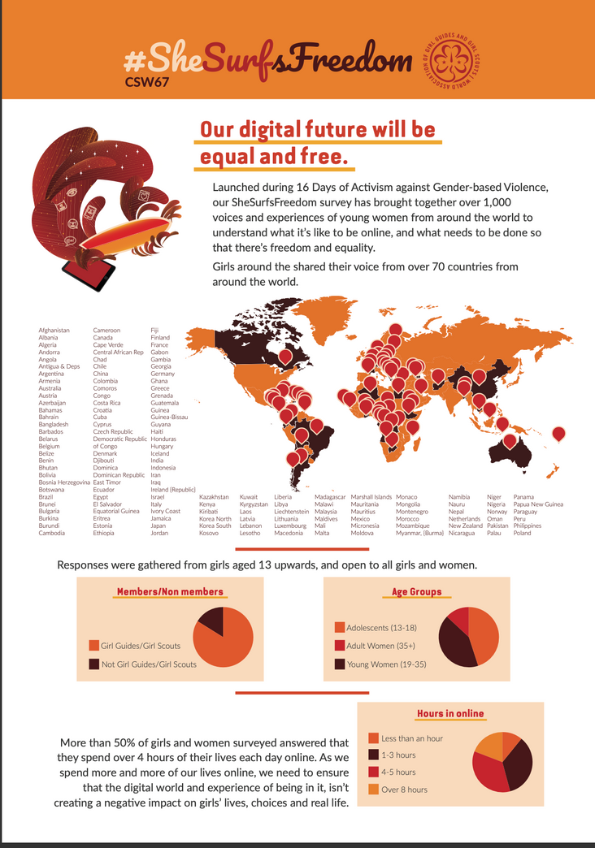
#SheSurfsFreedom: Reading Assignment

Slide 50


www.wagggs.org
@wagggsworld
World Association of Girl Guides & Girl Scouts.
World Bureau, Olave Centre, 12c Lyndhurst Road, London, NW3
SPQ, United Kingdom.

