Slide 1


Slide 2
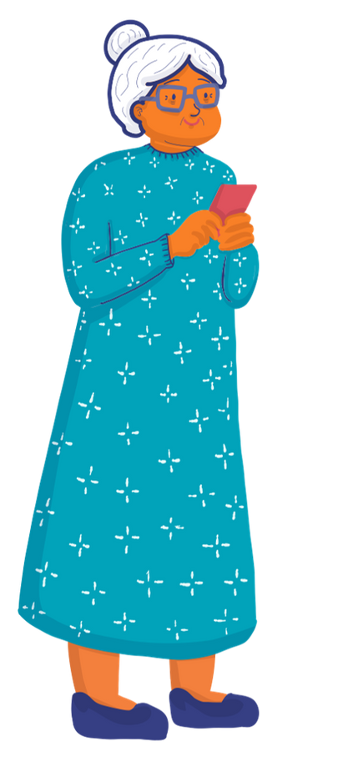
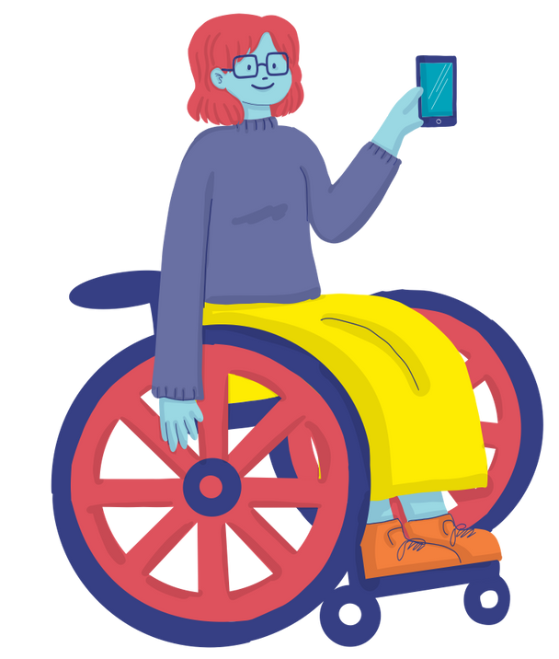
Ice Breaker Presents
This or That (...)…

Slide 3

Evaluation of ASSIGNMENT #Shesurfsfreedom

Slide 4
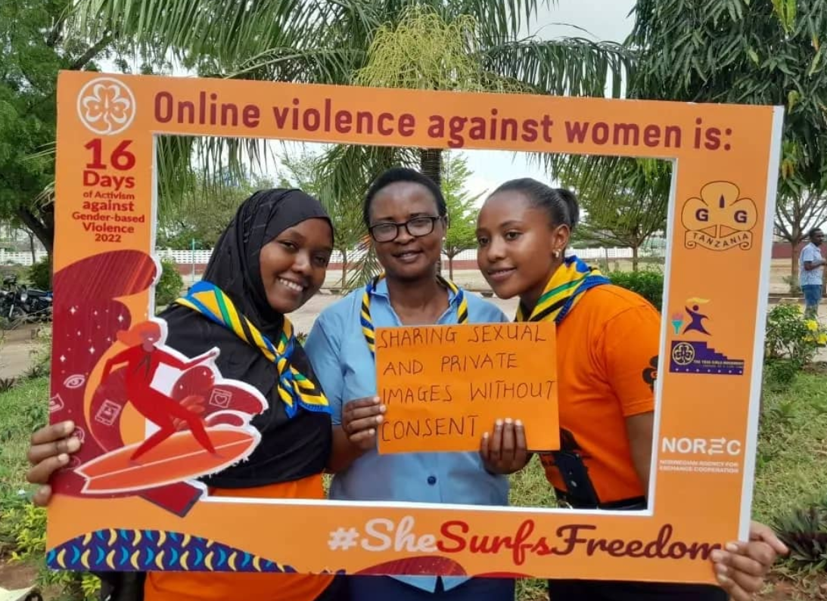
Assignment Discussion
#shesurfsfreedom
  What do you think about the impact of online gender-based violence on girls and women? (5 minutes)
Do you think governments should create laws specifically addressing online violence against women and girls? Why or why not? (5 minutes)

Slide 5

Forms of Advocacy

Slide 6
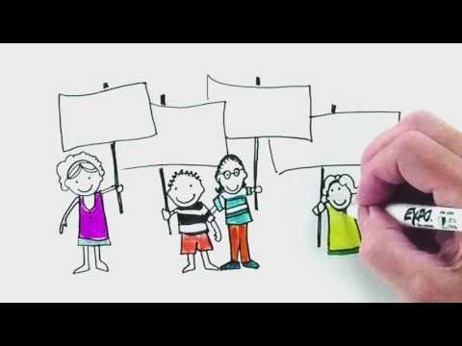
Understanding Advocacy and Action

Slide 7
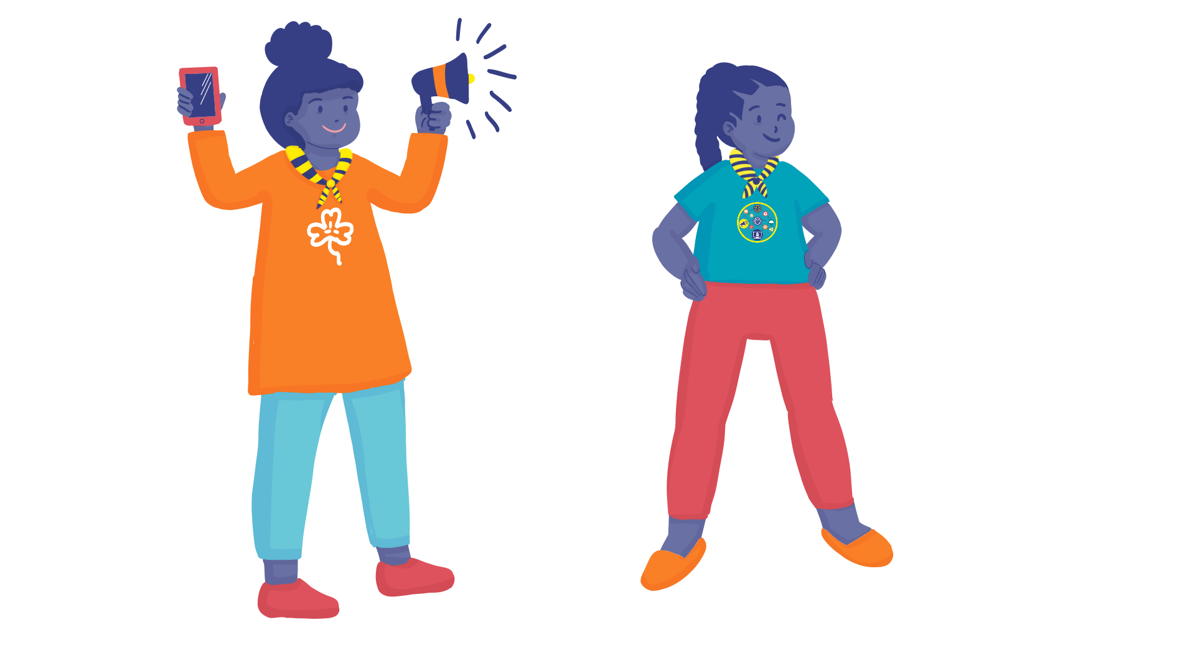
Definition
  Advocacy can be defined as an activity of speaking out and taking action by an individual or group which aims to influence those in the position of power.
  For example, change policies or regulations, implement a measure, allocate funding, provide support.
Surf Smart Programme

Slide 8


Advocacy can grow from small beginnings.
Start small but dare to dream big!

Slide 9
Difference between Awareness Raising and Advocacy
Awareness Raising | Advocacy
Awareness raising is aimed at changing knowledge and behaviour at the individual level. | Advocacy is aimed at mobilising collective action, promoting policy, practice or legislative change.
It is not necessarily targeted at those in positions of power. | It is always targeted at those in positions of power, for example Member of Parliament, school headteacher, city mayor, etc.
Awareness raising may be an important part of your advocacy initiative, but it is not an advocacy activity on its own.

Slide 10

Read the statements below and decide whether
they describe advocacy or awareness raising.
10 minutes Break-Out Room

Slide 11

Read the statements below and decide whether
they describe advocacy or awareness raising.
1. Holding a meeting with community leaders and elders about why the practice of female genital mutilation (FGM) should be stopped.
2. Presenting the findings of the survey on cyber bullying at the school assembly.
3. Holding a rally to call for integration of digital literacy in school curriculum.
4. Writing a letter to the headteacher demanding computers in your school.
5. Distributing fliers with information on new legislation on the internet regulation.

Slide 12
Answers
1. Advocacy,
2. Awareness raising,
3. Advocacy,
4. Advocacy,
5. Awareness raising

Slide 13
Types of Advocacy
Read the statements below and decide whether
they describe advocacy or awareness raising.
10 minutes Break-Out Room

Slide 14
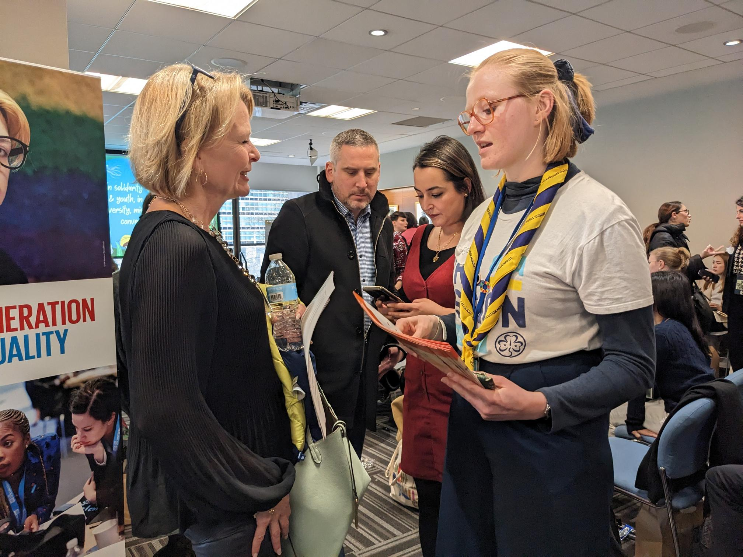
Types of Advocacy
1. Lobbying
2. Campaigning
3. Digital Campaigning
4. Building Alliances

Slide 15

Guess What?
Kenya Girl Guides achieved something incredible! They convinced the Ministry of Education in Kisumu to include lessons about gender-based violence in schools. UN Women stepped in with extra funds to support their efforts. And that's not all – the Girl Guides created an electrifying policy brief, highlighting the challenges in implementing laws against violence on women and girls. They boldly presented it to the finding to the government and shared it with the media, igniting a wave of excitement and awareness! 🌟🚀👏

Slide 16

Lobbying
Lobbying, or direct attempt to influence decision-makers, is typically done when working with governments to change policies, laws, actions or practices in favour of your advocacy objective.

Slide 17
Guess What?
Kenya Girl Guides achieved something incredible! They convinced the Ministry of Education in Kisumu to include lessons about gender-based violence in schools. UN Women stepped in with extra funds to support their efforts. And that's not all – the Girl Guides created an electrifying policy brief, highlighting the challenges in implementing laws against violence on women and girlsg. They boldly presented it to the Ministry and shared it with the media, igniting a wave of excitement and awareness! 🌟🚀👏

Slide 18
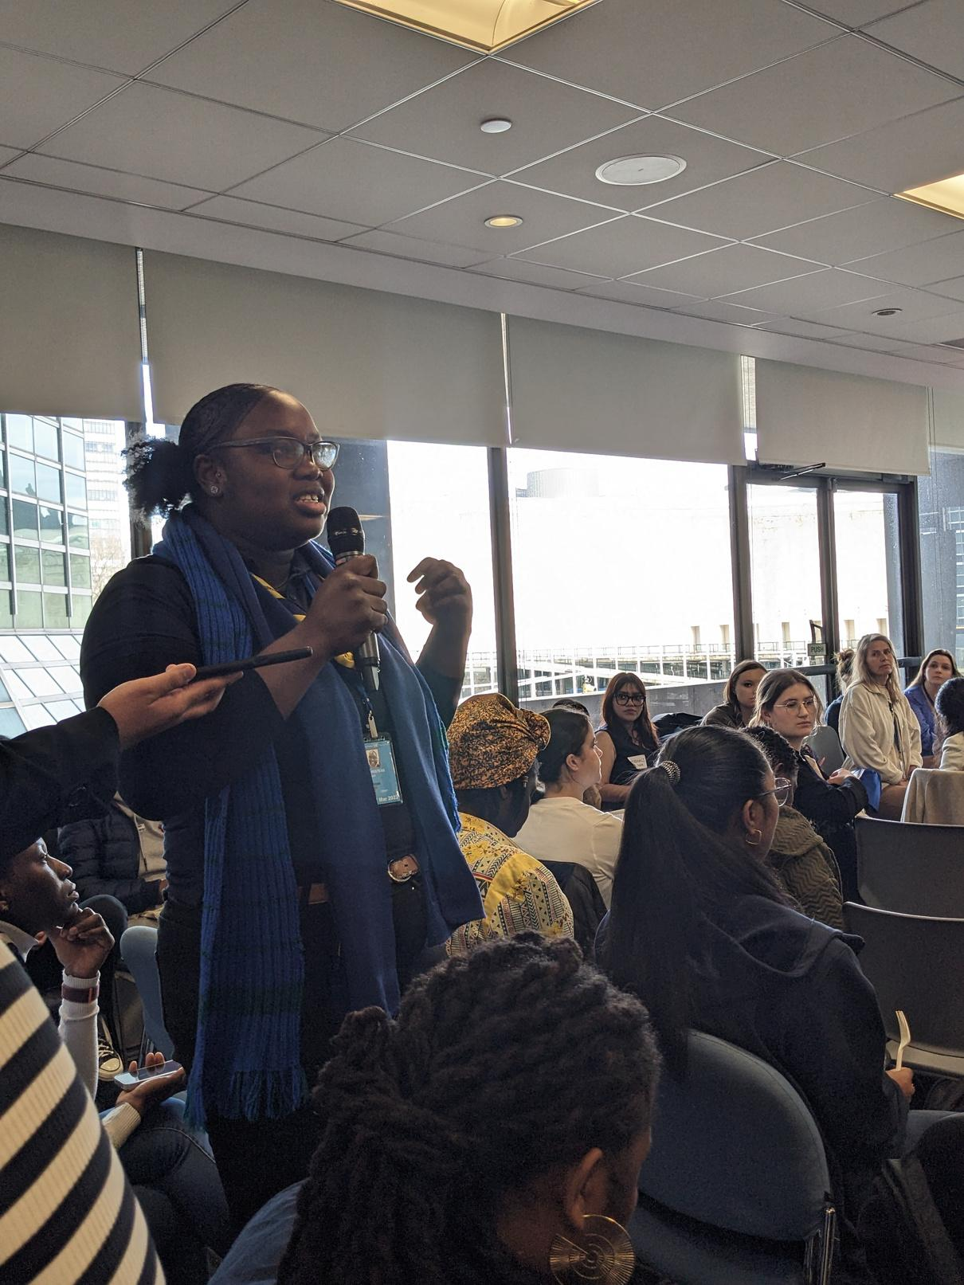

Think about ...
Why they should be involved in your campaign?
What you bring to the table?, and
How can they help?

Slide 19
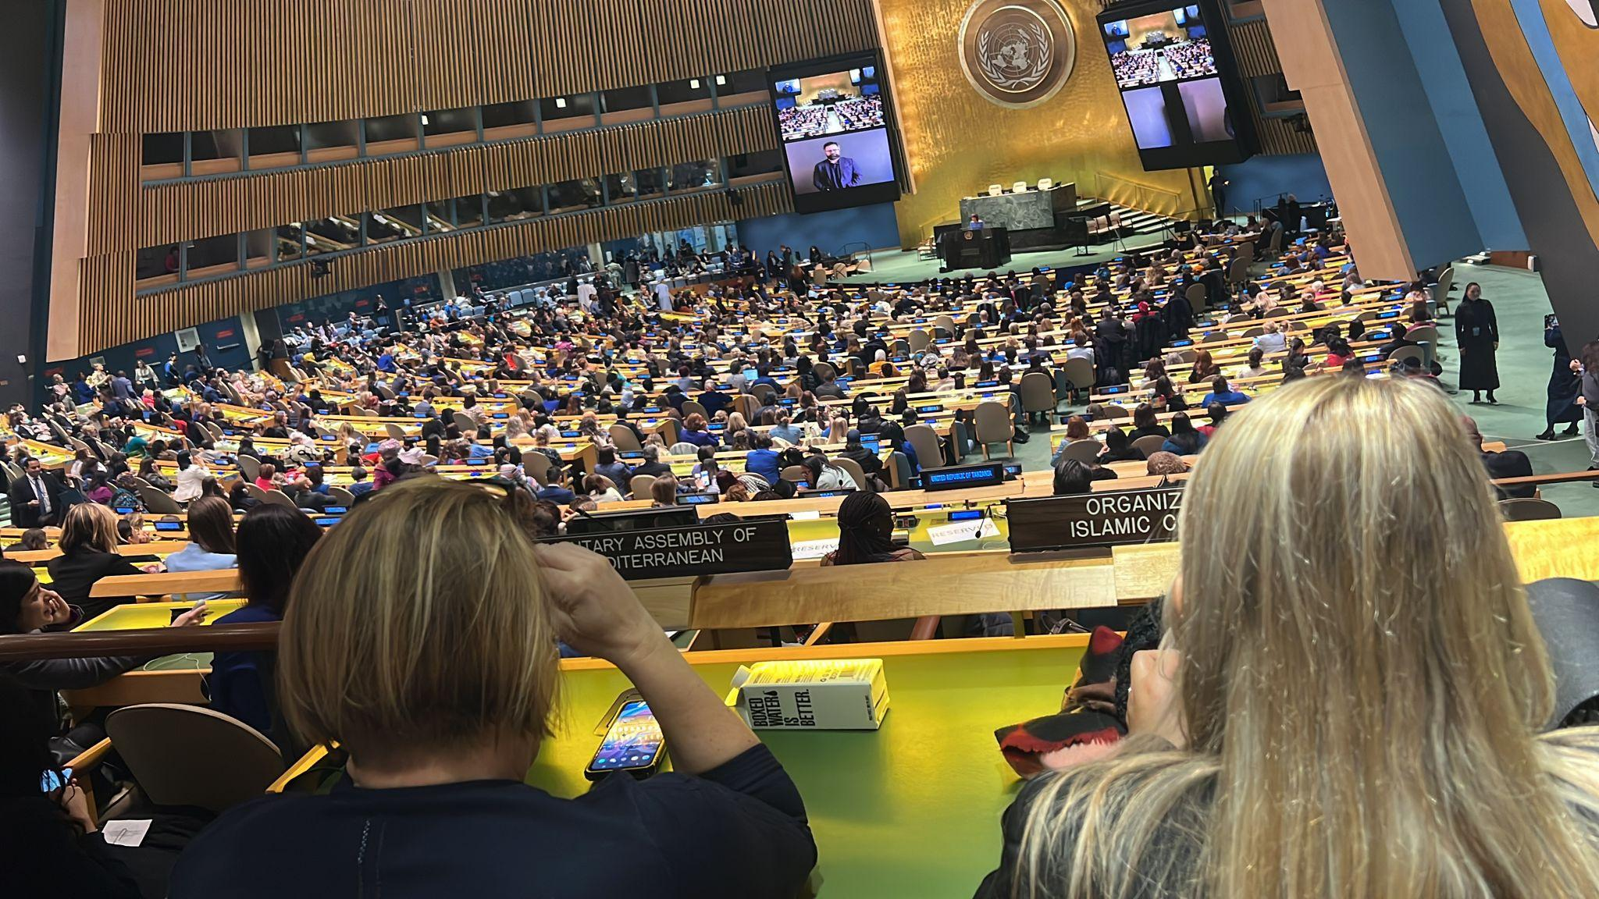

But How?
  Phone call with decision-makers.
  Write a letter (Eg. a letter to your Member of Parliament).
  Invite them to attend your campaign event, such as panel discussions or press conferences.

Slide 20
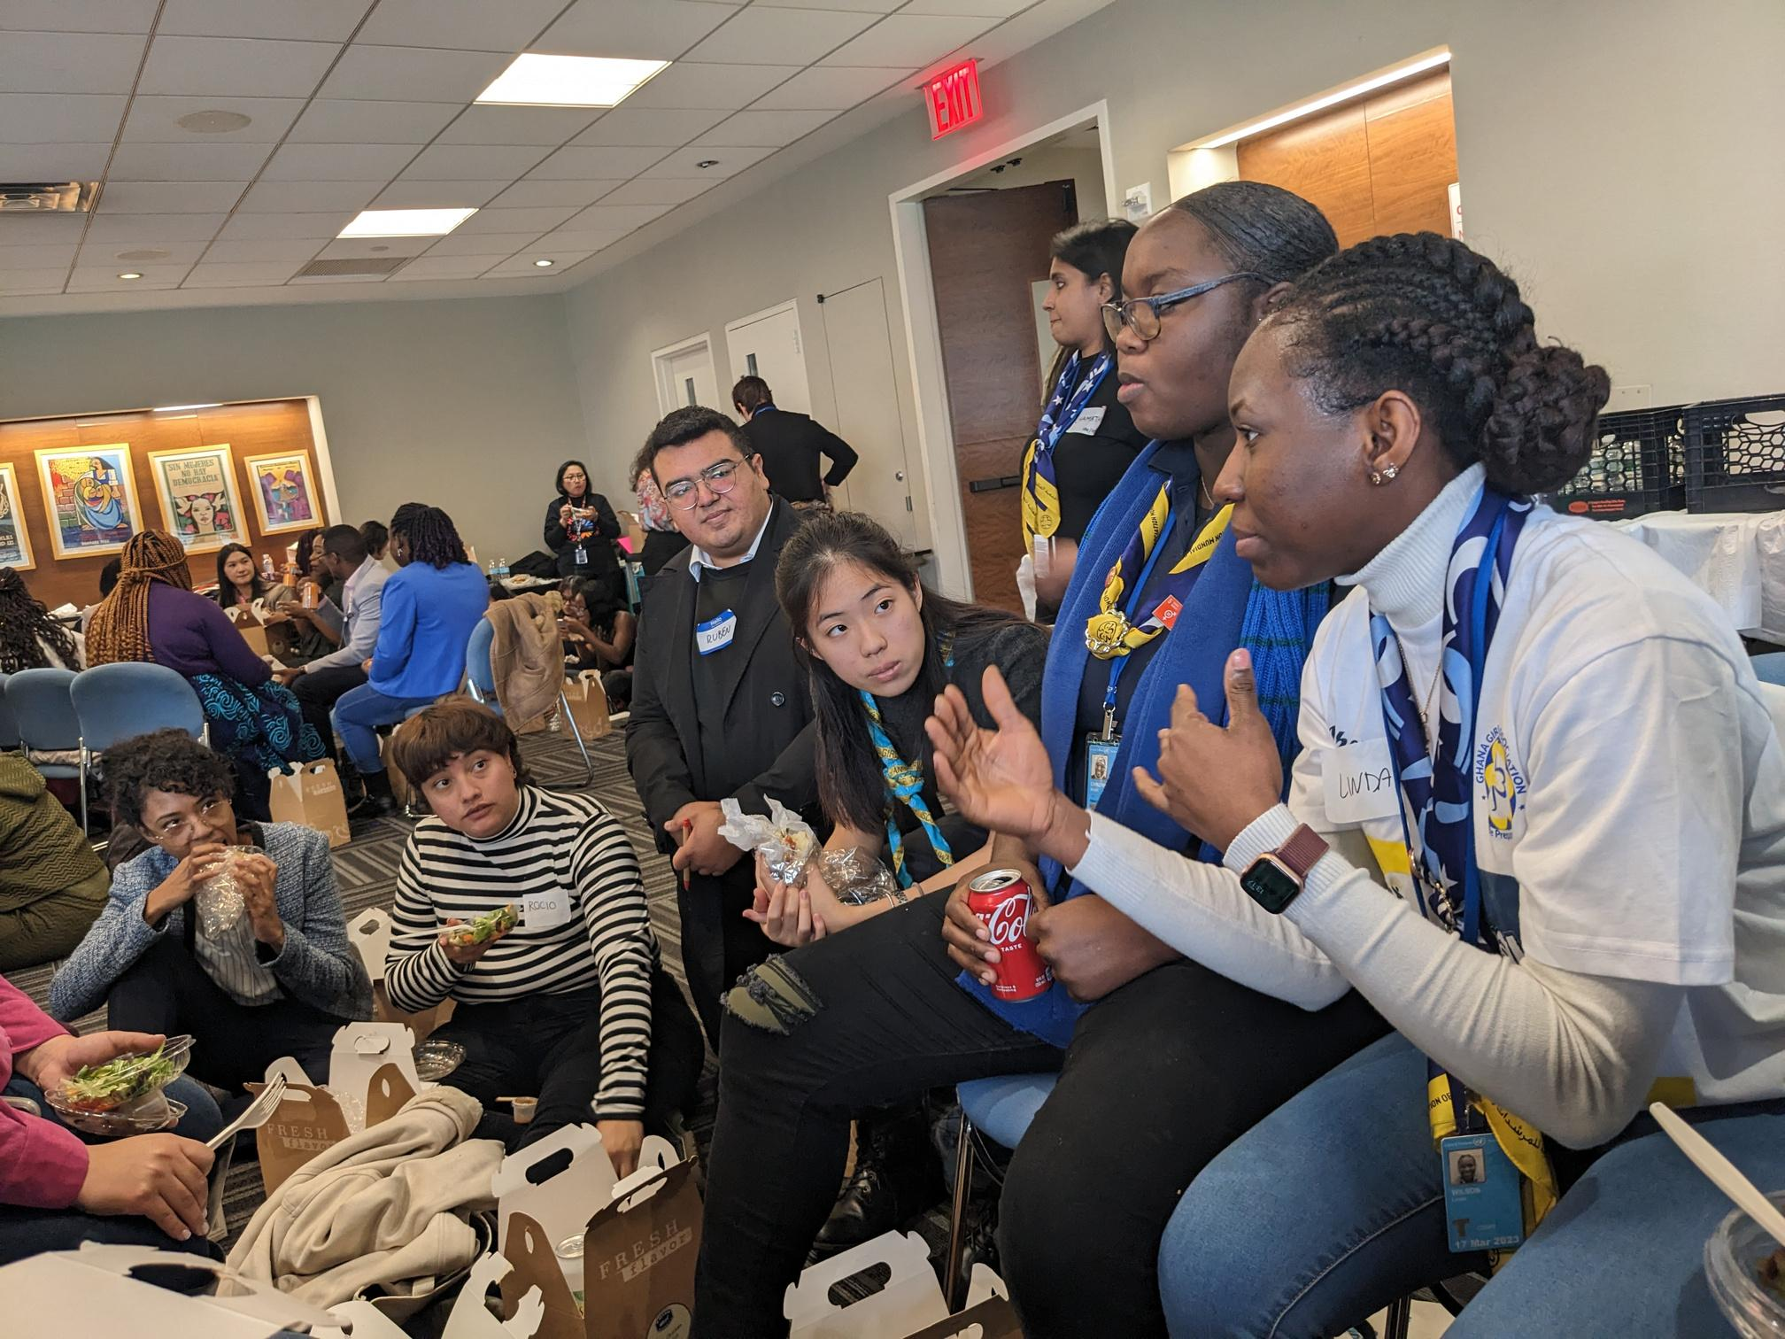
Some Ideas (…)
  Propose a recommendation or a resolution in current debates on policy/ legislation.
  Try to reverse decisions that undermine your campaign issues.
  Prioritise your campaign issue in their agenda by allocating time and resources.

Slide 21
Activity Time
Meet Emily, a bright and passionate 16-year-old high school student who is deeply concerned about the rising cases of cyber harassment in her community. She believes that stronger laws are needed to address this issue effectively. Emily is determined to make a change and decides to lobby the mayor for a panel discussion on "Why Laws of Cyber Harassment in your Country Should Be Implemented Seriously."
Now, write a letter as "Emily" to your major asking them to attend a panel discussion that you are organizing.

Slide 22
Guess What?
Girl Scouts of Peru staged a flash mob in the most important public square of the country - Ayacucho’s Plaza Mayor. They gathered supporters and marched with noisy rattles and whistles calling for the end of violence against girls.
As a result of their creative approach, they gained the attention of the public and were able to persuade the Minister of Women’s Affairs and Social Development to add her voice to their campaign, reinforcing its strength.

Slide 23

Campaigning

Slide 24
Campaigning, also called ‘mobilising’, is the advocacy method that aims to persuade the general public to support your campaign to put pressure on decision–makers.

Slide 25

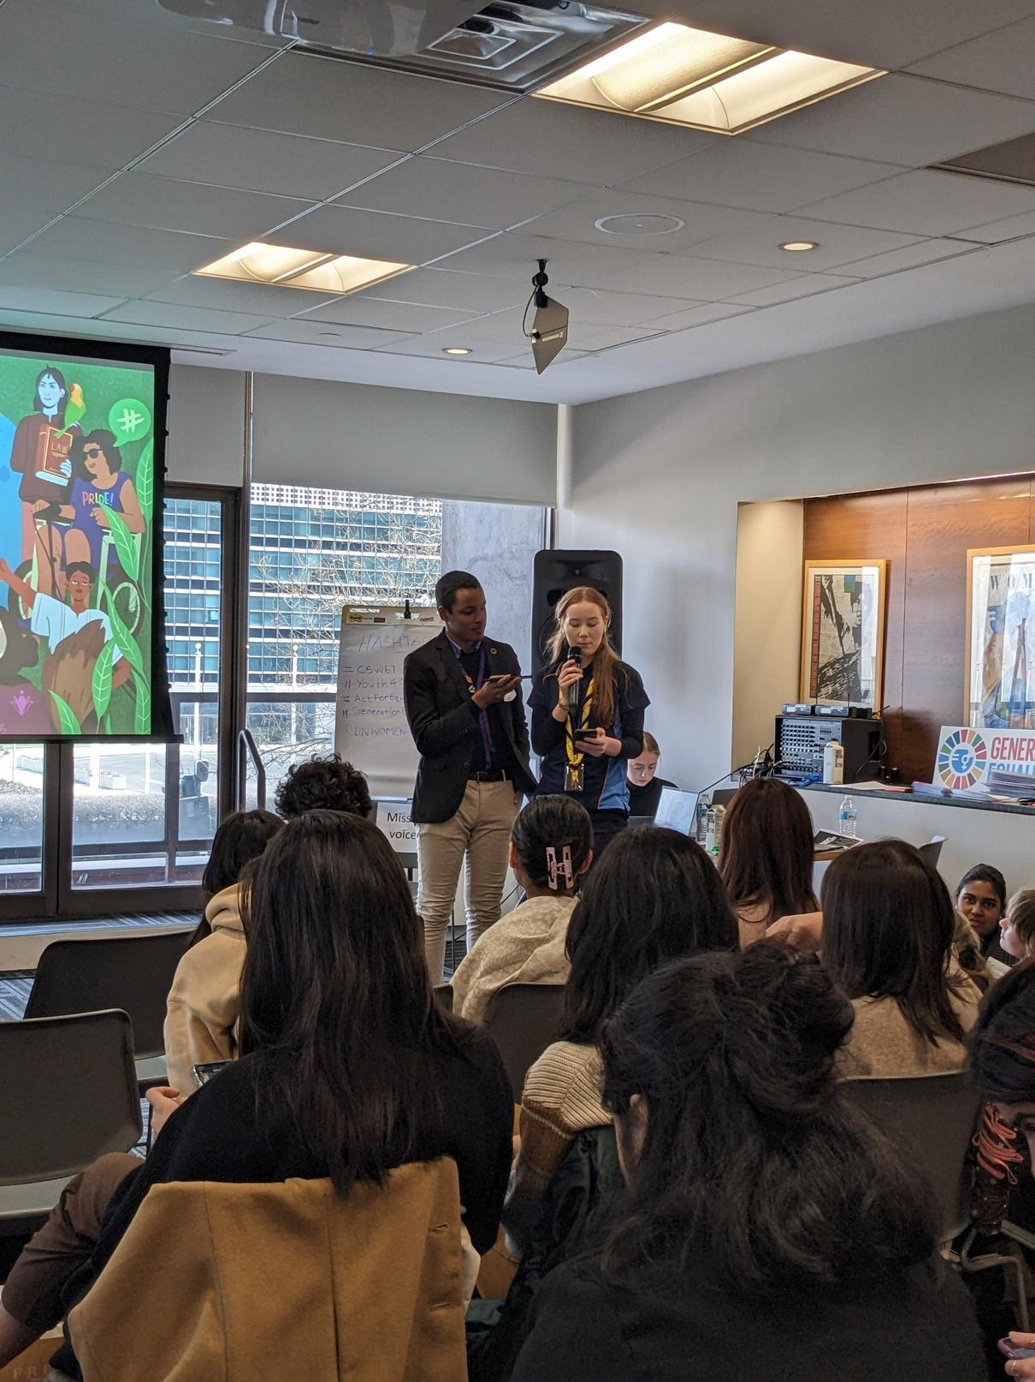

But How?
  Debates and public meetings
  Rallies or marches
  Concerts, film festivals, game night
  Petitions
  Community gathering
  Outdoor campaign
  Letter writing

Slide 26

Digital Campaigning

Slide 27

Digital campaigning is about mobilising large audiences using web-based tools.
This can include social media, video sharing, online petitions, live chats and social messaging platforms.

Slide 28



How does WAGGGS do it?
Each year, for 16 Days of Activism Against Gender-based Violence, WAGGGS runs online campaign against a particular form of violence affecting girls.
WAGGGS’ #OurStreetsToo campaign for 2018 started a conversation about unsafe streets for girls.
WAGGGS uses the data collected in its international advocacy work at the UN.

Slide 29
Building Alliances
Partnerships help you accomplish goals that would be harder to accomplish alone.

Slide 30
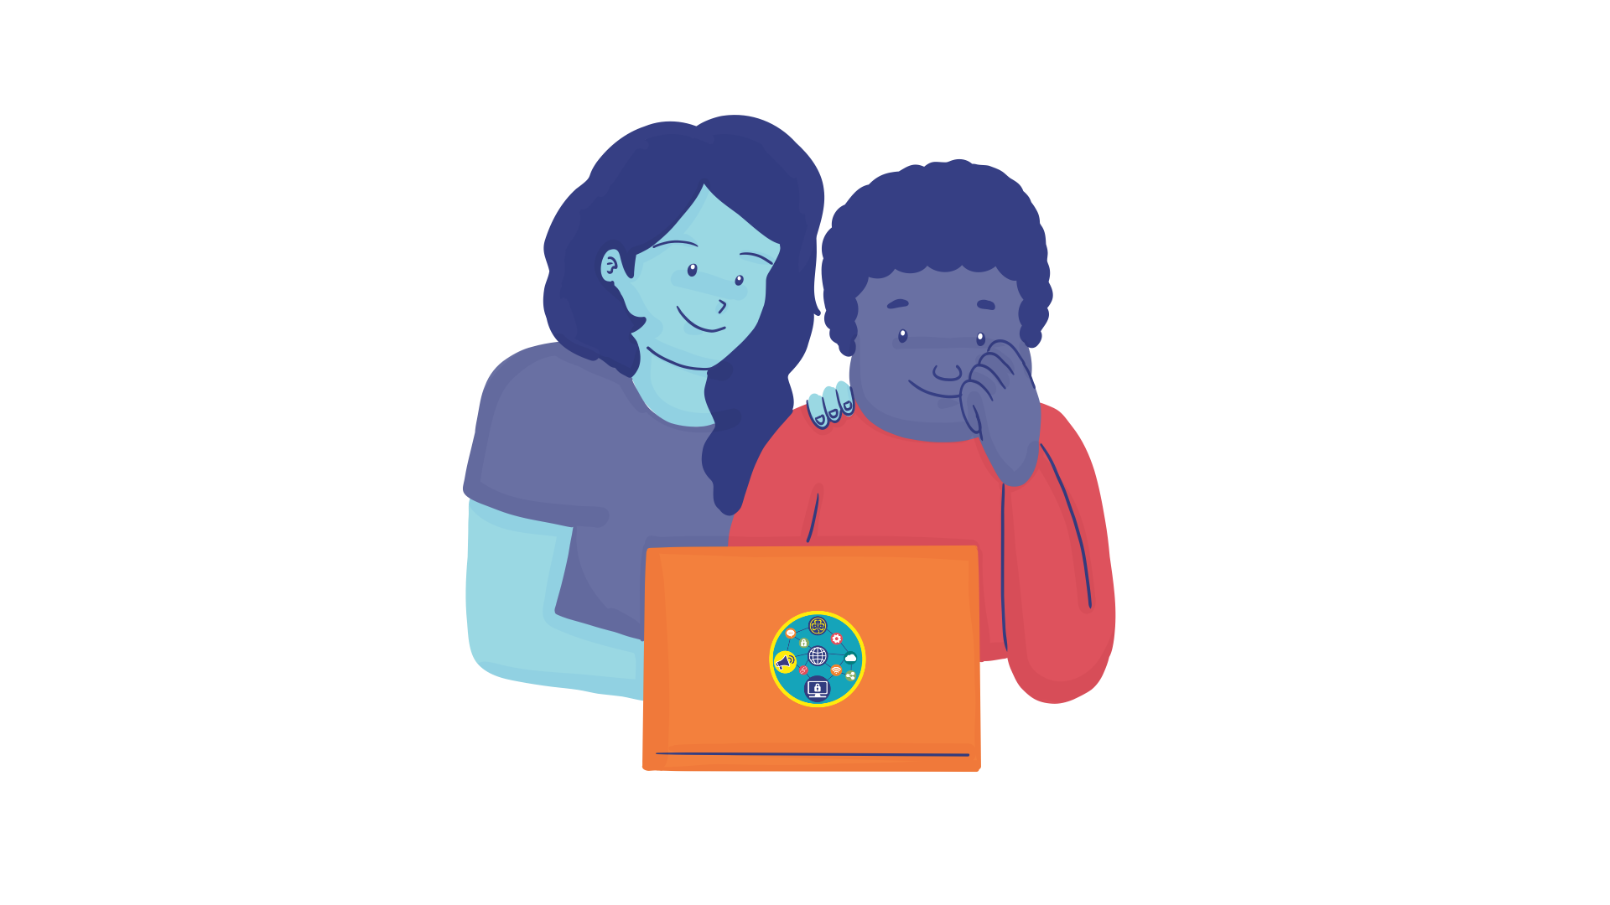
Building Alliances
Fastest Finger First
(5 minutes)

Slide 31
Break Out Room
If you are given £400 to implement an advocacy project, which form of advocacy would you implement and why?

Slide 32
Task: Group Division

Slide 33
Let’s Guess!
When a 25 years old Akeena from Phillipines saw widespread misinformation in the internet around women’s body, she decided to speak up against it. She conducted her own research on it. She found how online body filters, face photoshops and false advertisements of body sliming products directly affects self-esteem of normal women. Taking it further, she wrote her master’s thesis in misinformation and took up an advocacy project titled ‘MoDEFY”.
Today, she has a social media page for her project which is hugely successful. She is able to reach media and decision-makes through her project. Her position papers have been endorsed by the decision-makers who committed to fight against misinformation.

Slide 34
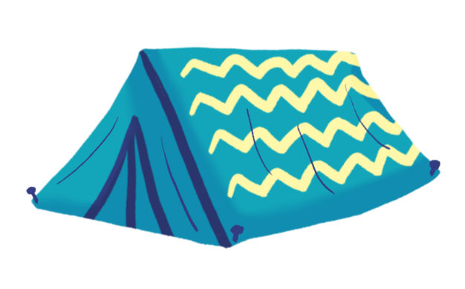
Home Assignment
  Identify one/two problems that you want to work towards solving them.

Slide 35


www.wagggs.org
@wagggsworld
World Association of Girl Guides & Girl Scouts.
World Bureau, Olave Centre, 12c Lyndhurst Road, London, NW3
SPQ, United Kingdom.

