Slide 1


Slide 2

Unveiling the Key to Successful Advocacy Projects.

Slide 3


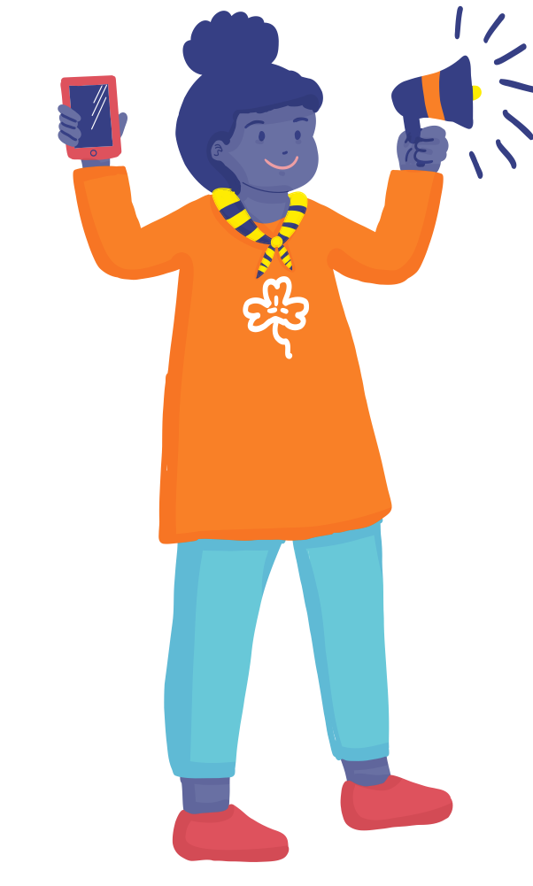
8 Steps to Effective Advocacy
  Step 1: Identify the Situation
  Step 2: Determine the Advocacy Issue
  Step 3: Choose an Advocacy Action
  Step 4: Set Goals and Objectives
  Step 5: Map Out Power Dynamics
  Step 6: Develop Communication Strategies
  Step 7: Engage with Media
  Step 8: Monitor and Evaluate Progress

Slide 4
Let's give your assignments a thorough evaluation, shall we?

Slide 5


Step 1: Situation Identification
Discuss in your Group:-
  Your Strengths and Weakness
  Your Likes/Dislikes

Slide 6

8 Steps to Effective Advocacy
Search
Serch
Look
Explore
Explore
Consult

Slide 7
Smart Surfers are Law Smart
What are the current national policies or laws relevant to your advocacy campaign?
Which international agreements related to your issue has your country signed?
Are relevant policies or laws on your issue not being adequately enforced at local, national, or international levels?

Slide 8

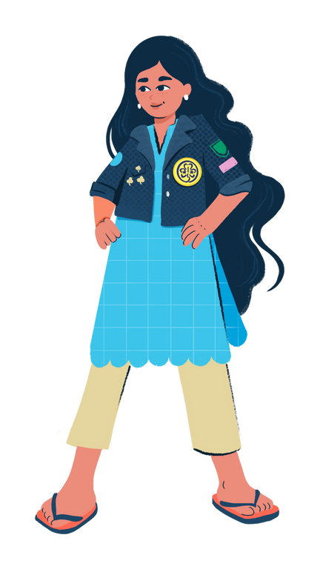


Smart Surfers are Law Smart
Definition of Laws/Legislation
Law (or legislation) is a system of rules that are created and enforced to regulate behavior. For example: the Information Technology Act, Anti-sexual Harassment Act, etc.
Definition of Policy/Plans
A policy is a commitment to a course of action by a decision-maker to achieve a certain goal. For example: National Plan of Action on Combating Sexual Harassment.

Slide 9


surf
Step 2: Identify Advocacy Issue: Problem Tree
smart
2.0
GENERATION
DIGITAL
Core Problem: An issue or challenge that negatively affects individuals, communities, or society that needs action.
Causes: The underlying factors or reasons that contribute to its existence or perpetuation
Effects: The outcomes or effects of the problem on the individual or the society.

Slide 10
Activity Time
Miro
Google Docs

Slide 11

Write your problem statement
The problem that I have identified ………….......................................................................................
This exists due to ………………………………………..…………..
As a result, ...............................................................................

Slide 12
Step 3:
Identify Advocacy Action

Slide 13
Solution Tree
Result: Intended impact or change that the advocacy efforts are expected to bring about.
Objective: A specific and measurable goal that advocates aim to achieve through their advocacy efforts.
Activities: The proposed actions, strategies, or initiatives to address the identified problem and achieve the objective.

Slide 14
Remember to look at the problem-tree to check if solution-tree addresses it
Results: Students understand how to connect positively online and report incidences
Main Objectives: Every Girl in my class is safe from cyber bullying.
Activities: Convincing your school board to have internet safety classes

Slide 15

Can you identify vision, solution and result of this campaign?
EXAMPLE: MALAYSIA
When an 11-year-old girl was forced to marry a man nearly three times her age in 2018, young women from Girl Guides Association of Malaysia (GGAM) refused to stay silent. They took advantage of the media spotlight on the story to build an advocacy campaign to end child marriage.
Through their research the girls and young women realised existing legislation had loopholes that made it legal for children to marry in some areas of Malaysia. Their #nobridesunder18 campaign has been hugely successful, and jointly with other groups, has secured 156,000 petition signatures. Forty Girl Guides joined efforts with other activists in a protest outside the Malaysian parliament, where the girls carried placards and banners and chanted slogans such as, "Hey hey, ho ho, child marriage has got to go".

Slide 16
Activity : Solution Tree
Miro
Google Form

Slide 17

Step 4: Setting Your Goals and Objectives
GOAL: The goal of your campaign is the long-term change you want to see.
OBJECTIVE: An objective is a specific, short-term result that is achieved within your project cycle and that contributes to your goal.

Slide 18

SMART Objective
  SPECIFIC: Providing a clear description on what needs to be achieved.
  MEASURABLE: So, you can track your progress. The more precise, the easier to measure success.
  ACHIEVABLE: Is it possible to achieve it, considering your context and existing resources.
  RELEVANT: The objective should fit your vision and respond to a real need of your campaign.
  TIME-BOUND: Deadlines provide a timeline and sense of urgency to meet them.

Slide 19

My Example
S= Lobby Ministry of Information and Communication Technology to introduce obligatory online violence prevention training for police and enforcement officers in 2 years
M= There is a new policy/training sessions planned on the OVAW
A= Position Papers, Training Curriculum/materials
R= Capacity enhancement of enforcement officers to handle the case of online violence and its victims
T= within 6 months

Slide 20
Activity
Miro
Google Form

Slide 21
POWER MAPPING

Slide 22


8 Steps to Effective Advocacy
“Primary Audience”
“Secondary Audience”
POWER TO MAKE CHANGE
Power to Influence

Slide 23
Guess who is whom?
Malta
In 2013, Girls Guides from Malta created an advocagy campaign after nurses and medical practitioners among them recognised many of the refugee women they treated had experienced FGM. At that time there was little awareness of FGM, so they decided to raise awareness and delivered training to police, doctors and teachers. As there were no policies or laws addressing FGM in their country they decided to lobby the government to make it illegal. With the support of the communities they had educated on the issue, they pressured the government to create legislation making it illegal to carry out FGM in Malta.

Slide 24
Activity Time
Google Doc

Slide 25


www.wagggs.org
@wagggsworld
World Association of Girl Guides & Girl Scouts.
World Bureau, Olave Centre, 12c Lyndhurst Road, London, NW3
SPQ, United Kingdom.

