Slide 1


Slide 2


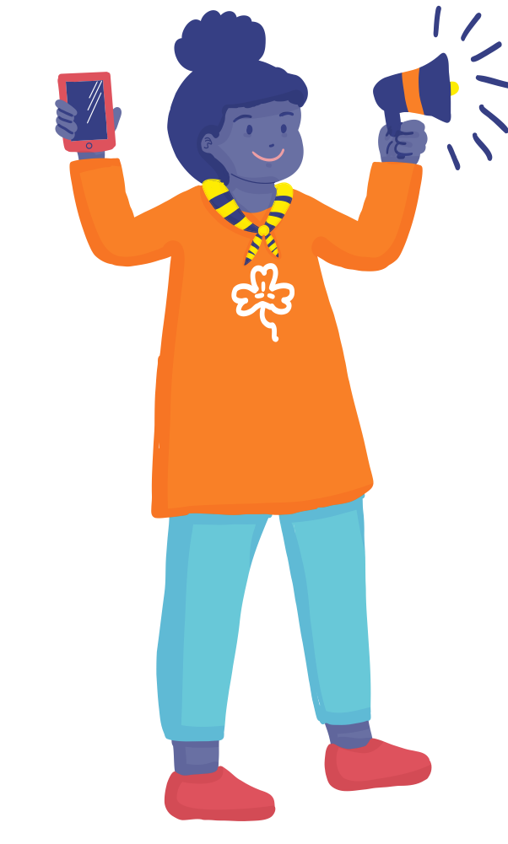
CONTENTS
  #SheSurfsFreedom
  CSW67: Innovation, Technology & Digital Education for gender equality: Expert Group Meeting Findings
  Safer Internet Day: February 2024

Slide 3
#SheSurfsFreedom
  WAGGGS’s theme of 16 days of activism against GBV of the year 2023.
  1000 G&YW from 70 countries participated in the survey
  Capturing “their experiences online and recommendations for freedom and equality in online spaces”.

Slide 4
Facts from the Survey
  Two-thirds of the GYW surveyed have seen and received sexual or violent content that made them feel uncomfortable.
  42% of girls have since changed their behavior online due to this.
  Over 30% have felt negative about themselves due to other people’s comments on their own or other people’s content.

Slide 5
Call to Action
1. We call on governments to create a clear legal framework to address OGBV.
2. We call on corporate social media companies to take responsibility
3. Provide girls, women and other marginalized groups with digital education and technology for more creative solutions.
4. Prioritize body confidence of young women and girls by providing mental health programs.

Slide 6
CSW67
Priority Theme: Innovation and technological change, and education in the digital age for achieving gender equality and the empowerment of all women and girls

Slide 7
CSW67: Expert Group Meeting
In 2022, it is estimated that 63% of women across the globe were using the Internet, compared to 69% of men.
While this rate decreases to 30% in many developing countries and closer to 20% in Least Developed Countries (LDCs).
Over 40% of countries studied had no meaningful policies or programs to expand women’s access to the Internet. - Alliance for Affordable Internet (A4AI)’s Affordability Report.

Slide 8
Women in STEM
  Only 28% of engineering and 40% of computer science graduates are women. - UNESCO (2021)
  Advancements in technology have not improved the overall labor market position of women.
  Women in richer countries may have a comparative advantage over women in poorer countries.
  E-commerce carries a higher risk of dropping out for women, who tend to hold lower digital skills.

Slide 9
Safer Internet Day
  Celebrated on the 7th February each year.
  Worldwide annual campaign promoting a safe digital environment for children and young people.
  Next year marks the 20th anniversary of Safer Internet Day.
  Safer Internet Day in your country
  Connect via Website, Facebook

Slide 10
Online gender-based violence (OGBV)
  OGBV can be understood as “any act of gender-based violence against women that is committed, assisted or aggravated in part or fully by the use of ICT, such as mobile phones, the Internet, social media platforms or email, against a woman because she is a woman, or which affects women disproportionately.”
  Source:- A/HRC/38/47, para 23

Slide 11
EGM Report
  Perpetrators of OGBV may be anyone, all of whom act with the objective of controlling or discrediting women.
  Women in prominent online roles like politicians, journalists, and activists are more likely to experience increased levels of OGBV. -UN Women (2022).
  A study involving 33 countries found that gendered disinformation undermines girls’ ability to see themselves as leaders. – Plan International Report.
  Women of colour were 34% more likely to be mentioned in an abusive tweet when compared to white women, with Black women in particular more vulnerable to abuse. – A report on Twitter, 2018.

Slide 12
EGM Report
  77% of those surveyed self-censor on the internet as a means of countering online violence.- Kamran, H. (2019) “Media Matters for Democracy.
  80% of the global population now lives with less freedom of expression than they possessed a decade ago. – Article19, The Global Expression Report 2022.
  Common themes of these assaults include character assassination, gendered slurs, sexualised speech, rape and death threats.

Slide 13
Impact of Disinformation on Women
  Gendered disinformation undermines girls’ ability to see themselves as leaders. - Plan International involving 26,000 girls in 33 countries.
  Politically engaged women likely to reconsider their ambitions or to self-censor.

Slide 14


www.wagggs.org
@wagggsworld
World Association of Girl Guides & Girl Scouts.
World Bureau, Olave Centre, 12c Lyndhurst Road, London, NW3
SPQ, United Kingdom.

