Slide 1

Communication Strategies

Slide 2



Advocacy Message
“When the whole world is silent, even one voice is powerful”
- Malala Yousafzai

Slide 3
Advocacy Message
Advocacy message is a combination of words that together express a powerful idea.

Slide 4
Crafting your advocacy message
  Appeal to the HEAD: What is the problem?
  Appeal to the HEART: How are voiceless and people living in marginalized communities affected by the problem?
  Appeal to the HANDS: A clear call to action that will inspire people to act.

Slide 5

Elevator Pitch
Imagine you find yourself sharing the elevator with the one decision-maker who could make a difference.
Problem Statement | Evidence | Example | Action Required
Girls and young women are rapidly subjected to online attacks and abuses. | In a survey conducted by WAGGGS, we asked 1000 girls and young women about their online experience, 45% of them said they have received unwelcomed messages in online platforms | A girl aged 16 from Malaysia shared, “I have received sexual comments from people older than me, especially at the start of having my own instagram account, which was 13. These guys sent me inappropriate pictures and also questions that made me feel very uncomfortable such as, if I’d already had my first period and if my breasts are big or not.” | “We want schools to develop, support, and strengthen mental health programmes and body-confidence building interventions both online and offline to address young women and girls’ low body confidence and self-esteem.”

Slide 6
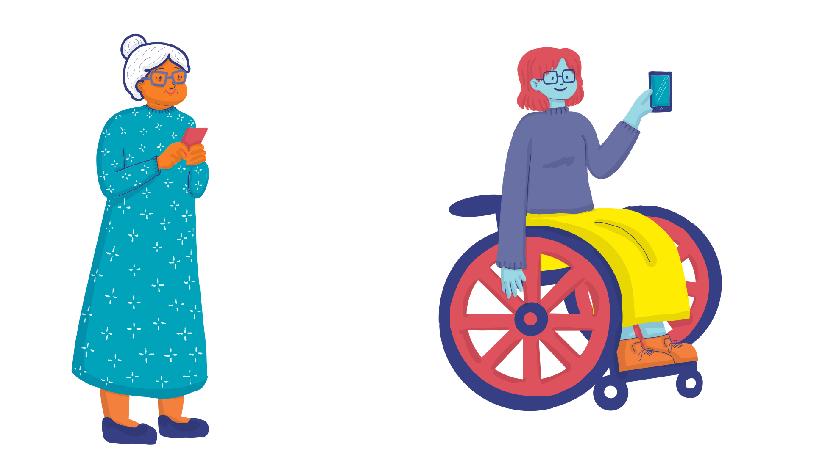
Remember your advocacy message is (…)
  SIMPLE
  SOLUTION FOCUSED
  EVIDENCE-BASED – USE FACTS AND FIGURES
  APPEALING ON A PERSONAL LEVEL
  APPROPRIATE FOR THE AUDIENCE

Slide 7
Media Outreach

Slide 8

Advocacy Message
The media, like a flashlight, can shine a light on your campaign.

Slide 9
Media Outreach
  Shape Public Opinion
  Raise Awareness
  Reach Decision-makers And Influencers
  Increase The Reach Of Your Campaign
  Widen Your Network Of Like-minded Organizations

Slide 10
Traditional Media
  Press Release
  Radio Broadcast
  Newsletters

Slide 11
Press Release
“A press release is a written communication directed at members of the media announcing something of public interest.“

Slide 12
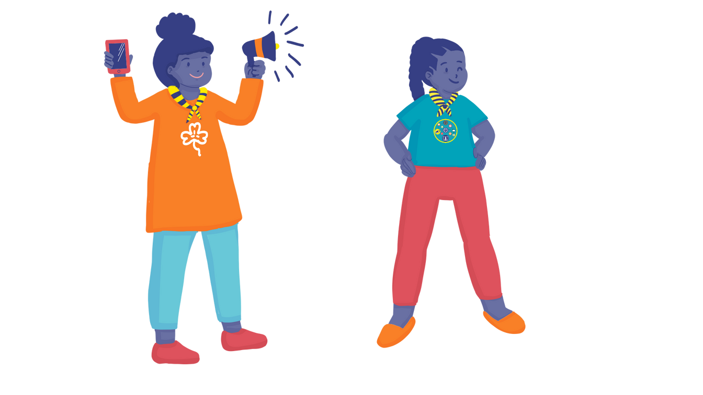
LEBANON
Girl Guides from Lebanon chose International Women’s Day to speak out against violence against women. As part of their campaign work in 2011 they decorated a bus with pictures of influential women alongside messages calling for equal rights for women.
They drove the bus through the capital, gave out balloons and information about gender based-violence. Members of the public were invited to sign a petition calling for a law on prevention of domestic violence.
As a result, the group was invited on national television to spread their campaign message and speak to a wider audience about their advocacy campaign.

Slide 13




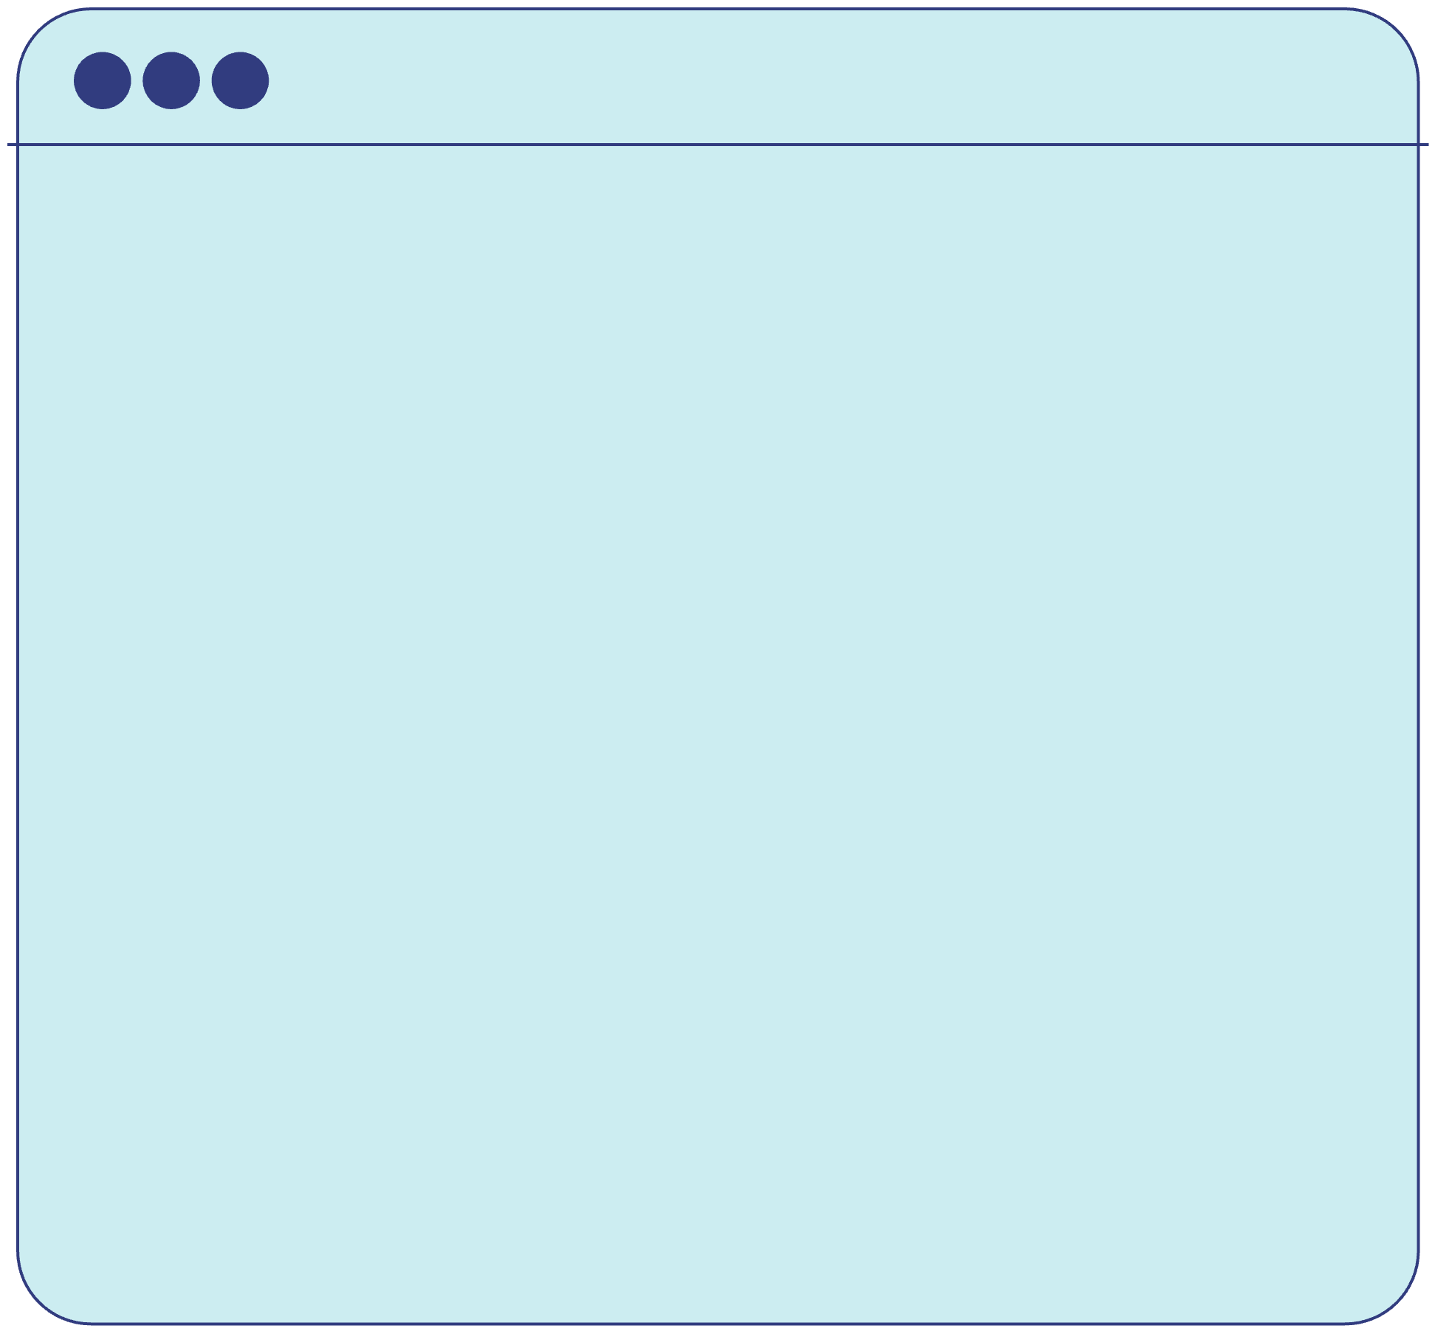
Top Tips
  Announce activities of your campaign
  Send your press release to local and nationals newspapers, radio stations and TV Channels
  Key dates: International Day of the Girl (Oct 11), 16 days of activism against GBV (Nov 25- 10 Dec), Safer Internet Day (Feb 7), International Women’s Day (Mar 8
  Inviting journalists to your events

Slide 14
Interview
An interview for a radio station, a newspaper or a television show is always a great opportunity to raise awareness of your campaign.

Slide 15

Top Tips
  Know your interviewers - get familiar with their work and types of questions they usually ask.
  Adapt your key message to the specific context of the interview and type of audience.
  Highlight evidence from your research that supports your campaign.

Slide 16

Digital Media
  Social Media Marketing
  Digital Campaigning
  Online Petitions

Slide 17
Social Media
Social media can increase awareness and bring attention to issues and causes in ways that the traditional media cannot.
However, ‘Likes don’t save lives’. Social media is only a means in raising awareness, not the main goal.

Slide 18

Top Tips
  Create a social media account designated to your cause that people can follow to get informed, and take action.
  Facebook, Instagram, Twitter, TikTok.
  Check your eligibility
  Be thoughtful
  Storytelling
  Celebrate milestones
  Call to Action

Slide 19
Social Media
  Hashtags
  Informational Videos: Interviews/Podcast
  Live broadcasting and stories
  Catchy Graphics
  Trendy Memes

Slide 20
Social Media
  Online Petitions:Change.org, Avaaz.org
  Online Surveys: Google forms, SurveyMonkeys
  Website/Blog: Wix.com, Wordpress.com
  Crowdsourcing/Fundraising: Kickstarter and Go Fund Me
Notes:
*Note: Before you start using them make sure you have a budget plan in place and you have checked with your local laws and MO guidelines.

Slide 21


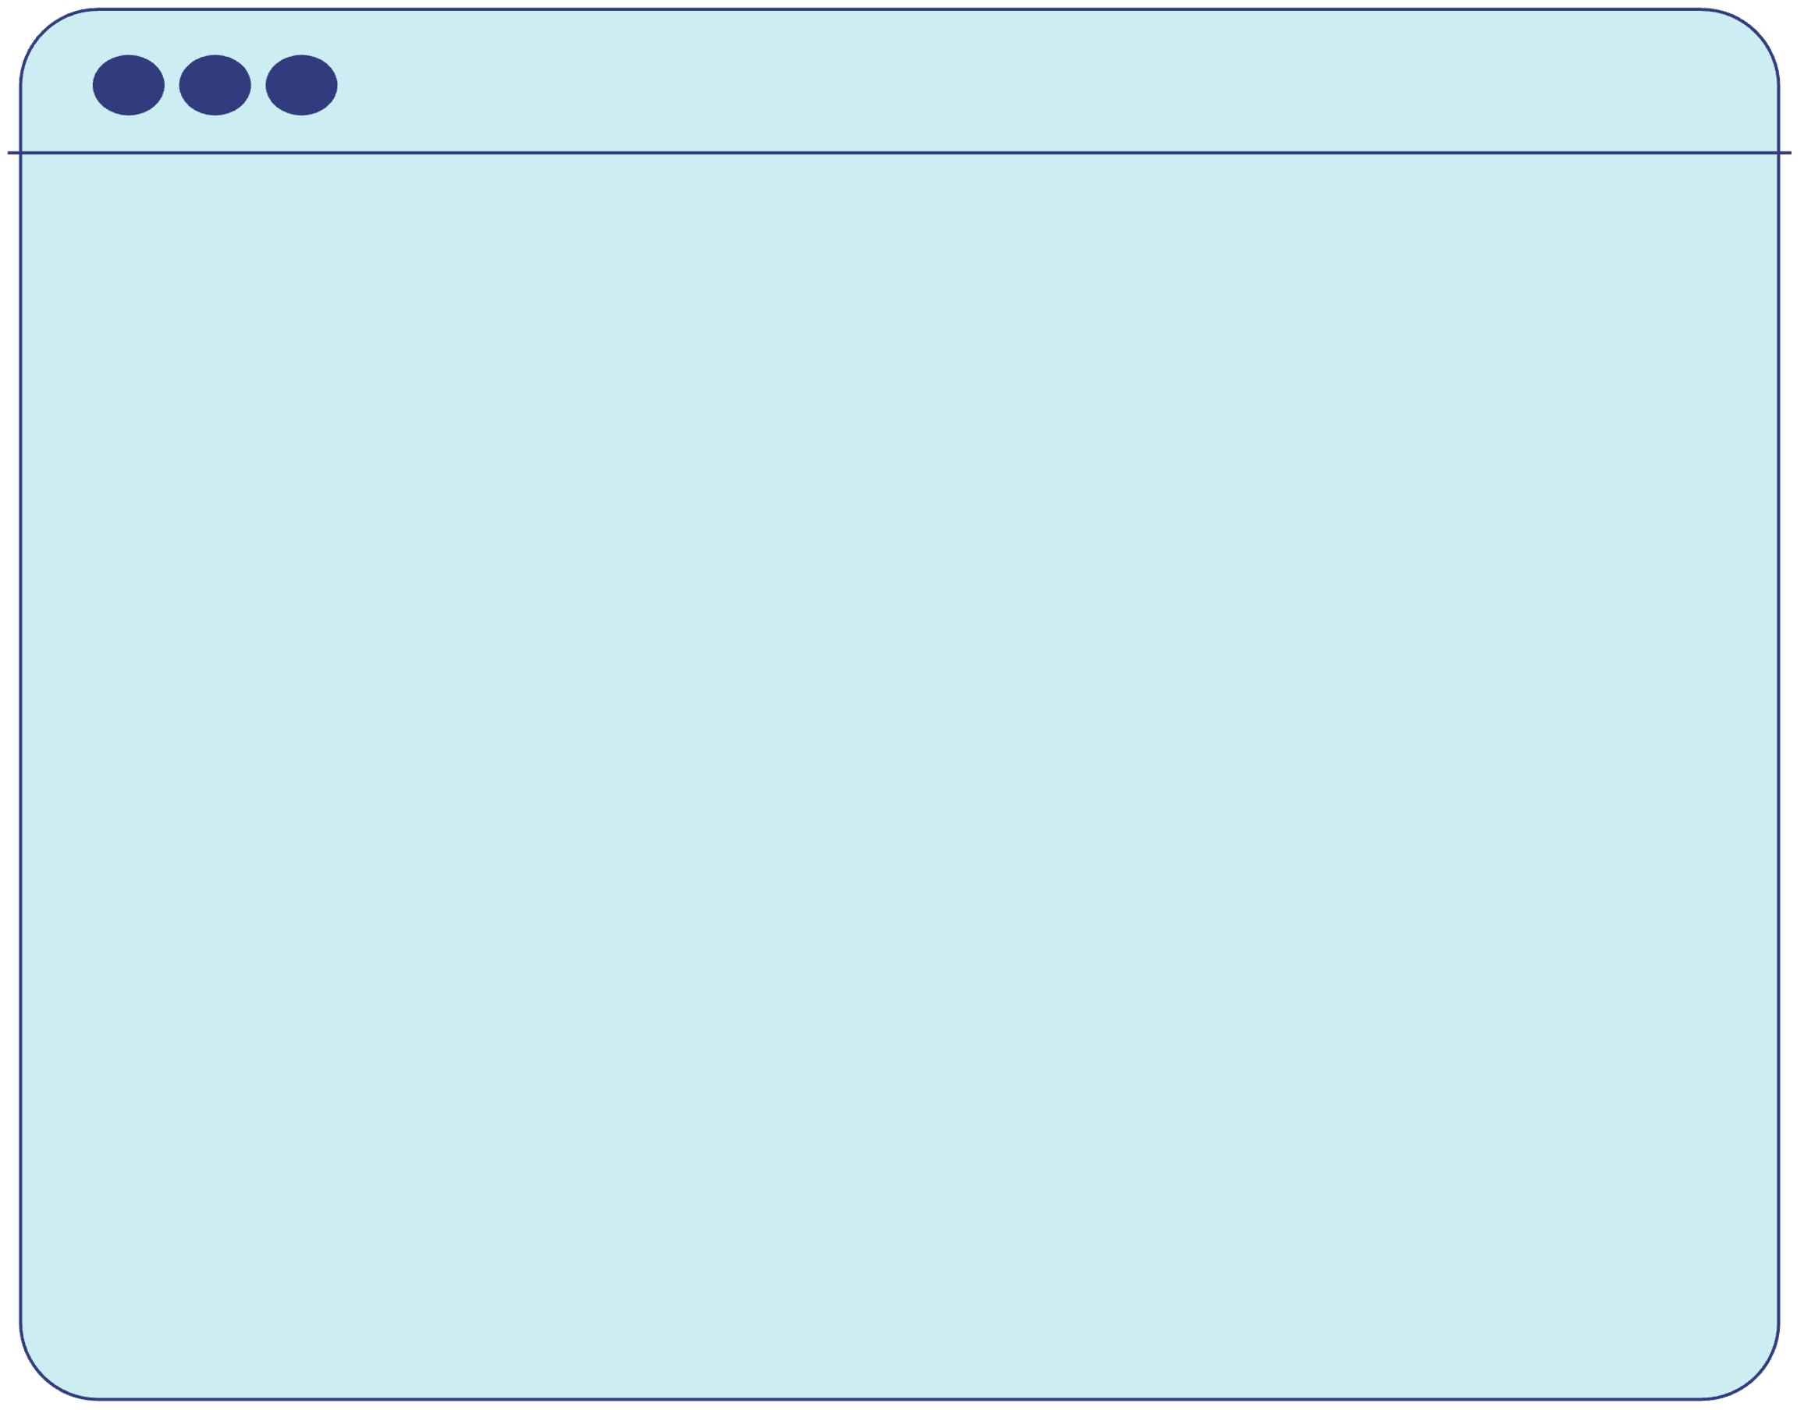
Top Tips
  Website: The hub for publishing content in full
  Facebook: A platform for conversation (1-2 posts per day)
  Instagram: The visual app (1-2 posts per day)
  Twitter: Short, sharp thoughts (3-6 posts per day)

Slide 22


www.wagggs.org
@wagggsworld
World Association of Girl Guides & Girl Scouts.
World Bureau, Olave Centre, 12c Lyndhurst Road, London, NW3
SPQ, United Kingdom.

