Slide 1




Slide 2
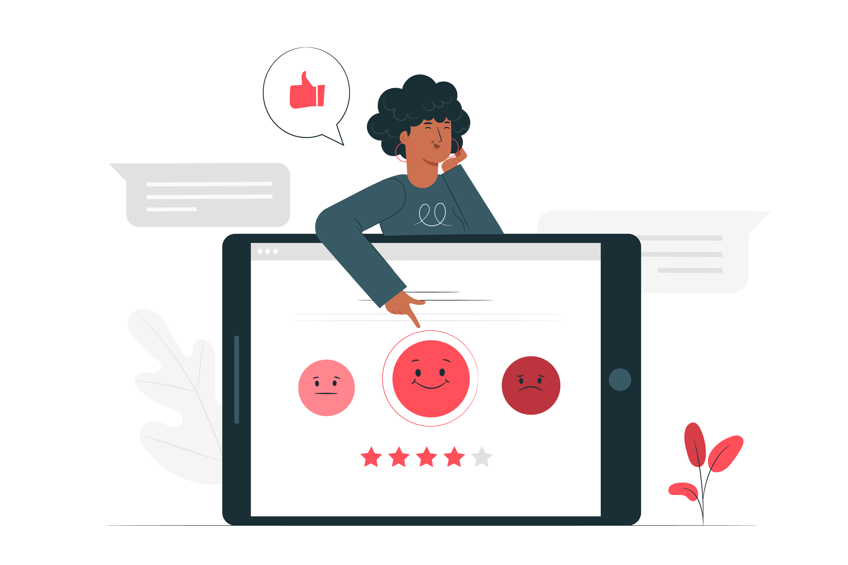
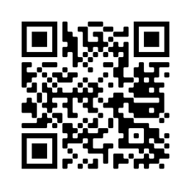
Pre-Survey
<a href="https://www.freepik.com/vectors/illustrations">Illustrations vector created by stories - www.freepik.com</a>
Please do the survey online using the link or QR code
https://ee.kobotoolbox.org/x/vqZIoRpO

Slide 3

DID YOU KNOW THAT…
As of June 2020, 4.8 billion people were using internet = 60% of the global population.
On average, they spend two and a half hours each day online.
By 2030, almost 50 billion devices will be connected to the internet.
More than 175,000 children go online for the first time every day.

Slide 4
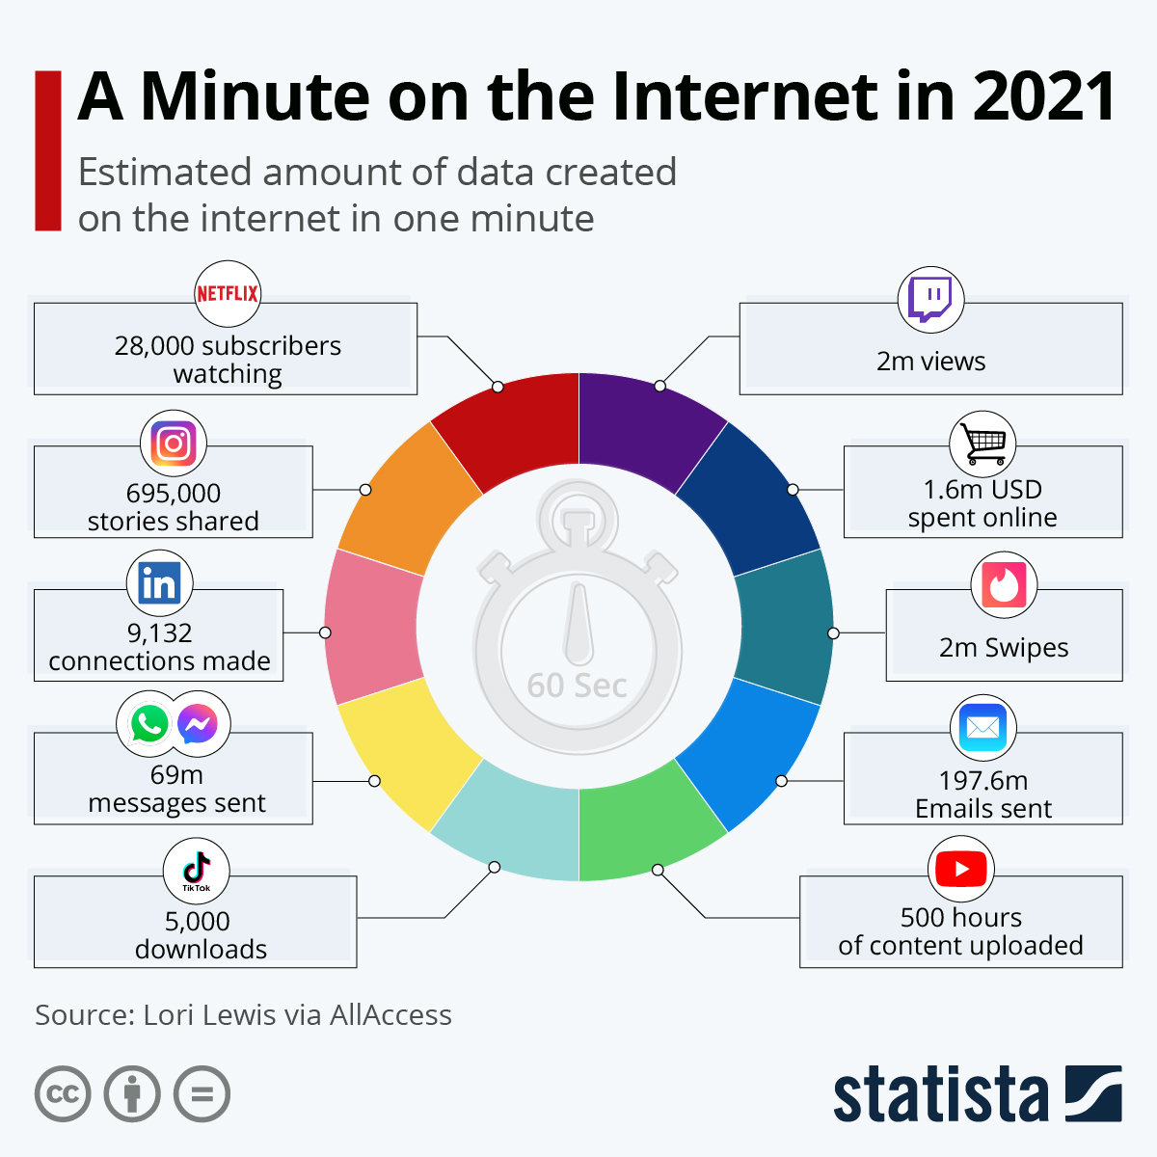
DID YOU KNOW THAT…
https://www.statista.com/chart/25443/estimated-amount-of-data-created-on-the-internet-in-one-minute/

Slide 5

WHY INTERNET SAFETY?
>>NEW TECHNOLOGY IS GOOD NEWS!
The internet is bringing our movement closer together than ever before, giving Girl Guides and Girl Scouts the tools to connect, share and advocate for issues affecting them.
>>… BUT THERE ARE RISKS
Children and young people’s rights and online footprints are at risk when using the internet.
They need the skills, awareness and confidence to manage the risks, and help their friends, family and communities do the same.
>> WHICH HAVE INCREASED IN 2020

Slide 6
COVID 19 IMPACT
>> Increase of online safety concerns
>> Deepening of digital gaps
Rise of fake news and conspiracy theories
Increase in online abuse and violence towards women and children.
Further challenges for girls and women with less access to the internet than men.
Less online opportunities for the poorest and most disadvantaged children and young people.
2nd best online experience for those who:
Lack appropriate devices
Lack digital skills
Have poor access to the internet
Speak minority languages
More exposure to potentially harmful and violent content and to cyberbullying
Notes:
COVID 19 has had a great impact in our relationship with the internet and the digital life
The pandemic has increased our use of devices for school, work, play and connecting, mostly through video chat, social media and video games.
It has also brought to surface a number of safety concerns and has deepened the digital gaps which already existed.
As humankind has been trying to understand more about the virus, fake news and conspiracy theories have found fertile soil, making it hard to know what is real and what is not.
Domestic abuse towards women and girls has risen but so has online abuse and violence towards women and children increased.
In some places where girls and women have always had less access to the internet than their male counterparts, the pandemic has been even more challenging.
Online opportunities have traditionally been difficult to reach by the poorest and most disadvantaged children and young people.
Children and young people that do not have the appropriate devices, or lack digital skills, or have poor access to the internet, or speak minority languages may only get a second-best online experience.
Increased and unstructured time online has exposed children to potentially harmful and violent content as well as higher rates of cyberbullying.

Slide 7



GENERATION DIGITAL
Do not share private information online
Treat others with kindness online and take into consideration their feelings and opinions
Use the internet safely to create, play, communicate, learn and share
Girl Guides and Girl Scouts enables members to develop their fullest potential as responsible citizens of the world.
Speak out for equal digital rights and access for all
Responsible digital citizens
Contribute positively to digital communities
Inform others about the benefits and the risks one may encounter online
Think carefully when being approached by strangers online
Confront cyberbullying by reporting and blocking
>>WHAT DOES IT MEAN TO BE A RESPONSIBLE CITIZEN IN ONLINE SPACES?
Notes:
How can we navigate the online world safely and responsibly, making the most of the opportunities it offers to learn and create?
And how can we use online spaces to raise our voices and participate in social change, to make the world, both online and offline, a better place?
What are some of the things that responsible digital citizens do?
What are some of the things that responsible digital citizens do?
They protect their personal and private information by avoiding posting anything online that might be harmful to themselves or others.
Engage competently and safely with digital technologies. Use the internet safely to create, play, communicate, learn and share
They treat others with kindness and respect other’s feelings and opinions
Conduct themselves positively in digital environments and actively participate in digital communities with the appropriate skills, attitudes and knowledge.
Think carefully when being approached by strangers online. They know they might not be who they claim to be.
Confront harassment and bullying online by reporting and blocking
Inform others about the benefits and the risks one may encounter online
Speak out for equal digital rights and access for all

Slide 8

OUR AIM
To raise a generation of internet savvy girls and young women who can use the internet to make a positive difference in the world.

Slide 9

Norton PARTNERSHIP
Surf Smart began in 2011 in partnership with Norton.
One of the world’s largest software companies.
Security, storage and systems management solutions to customers. Based in California, USA
>>COMMITTED TO
Gender equality and advancement of women in technology
Educating parents, schools, and students about safe and ethical practices on the Internet

Slide 10
Norton PARTNERSHIP
>>OUR AIM
For SURF SMART 2.0 – Generation Digital to reach as many girls/young women and boys to support them to:
Find out about the tools that will help them stay safe and make thoughtful and balanced decisions when connected.
Explore how to get more out of their time online and connect positively with local and global communities.
Look into ways they can actively participate in digital communities and practice being a digital citizen responsibly.

Slide 11

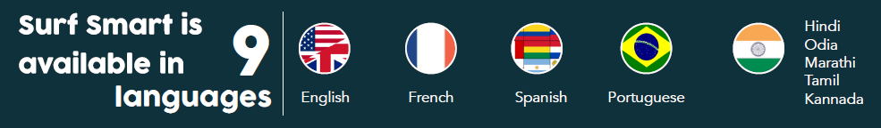
SURF SMART JOURNEY
More than 350,000 reached across
5 continents
44 countries globally are involved in the program
Notes:
!

Slide 12

SURF SMART 2.0 JOURNEY
Launched MO Fund.
Globally, countries have shown interest.
Available in 4 Official Languages of WAGGGS:
-Arabic
-English
-French
- Spanish
Audiobook available for download
Notes:
!

Slide 13
SURF SMART 2.0 – AN OVERVIEW
>>Main parts of the new curriculum
Getting Started
Introductory activities
Press Enter
Five sections with a variety of activities for new digital skills and awareness
#BeTheChangeOnline
Bringing change online the WAGGGS way
To earn your Surf Smart 2.0 badge you need to complete at least:
1 activity from each Press Enter section (5 in total)
+
#BeTheChangeOnline
Notes:
Getting started Activities: these will help establish a safe space for participation. They will also give participants time to reflect on how they use the internet and what they would like to learn from the pack. Not mandatory to earn the badge.
Press Enter: Five activity sections for new digital skills and awareness. Complete one activity in each section
#BeTheChangeOnline: Explore how to make change happen - Take up your own project to bring social change - Take your Generation Digital Promise

Slide 14
SURF SMART 2.0 – AN OVERVIEW
>>Getting Started Activities
Although not mandatory to earn the badge, they are highly recommended as they:
provide tools to the facilitator to understand the group’s relationship with the Internet.
help establish a safe space and a brave space for participation.
Support participants into being more aware of how they use the internet and what they would like to get out of the Surf Smart journey.
It is advised to do them prior to creating your curriculum or starting the pack.

Slide 15
SURF SMART 2.0 – AN OVERVIEW
>>Press Enter
Five activity sections for new digital skills and awareness.
Complete one activity in each section
DISCOVER... internet wonders: Discover and use the positive aspects of the internet
CONNECT... positively online: Learn how to use social media and other platforms in ways that connect us with others positively and safely
PROTECT... yourself from online risks: Learn how to navigate the web safely
RESPECT... your digital rights and footprint: Explore digital rights, learn about safe digital footprints and discover how to look at information critically.
IMAGINE… a better internet: Use the internet in a positive way to spark creativity and make it more enjoyable for others.

Slide 16
SURF SMART 2.0 – AN OVERVIEW
>>#BeTheChangeOnline
Step 1: Explore how to make change happen
Step 2: Take up your own project to bring social change
Step 3: Take your Generation Digital Promise
Notes:
Explore how to make change happen: through quick and easy activities you will learn how WAGGGS defines change, what is awareness raising, advocacy and community project
Take up your own project to bring social change: choose from a list of suggestions or create your own social change project depending on the participants’ interests.
Take your Generation Digital Promise of contributing to a safer and positive internet experience for you an everyone around you.

Slide 17
TRY OUT ACTIVITIES
GETTING STARTED
Getting started activities | Is there someone who…
PRESS ENTER
DISCOVER...internet wonders | Best of the web, Treasure hunt, Let’s go e-shopping
CONNECT...positively online | Super spread, Go live, Getting the best out of social media, Intergalactic battle
PROTECT...yourself from online risks | Perfect password, Share it or keep it?, Who is it?
RESPECT... your digital rights and footprint | Digital divides, Fact or opinion, The perfect selfie
IMAGINE… a better internet | Helping hand, A positive online community, Internet if things
#BeTheChangeOnline
Step 1: Bringing change the WAGGGS way (with amendment)
Step 2: #BeTheChangeOnline project (with amendment)
Step 3: My Generation Digital Promise

Slide 18
ADULT INTERNET SAFETY GUIDANCE
It is recommended that leaders follow the guidance from your
Member Organization on safeguarding children online. General best
practice is found at the end of the Surf Smart pack, including:
EMAIL : considering how to safely communicate with children and parents
SOCIAL NETWORKING: ensuring any social networks set up for your group are safe spaces
PHOTO AND VIDEO: creating guidelines with parents’ input for appropriate sharing of video and photo content
YOUR OWN ONLINE SECURITY: make sure your own devices and profile are safe
SAFEGUARDING GROUP MEMBERS: dealing with concerns about young people’s online activities
We also suggest you inform parents and carers before getting started with the pack about working on the Surf Smart pack, by using the parental consent form provided in the pack.
Notes:
ACTIVITY SUGGESTION:
Ask participants: does anyone already have a policy you use for any of these topics? Does your Member Organization? Would it be useful to improve or expand the policies you use day to day?
Divide training participants into small groups, each focusing on one of the areas covered in this slide. Ask them to discuss the ideas suggested on the back of Surf Smart 2.0 on their topic. Ask them to agree a policy that could be used in their own context, and present this to the rest of the group in a creative and engaging way – for example as a public service announcement on television.

Slide 19
GETTING STARTED
Is there someone who…
The internet is a big part of our lives today.
Across the world, we use it in many different ways: to learn new things, to watch a movie, to listen to music and even to workout!
Let’s explore and reflect on the things we might do online and some of our main concerns.
Go through the quiz and select the answers that apply for yourself.
Slido
#SurfSmart2
Notes:
https://forms.gle/umYDTNkGvcGF47Bt8

Slide 20
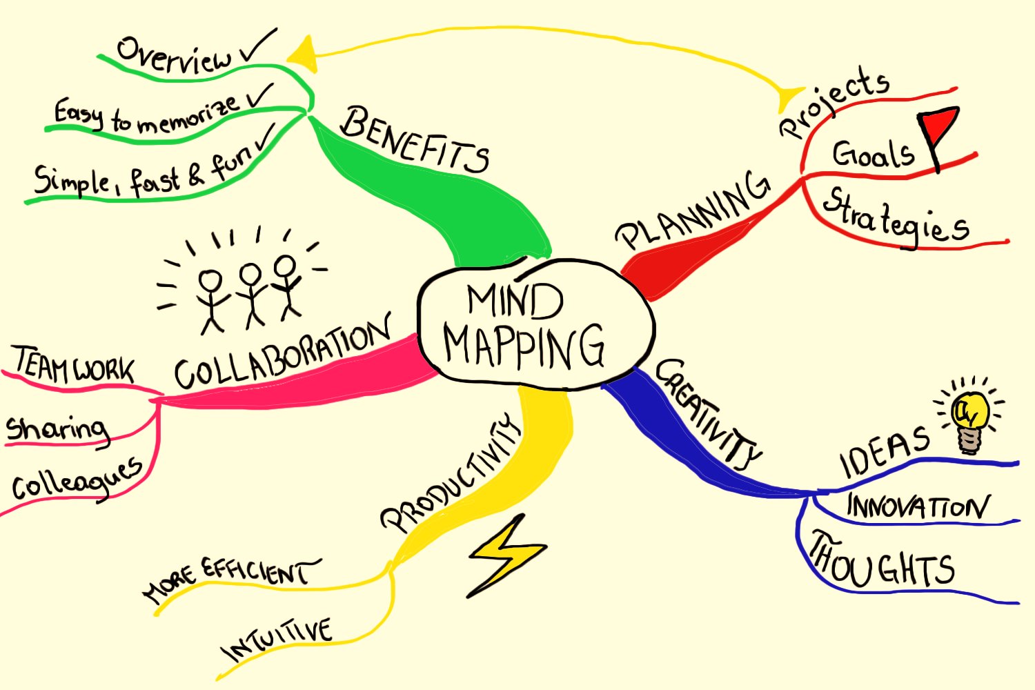
PRESS ENTER:
DISCOVER…internet wonders
Best of the web
There are so many great websites out there, you can’t try them all. Instead, sharing knowledge with our friends about things that we do online is how we can promote the best of the web.
In groups, talk about your favourite sites or applications, what they do and why you like them.
When you have listed everything, try and create a visual map of the great websites your group recommends.
Can you arrange your recommendations by use, for example social networking, listening to music, learning about an outdoor activity or playing games?
Try to create a mind map* or a presentation either by hand or by using online tools, such as https://www.canva.com/graphs/mind-maps/ or google slides.
Notes:
A mind map is a type of graphic organizer that uses a diagram to visually organize ideas and concepts.

Slide 21
PRESS ENTER:
CONNECT…positively online
Super spread!
Information, messages, photos and any type of digital content can spread very quickly online.
That can mean that important content can reach almost every part of the globe fast. But also misleading content can spread in the same way, giving false information to people.
Let’s find out how fast it can spread with this activity!
Discussion points:
Messages, images and any type of information can spread very quickly online. Do you think this is a good thing or can it have a negative impact?
Is there anything wrong with having images or photos public for everyone online to see? What if someone didn’t like what you posted?
Is it possible to spot the person responsible for starting a rumor or sending a message online?
Are there ways to stop the spread?

Slide 22
PRESS ENTER:
PROTECT…yourself from online risks
Perfect Password
In teams you have 10 min to create the perfect password.
Choose a memorable object or a favourite phrase or saying, such as a line from your favourite book or film. Can you think how to turn this phrase into a hard-to-guess but easy-to remember password? It needs at least eight characters, using a mixture of letters, numbers and symbols.
To help, draw a grid with two rows and as many columns as there are different letters in your password. If using a phrase, use the first letter of each word. Write the letters in the top row and a corresponding symbol or number below it.
For example, here the easy-to-guess word
“butterfly” becomes “B@++3rf1Y”.
Try to create the most hard-to-guess password, because when you come back to the group, the opposing teams will try to guess its strength.
B | U | T | T | E | R | F | L | Y
B | @ | + | + | 3 | r | f | 1 | Y

Slide 23
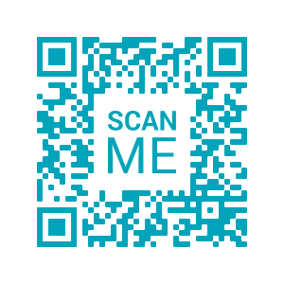
PRESS ENTER:
RESPECT…your digital rights and footprint
Real or Fake?
Can you tell fake from real online news?
Take this quiz to find out how savvy you are!
Try to keep track of everything that doesn't look right or that looks credible.
You can also try to investigate if it is real or fake.
Google forms
https://forms.gle/gNkuocGmgYRfLNK26
Notes:
https://forms.gle/gNkuocGmgYRfLNK26

Slide 24

PRESS ENTER: RESPECT
PRESS ENTER:
RESPECT…your digital rights and footprint
Real or Fake?
Extravagant titles with the words shock, awesome, incredible, lots of exclamation points.
Name of author is missing.
Date of publication is missing.

Slide 25
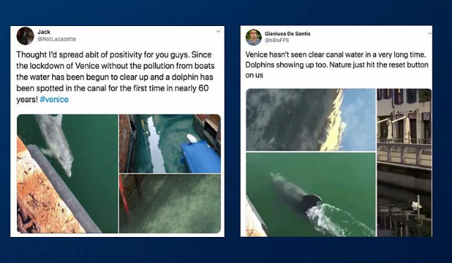
PRESS ENTER:
RESPECT…your digital rights and footprint
Real or Fake?
Sources. Does the story give facts? Or are the sources and evidence vague about who said what, when something happened, etc?
Aims for extreme emotions.

Slide 26
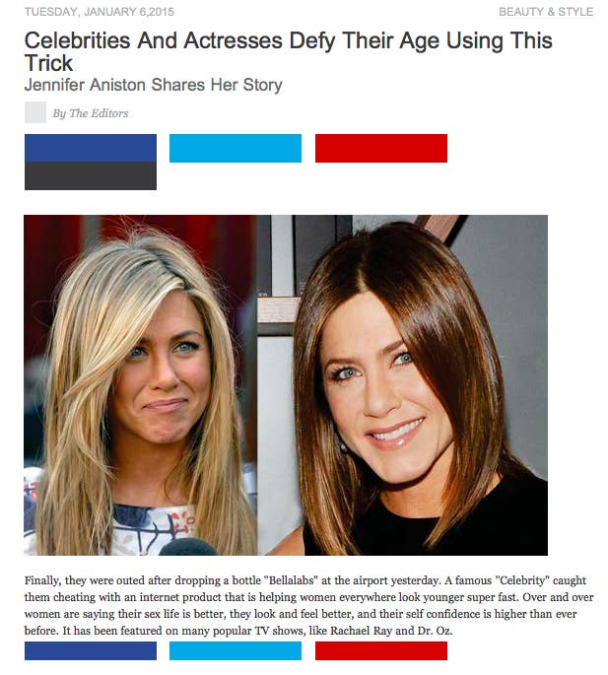
PRESS ENTER:
RESPECT…your digital rights and footprint
Real or Fake?
The name of the authors is not mentioned.
Vague information with no sources cited.
Using celebrity names.

Slide 27
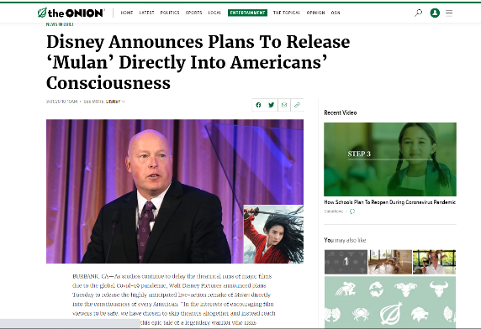
PRESS ENTER:
RESPECT…your digital rights and footprint
Real or Fake?
News that are outright unbelievable.
Satirical website.

Slide 28
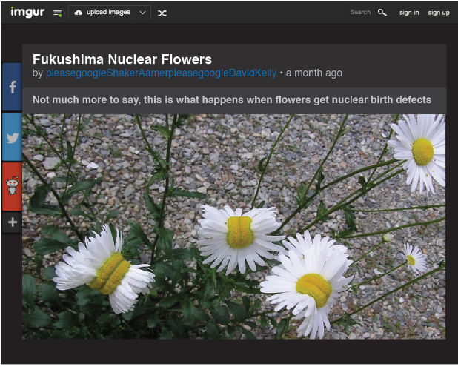
PRESS ENTER:
RESPECT…your digital rights and footprint
Real or Fake?
Sources are not cited.
Further information not shared.
Aiming for intense emotions and extreme reactions. If it makes you angry or afraid, it could be a sign that it is constructed.

Slide 29
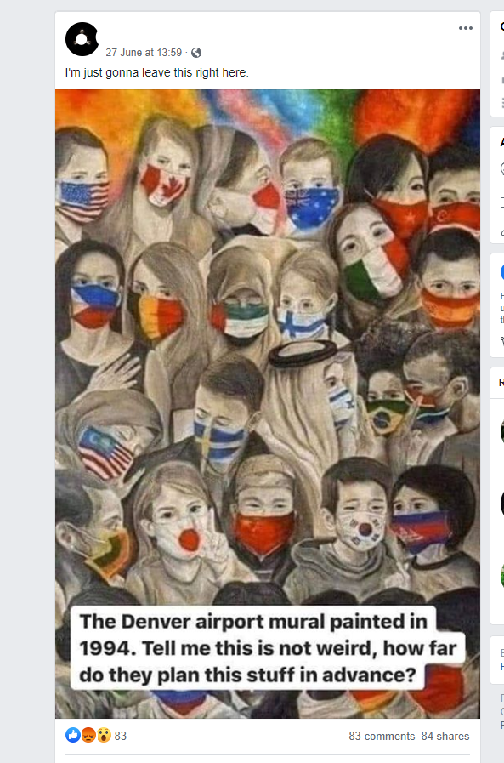
PRESS ENTER:
RESPECT…your digital rights and footprint
Real or Fake?
No author, so sources, no date of publication.
Aiming for intense emotions and extreme reactions. If it makes you angry or afraid, it could be a sign that it is constructed.

Slide 30
PRESS ENTER:
IMAGINE…a better internet
A positive online community
Your Guiding/Scouting promise does not stop at the physical world. It extends in the online world too. You can make it a better place by contributing positively through your social platforms!
Think about girls or women around you whose leadership is inspiring you, why they're inspiring you and how they can inspire others.
Share a few thoughts with the group and during the next days post a shout out on your social media with #PositivityPatrol and #LeaderLikeYou, so their leadership can inspire girls all around the world.

Slide 31

#BeTheChangeOnline:
Step 1 - Bringing change the WAGGGS way
Changemaker stories
The ALS Ice Bucket Challenge
The #metoo movement
Cecil the lion
Guide dogs
Environmental emergency
Humans of New York (HONY)
Discuss:
What are some things that stood out in the stories you read?
What were some online methods that brought change in
a society, a law, in practices or in biases?
How would you describe social change based on
what you have heard?

Slide 32
#BeTheChangeOnline:
Step 1 - Bringing change the WAGGGS way
How do Girl Guides and Girl Scouts make change happen
For more than a century Girl Guides and Girl Scouts have been taking action to successfully make change happen in small or large communities.
There are 3 routes to do so:
Raising Awareness
Taking Action in your Community
Speaking Out
Take the quiz to find out if you can tell the difference between these 3 actions!
Slido
#SurfSmart2
Notes:
Raising awareness is when we want as many people as possible to know about an issue. This empowers people with knowledge and understanding of the issue, and also of how they can take action.
Taking Action in your Community includes any activity that aims to make changes within a community. The project directly tackles an issue that matters to you by taking action to develop a local solution, in a community you care about.
Speaking out for change means that: we influence (persuade) people - by speaking, doing and educating, - to take decisions ( for example on policies/rules, actions, attitudes, funding, support etc.) - that will improve our life and the lives of others, aiming towards the result we are trying to achieve
You may also have heard it as Advocacy!
When we are working for social change, we don't want people to just know about an issue, we want them to understand it, and then to go on to take action, either by changing their own behaviour or by asking decision makers for change in structures, services, laws and practices. Awareness raising is very important as the first step to social change. If you want to make more of an impact and see real change happen, combine Raising Awareness with either Speaking Out or Taking Action in the Community.

Slide 33
#BeTheChangeOnline:
Step 2 - The project
It is time to take action the WAGGGS way regarding online issues that affect us and/or our community:
Internet Safety
Online harassment
Digital accessibility
Fake news
Online grooming
Getting help
Split into groups select and discuss about one of the ways to take action:
Raising awareness – Taking action in your community – Speak out
Come up with a list with things you could do and present them to the other groups.

Slide 34
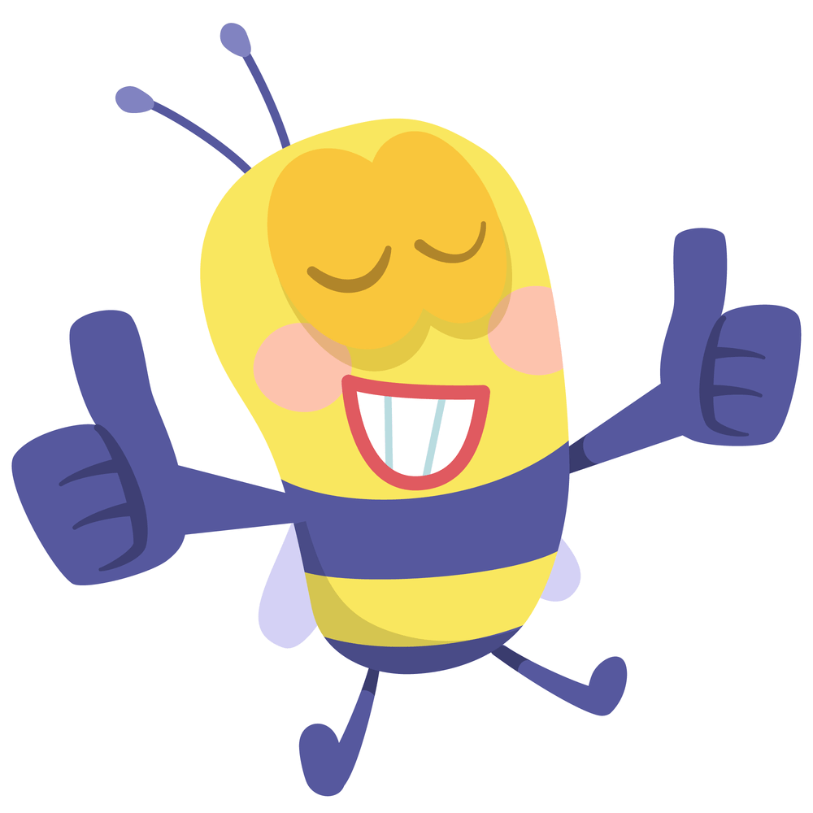

Do you feel confident to deliver SURF SMART 2.0?

Slide 35

Do you
HAVE ANY QUESTIONS OR CONCERNS?

Slide 36
Girl Guides and Girl Scouts in charge
>>Girl Guide/Girl Scout-led approach in creating your
SURF SMART 2.0 curriculum:
Think about these key factors:
the size of the group
the age of the group
the experience of the group
Support participants in creating their own path:
Set the context: What is Surf Smart 2.0 all about? What are their internet safety needs?
Set up the space: Where will the program be delivered? How large is the space? How can you make it more inviting and functional?
Facilitate decision making according to the participants’ age and experience of participants
Support planning according to age and experience.
Encourage delivery by members of the group according to their age and experience.
In case practical or age-related reasons exist, a leader-led or a combined approach might be necessary. The Activity Guide in the pack provides a quick glance to the activities, showing all necessary information. You can use it to create the best path for you and your group.
Notes:
The Girl Guide and Girl Scout educational method encourages members of all ages to take the lead and make choices about what they do.
As leaders we are called to support a Girl Guide/Girl Scout-led approach and allowing our members to take charge and make decisions by using age-appropriate methods.
Think about these key factors:
the size of the group – how many members do you have? Are you working in groups or individually?
the age of the group
the experience of the group – has your group worked on other packs and badges before?
Support participants in creating their own path:
Set the context: Make sure that the group understands what Surf Smart 2.0 is all about. Once you do that, support them in figuring out their internet safety needs. The Getting Started activities can help you with this step.
Set up the space: Will the program be delivered indoors or outdoors? Is the space large enough for your group? How can you make it more inviting and functional to deliver the activities?
Facilitate choice: Find ways to involve members in the decisions according to their age. For example, if the participants are still learning to read or write, you could use pictures or sounds to help them select subjects, while older members could select the activities themselves.
Support planning: Older participants can plan when to do the activities and how often, for example one activity each week, several sessions or a one-off event.
Encourage delivery: Older and/or more experienced participants could deliver some or all of the activities to the group.
If you are a leader, we invite you to support a Girl Guide/Girl Scout-led approach by using the above steps. In case practical or age-related reasons exist, a leader-led or a combined approach might be necessary. Visit the Prepared to Learn, Prepared to Lead curriculum to learn more!
Use the Activity Guide on page… of this pack. It provides a quick glance to the activities, showing the type, the suggested age, the suggested space, use of the internet, the leadership mindset. You can use it to create the best path for you and your group.

Slide 37
PRACTICAL ADVICE
>>Adapting activities
You know your group best. Feel free to adapt activities to suit them.
Time: The suggested times depend on the size of your group and how much you are adapting the activities.
Suggested space: Almost there is here is a suggested space for each activity, all activities can be done both indoors and outdoors by making appropriate adjustments.
Number of people: Some activities may suggest that they are more suitable for a number of people, but by making some adjustments, any activity can be done by both groups and individually.
Appropriate age: The activities in this pack have been marked as more suitable for older or younger members, but please use your own judgement when selecting activities for your group.
Notes:
Time: The suggested times for each activity are a guide to help you with your planning. They depend on the size of your group and how much you are adapting the activities. You can spend more or less time on each activity if you wish or need to.
Suggested space: Indoors / Outdoors
The icons work as a suggestion on the space you may use to do the activity. Keep in mind that almost all activities can be done both indoors and outdoors by making appropriate adjustments.
Number of people: Group / Individual
Although some activities may suggest that they are more suitable for a number of people, keep in mind that by making some adjustments, any activity can be done by both groups and individually.
Appropriate age:
The activities in this pack have been marked as more suitable for older or younger members, but please use your own judgement when selecting activities for your group.

Slide 38
PRACTICAL ADVICE
>>Choosing the activities
Activity type:
Explore: reflect, discuss, communicate and exchange views and ideas
Hands-on: practical activities inviting participants to create
Active: engaging, fun and meaningful games to learn
Try to combine the types to provide a holistic and quality experience to participants.
Time/duration: You are free to choose if you will run the activities consecutively in a one-off event. Or over seven weeks or more, breaking them up with other Girl Guiding and Girl Scouting activities. You can also run them during a camp or another Girl Guiding and Girl Scouting event.
Internet: Surf Smart can mostly be used in environments without internet access.
Online links: the suggested links are considered appropriate for a youth audience, but we advise you to check them in advance to be sure you are happy sharing them with your group.
Notes:
Under each activity, you will find the learning outcome and the preparation and materials that you need before you begin.
Then depending on the activity, you will find the following:
Activity type: We have created different types of activities in this pack. We recommend you try and combine them in order to provide a holistic and quality experience to participants. There are three types of activities:
Explore: participants reflect, discuss, communicate and exchange views and ideas
Hands-on: a practical activity that invites participants to create or produce something
Active: activities using engaging, fun and meaningful games to learn
Time/duration: you are free to choose if you will run the activities consecutively in a one-off event. Or you can run them over seven weeks or more, breaking them up with other Girl Guiding and Girl Scouting activities. You can also run them during a camp or another Girl Guiding and Girl Scouting event.
Internet: Internet free / internet required
Although it is important for our members to be aware of how to stay safe in any online situation, Surf Smart encourages, but does not push members to go online and can mostly be used in environments without internet access.
The online links we’ve chosen are considered appropriate for a youth audience but we advise you to check them in advance to be sure you are happy sharing them with your group.

Slide 39
PRACTICAL ADVICE
Social media activities are recommended for members of 13 years
and older, especially those requiring use of social platforms. You may consider some activities appropriate for younger groups.
Videos: Some activities may suggest you watch a video to learn more about a specific subject. If the activity is marked as internet free you are welcome to skip the video and share the information you will find in this pack or through your own research.
Search results: A section that provides further information about the topic of the activity and areas to consider. At the back of the Surf Smart pack is a page of online resources as well as a glossary of terms for easy reference
Tool: A section that provides templates and material what you will need to deliver the activity.
Notes:
We recommend that activities concerning social media be restricted to members of 13 years and older, especially those requiring use of social platforms. This is because some commonly used online services such as Facebook, Instagram and YouTube are not intended for children under 13. However, you may consider some activities appropriate for your group, for example those that concern learning about social media or if you are aware that members already own an online profile.
Videos: Some activities may suggest you watch a video to learn more about a specific subject, but if the activity is marked as internet free you are welcome to skip the video and share the information you will find in this pack or through your own research.
Search results: A section that provides further information about the topic and areas to consider. At the back of the Surf Smart pack is a page of online resources as well as a glossary of terms for easy reference
Tool: A section that provides templates and material what you will need to deliver the activity.

Slide 40
PRACTICAL ADVICE
‘Take it further’: This option gives you the opportunity to learn
more about a subject, if you are interested in it. Although not mandatory, we encourage you to do them as they will provide you with a wider perspective
on each subject.
Leadership mindsets:
The WAGGGS leadership model uses a system of six mindsets to make leadership practice conscious. These are being practiced with each activity in Surf Smart 2.0:
Reflective mindset
Collaborative mindset
Creative & critical thinking mindset
Gender equality mindset
Worldly mindset
Responsible action mindset
Notes:
‘Take it further’: A number of activities provide a ‘Take it further’ option which gives you the opportunity to learn more about a subject, if you are interested in it. Some of the ‘Take it further’ activities are intended for older members. Others might suggest to combine the main activity with an activity form the same or another section. In all cases, although not mandatory, we encourage you to do them as they will provide you with a wider perspective on each subject.
Leadership models: The WAGGGS leadership model uses a system of six mindsets to make leadership practice conscious.
LEADING YOURSELF - Reflective mindset,
LEADING RELATIONSHIPS - Collaborative mindset,
LEADING FOR INNOVATION - Creative & critical thinking mindset,
LEADING FOR GIRLS’ EMPOWERMENT - Gender equality mindset,
LEADING IN CONTEXT - Worldly mindset,
LEADING FOR IMPACT - Responsible action mindset
By drawing meaning from our experiences, we can “internalise” leadership behaviours until they become part of who we are as leaders.
You can see which mindsets are being practiced with each activity in Surf Smart 2.0, in the Activities Guide of the pack.
Check the Girl Guide and Girl Scout leadership model summary to learn more!

Slide 41
#BeTheChangeOnline:
My Generation Digital Promise
I am a responsible digital citizen. I want to stay safe online, take care of my friends and be able to enjoy using the internet.
To make this happen, I promise myself I will try to...
•
•
•
•
Notes:
Raising awareness is when we want as many people as possible to know about an issue. This empowers people with knowledge and understanding of the issue, and also of how they can take action.
Taking Action in your Community includes any activity that aims to make changes within a community. The project directly tackles an issue that matters to you by taking action to develop a local solution, in a community you care about.
Speaking out for change means that: we influence (persuade) people - by speaking, doing and educating, - to take decisions ( for example on policies/rules, actions, attitudes, funding, support etc.) - that will improve our life and the lives of others, aiming towards the result we are trying to achieve
You may also have heard it as Advocacy!
When we are working for social change, we don't want people to just know about an issue, we want them to understand it, and then to go on to take action, either by changing their own behaviour or by asking decision makers for change in structures, services, laws and practices. Awareness raising is very important as the first step to social change. If you want to make more of an impact and see real change happen, combine Raising Awareness with either Speaking Out or Taking Action in the Community.

Slide 42
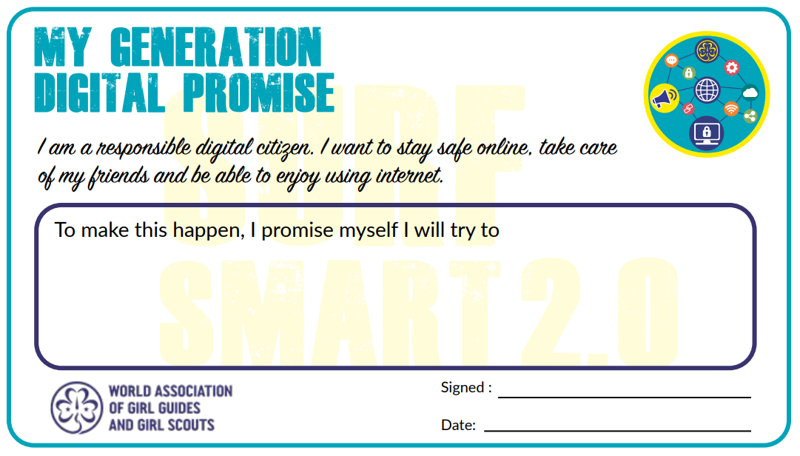

Slide 43
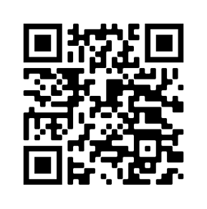
Post-Survey
<a href="https://www.freepik.com/vectors/illustrations">Illustrations vector created by stories - www.freepik.com</a>
Please do the survey online using the link or QR code
https://ee.kobotoolbox.org/x/1buRh7yx

Slide 44
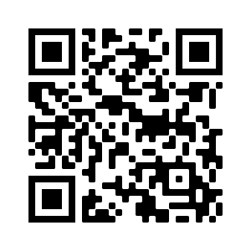
LINKS to resources
To learn more about WAGGGS:
https://www.wagggs.org/
Surf Smart programme:
https://www.wagggs.org/en/what-we-do/surf-smart-20/
Email us: surfsmart@wagggs.org

Slide 45
Thank-You!

